Slide 1
P2P Data Leakage (uTorrent Log File)
Malcolm Hayward
University of Baltimore
Forensic Science – Cyber Investigations

Slide 2
Previous Presentations
0. Lab Setup
1. Disk Image and Partitions
2. Registry and File Directory
3. MFT Timeline
4. USN Journal Timeline

Slide 3
Objectives
Learn how torrenting works
Identify the torrent application on the system
Extract and analyze torrent files
Locate and analyze uTorrent’s log file
Learn how to identify peer IP addresses and port numbers
All timestamps are in UTC format.

Slide 4
How Torrenting Works
For a user to torrent, he/she needs four things:
Torrent Client/Application (recap)
Torrent File (recap)
An original file to create the torrent from
Method of downloading/transferring the file (email, download link on a website, cloud, etc.)

Slide 5
How Torrenting Works
Currently, we know that the suspect has three of the four things:
Torrent Client - uTorrent
Torrent File – Sample-1.mp3.torrent, Contraband.mp3.torrent
An original file to create the torrent from – Sample-1.mp3, Contraband.mp3

Slide 6
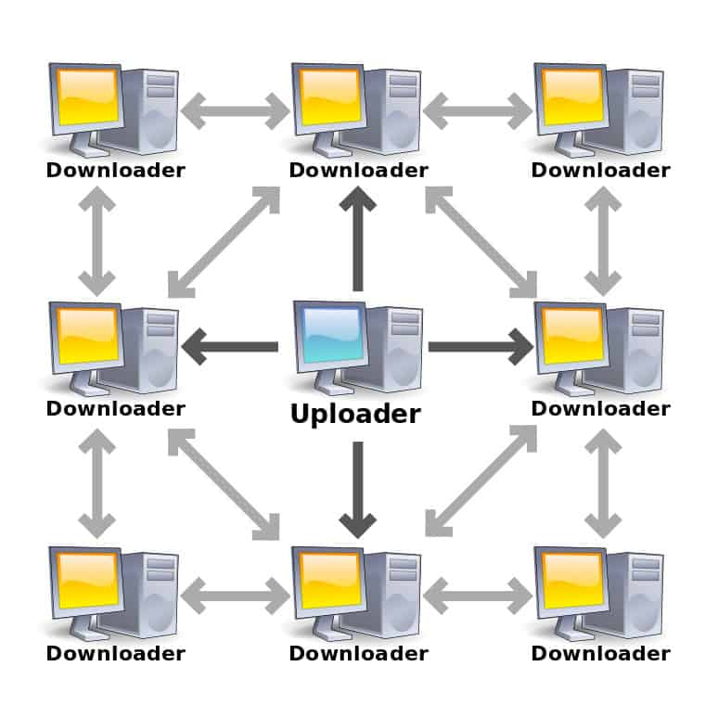
When a user is downloading a torrent (‘torrenting’): here is what happens:
A tracker server determines who wants to download and/or who is seeding the file that he/she wants to download. These are called ‘peers’.
Seeding occurs after someone has download a torrent. This is when the user makes the file available for other users to download.
A peer is a computer that is downloading or seeding a torrent file.

Slide 7
When a user is downloading a torrent (‘torrenting’): here is what happens:
The torrent client will begin to process the torrent. If the torrent file is called ‘example.mp3.torrent’, then the torrent client will download ‘example.mp3’.
To download the file, the torrent client will take pieces of ‘example.mp3’ from the data that the peers are downloading or seeding.
If Jane is seeding ‘example.mp3.torrent’, she is considered a peer. Her torrent client will give a piece of ‘example.mp3’ to John as he is trying to download it.
Depending on how big ‘example.mp3’ is, John may only need one piece of the file to fully download it. He could need several pieces if the file is larger.
Once the download is completed, the user will begin seeding the file.
John will then be seeding ‘example.mp3’. Now when John Jr. wants to download ‘example.mp3’, a tracker server will list him as a peer, and then John Jr. will get a piece of ‘example.mp3’ from John.

Slide 8
Consider looking at these videos if you need a better understanding of the process.
https://youtu.be/OFswNCU5CKA
https://youtu.be/xH00ikD1oDo
https://youtu.be/KYavEryz34Q

Slide 9
7. What torrenting application is on the pc?
Tool Used:
Regripper
Uninstall plugin
icat (optional)

Slide 10
Use Regripper to find out when uTorrent could have been installed.

Slide 11
Use grep to get relevant file paths for uTorrent.

Slide 12
Explanation
uTorrent is the torrent application on the system.
The uninstall key for uTorrent was created on 03/21/2021 at 20:39:08.
uTorrent.exe is on the system’s Desktop directory.
A uTorrent.exe also exists in Users/Kamryn/AppData/Roaming/uTorrent.

Slide 13
Alternate Ways of Answering the Question
You could use icat to extract each executable since you have their inodes. This can be done when you want to collect the files and/or programs that you are investigating.
You could manually look for these files by going through each directory. This is inefficient compared to searching for it with fls, but it is an option.

Slide 14
8. What torrent files are on the pc?
Tool Used:
None

Slide 15
Use grep to search for the torrent files.

Slide 16
Explanation
There are two torrent files:
Sample-1.mp3.torrent
Contraband.mp3.torrent
While there are two torrent files, there are four altogether:
Two reside in the Downloads/Torrents directory.
Two reside in Users/Kamryn/AppData/Roaming/uTorrent.
Timeline data from the MFT and USN Journal should show us timestamps related to these files. Alternatively, use istat to get timestamps for each torrent file.

Slide 17
Alternate Ways of Answering the Question
You could manually look for these files by going through each directory. This is inefficient compared to searching for it with fls, but it is an option.
Regripper’s recentdocs plugin was used back on question #5. It could be used again since both torrent files were in the output; however, you would not have specific information about where these files were on the system.

Slide 18
9. For the torrent files on the pc:
a. What was the original file?
b. What trackers are on the torrent file?
c. What torrent application created it?
d. When was the torrent file created?
Tool Used:
Torrent File Editor

Slide 19
Use icat to extract the torrent files.

Slide 20
Verify that you have genuine copies.
Note: You are encouraged to also verify the SHA1 hash.

Slide 21
Verify that the extracted files are the same as the ones in Users/Kamryn/AppData/Roaming/uTorrent
Note: You are encouraged to also verify the SHA1 hash.

Slide 22
Explanation
We extracted the torrent files using icat.
The torrent files we have in our new Torrents folder are the same files that are on the system.
We verified this by comparing the md5 hashes. (Similarly, you can use other hash algorithms to verify that these files are the same and is recommended.)
It appears that the torrent application may have duplicated the torrent files, because the torrent files appear in two separate locations.
download or upload?

Slide 23
As a reminder:
To analyze the torrent files, we will use Torrent File Editor.
Torrent File Editor will be launched using an alias we configured in the lab setup.
If you have not seen this, please review these slides on creating aliases.
If you have not configured any aliases and/or choose not to do it, you will have to launch wine and type the file path to the Torrent File Editor application.
Ex. wine /folder/folder/torrent-file-editor

Slide 24
Use Torrent File Editor to analyze the torrent files.

Slide 25
A GUI will open. You should see:
For Sample-1.mp3.torrent:
Source File: Sample-1.mp3
App That Created It: uTorrent 3.5.5
Created on: 03/21/2021 at 4:42:39 PM (EDT)
Trackers: *too many to list*

Slide 26
Use Torrent File Editor to analyze the torrent files.

Slide 27
A GUI will open. You should see:
For Contraband.mp3.torrent:
Source File: Contraband.mp3
App That Created It: qBittorrent v4.3.3
Created On: 03/27/2021 at 10:05:03 AM (EDT)
Trackers: *too many to list*

Slide 28
Explanation
Using torrent-file-editor-0.3.17-x64.exe (called by the torrent-file-editor alias), we discovered how and when these torrent files were created.
The version of uTorrent that created Sample-1.mp3.torrent matches the version the uTorrent on the system is: uTorrent 3.5.5
Contraband.mp3.torrent may not have been made on this system. The user in this case had uTorrent, not qBittorrent, which is another torrent application. It is possible that this file was downloaded from somewhere else and/or sent to the user via messaging, emails, or a similar service.

Slide 29
10. Does the torrent application have a log file? If so, where is it located?
Tool Used:
None
The name of the log file does not make it obvious that it is a log file. A Google (and/or another search engine) search will tell us that the log file is titled ‘resume.dat’.
Read this article on where the log file and other important files are located: https://www.forensicfocus.com/articles/forensic-analysis-of-the-%CE%BCtorrent-peer-to-peer-client-in-windows/

Slide 30
Use grep to find the log file.

Slide 31
Explanation
uTorrent’s log file is resume.dat. This information can be obtained on the Internet.
You will also see old versions of the file (resume.dat.old). You may also see this if you try to recover the deleted files on the system using foremost or a similar tool.
For the lab demonstration, we will not cover those, but you may want to consider those as well in your investigation.

Slide 32
Alternate Ways of Answering the Question
You could manually find this file by looking through the volume, but it is inefficient compared to what fls and tree will do for you.

Slide 33
11. Analyze the torrent application’s log file:
a. What are the IP addresses and port numbers for each peer?
b. What torrents were added to the app?
Tool Used:
Icat
Python
Regripper
ips plugin
Torrent File Editor
Rapidtables or other Online Conversion Calculator (alternatively)
IDE or Code Editor (optional)

Slide 34
As a reminder, please read through this article by former HSI special agent Michael Godfrey:
https://www.forensicfocus.com/articles/forensic-analysis-of-the-%CE%BCtorrent-peer-to-peer-client-in-windows/
The methodology in this article will be used in this demonstration.
The following slides will demonstrate how to obtain the IP address and port number for each peer.

Slide 35
Use icat to extract the log file.

Slide 36
Verify that you have a genuine copy.

Slide 37
Use Torrent File Editor to analyze the log file.

Slide 38
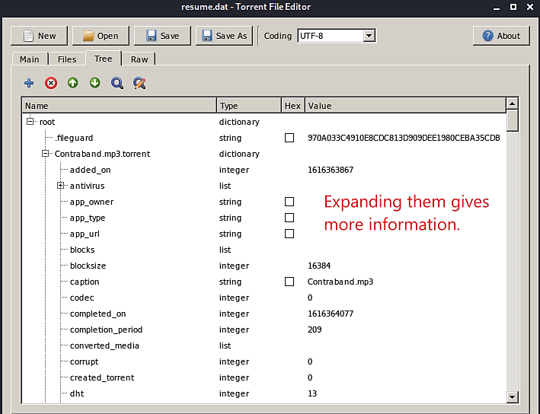
Find out which torrents were added to uTorrent.

Slide 39
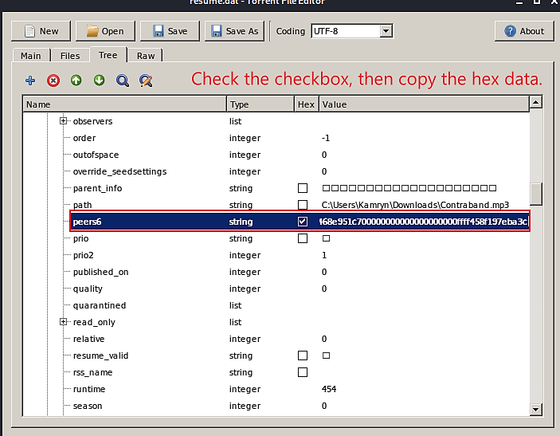
Locate the peer information for both torrents.

Slide 40
Create a new text file to place the hex data in.

Slide 41
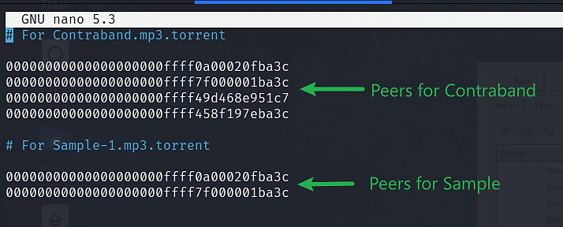
Paste the hex data in the new text file.
Tip: If you want to place your cursor anywhere in Nano via a mouse click, you can enable the option in /etc/nanorc.

Slide 42
Consider only the last 12 characters for each line.

Slide 43
How to obtain the IP addresses and port numbers.
For each line:
For the first 8 characters, split into four groups of two characters.
For example: 0a00020f → 0a 00 02 0f (IP in hex)
For the last 4 characters, the third and fourth character should come before the first and second.
For example: ba3c → 3cba (Port in Hex)
In computing, this is called little endian.

Slide 44
You should have a text file with these entries.

Slide 45
Launch Python

Slide 46
Write Python script to convert from hex to decimal number.
Hex to decimal conversion is possible using Python.
To do so, we will use a ‘For Loop’.
First, we will put our entries into a list.
peer1 = [“0a”, “00”, “02”, “0f”, “3cba”]
Each entry in quotation marks is an item.
Second, we will use a ‘For Loop’ that will convert hex numbers to decimal until the end of the list is reached.
for x in peer1:
result = int(x, 16)
print(result)
Altogether, this is how the code will be read:
For each item in peer1, convert to decimal.
Let’s try it out!

Slide 47
Write Python script to convert from hex to decimal number.
Tip: The lines with ‘result’ and ‘print’ are tab spaced.
Tip: If you are not comfortable with Python, use an online conversion calculator such as RapidTables.

Slide 48
(Alternatively) Use Rapidtables or other online conversion calculator instead.
Rapidtables Hex to Decimal Calculator

Slide 49
These are the IP addresses and port numbers for each peer:

Slide 50
These are the IP addresses and port numbers for each peer:

Slide 51
Use Regripper to find the IP address of Kamryn’s system.

Slide 52
(Optional) Look up IP addresses
You can geolocate the location of IP address online.
Some websites that allow you to do this:
https://www.geolocation.com/
https://www.iplocation.net/
Type in the IP address you want to lookup.

Slide 53
Lookup 73.212.104.233 on https://www.iplocation.net/
This IP address is in the US in Maryland.
The city may not be an approximate location, but it may tell us what service provider is servicing this area.
This information is useful for subpoenas where investigators want the identity of the user(s) who are assigned this IP address.

Slide 54
Explanation
Using Regripper, we were able to determinate that Kamryn’s IP address is 10.0.2.15. uTorrent’s log file recorded this IP address and showed that Kamryn used port 15,546.
The 127.0.0.1 is a loopback address.
The 69.143.25.126 address may belong to Kamryn as well.
The 73.212.104.233 address belongs to a user who also has the Contraband.mp3 file. This is because this user was a peer for the said .mp3 file.
A peer was not recorded for Sample.mp3. It is possible that no one else had the file during the time Kamryn seeded it.

Slide 55
What does this mean for the investigation?
Sample-1.mp3.torrent may have been seeded by Kamryn alone.
No peers were recorded for this torrent file. Therefore, with no one else being a peer, Kamryn had to be the only one who possessed the file.
This also means that Kamryn was the creator of this torrent file.
Contraband.mp3.torrent was downloaded from somewhere else.
The torrent client that made it was qBittorrent. Kamryn is using uTorrent, a different client. Since we have ruled out Kamryn having qBittorrent, she could not have created this torrent file on this system.
More than one person has the copyrighted Contraband.mp3.
We have verified that the user with the external IP address 73.212.104.233 was a peer who was either downloading the file also or had the file already.

Slide 56
Alternate Ways of Answering the Question
If you are uncomfortable with Python, use an online conversion calculator like Rapidtables.
Python can also be used in an IDE or text editor. Some recommended programs to write Python: Thonny, Geany, Notepadqq, Visual Studio Code/VSCodium.

Slide 57
Next Presentation
File Signature

