Slide 1
Memory Forensics
A Practical Approach to Investigate Data Leakage with Volatility 2

Slide 2
Pre-investigation

Slide 3
How to install Volatility 2?
Create a lab folder
Install Volatility
Verity installation

Slide 4
Where to download the memory image for investigations?
Download memory dump
Verify downloaded file
Notes:
https://www.dropbox.com/s/x41f2lyhlrixts6/memdumpWin7.mem

Slide 5
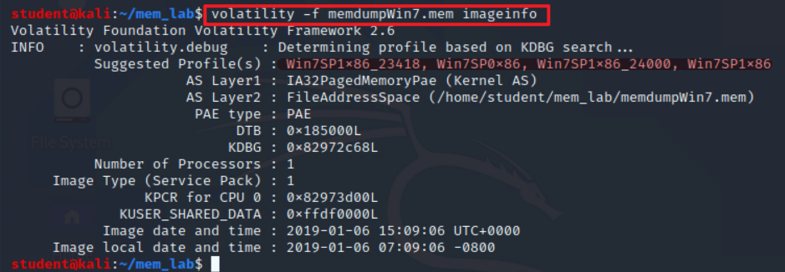
How to identify the image profile?
Notes:
volatility -f memdumpWin7.mem imageinfo

Slide 6
Investigation
Understand the Suspect and Accounts
Understand the Suspect’s PC
Network Forensics
Investigate Command History
Investigate Suspect’s USB
Investigate Internet Explorer History
Investigate File Explorer History
Timeline Analysis

Slide 7
Understand the Suspect and Accounts

Slide 8
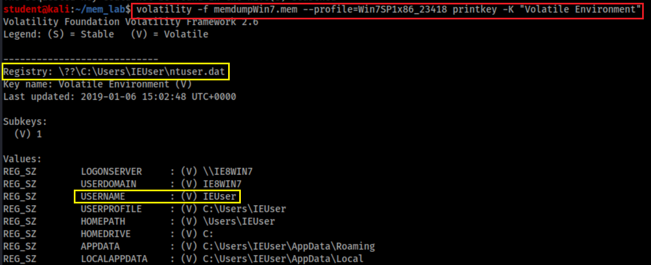
Who was using the device?
Physical file location = {subkeys of active user profile}
=HKEY_USERS \<SID> (linked to by HKEY_CURRENT_USER)
SID: Security Identifier: a unique, immutable identifier of a user, user group, or other security principal.
Users can change names but not SID

Slide 9
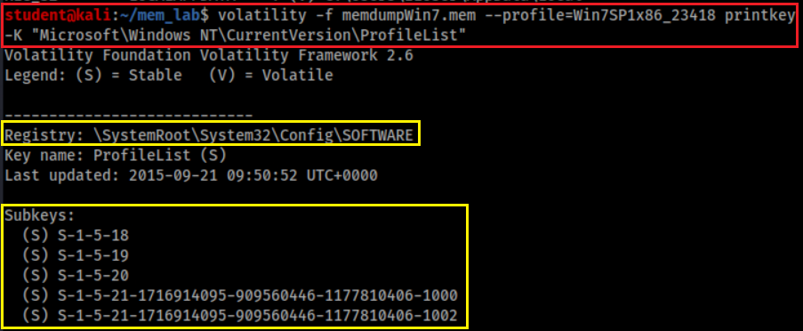
Who are associated with the device?
Sam – HKEY_LOCAL_MACHINE\SAM
Security – HKEY_LOCAL_MACHINE\SECURITY
Software – HKEY_LOCAL_MACHINE\SOFTWARE
System – HKEY_LOCAL_MACHINE\SYSTEM
Default – HKEY_USERS\.DEFAULT
Notes:
volatility -f memdumpWin7.mem --profile=Win7SP1x86_23418 printkey -K "Microsoft\Windows NT\CurrentVersion\ProfileList"

Slide 10
SID format details
S-1-5
S: SID
1: Version 1
5: Managed by the NT security subsystem
SID | Name | Description
S-1-5-18 | Local System | A service account that is used by the operating system.
S-1-5-19 | NT Authority | Local Service
S-1-5-20 | NT Authority | Network Service
S-1-5-21 | Administrator/Guest | A user account for the system administrator.

Slide 11
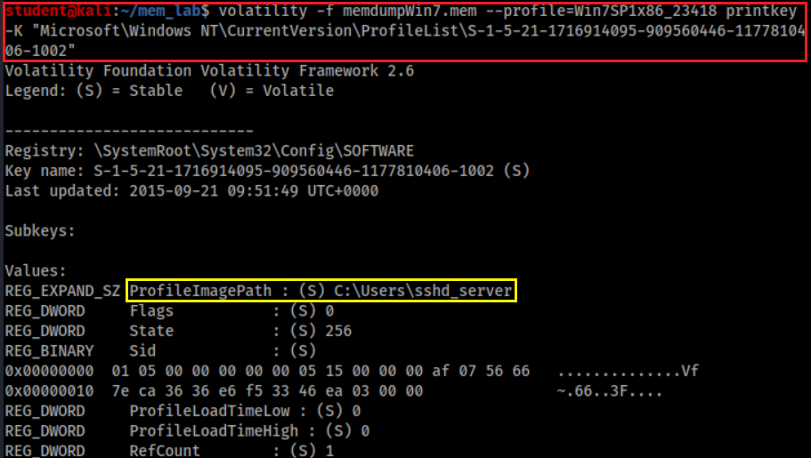
Who has SID= S-1-5-21-1716914095-909560446-1177810406-1002?
SSHD_Server is an account made by an SSH server.., It allows remotely log in to the computer.
Notes:
volatility -f memdumpWin7.mem --profile=Win7SP1x86_23418 printkey -K "Microsoft\Windows NT\CurrentVersion\ProfileList\S-1-5-21-1716914095-909560446-1177810406-1002"

Slide 12
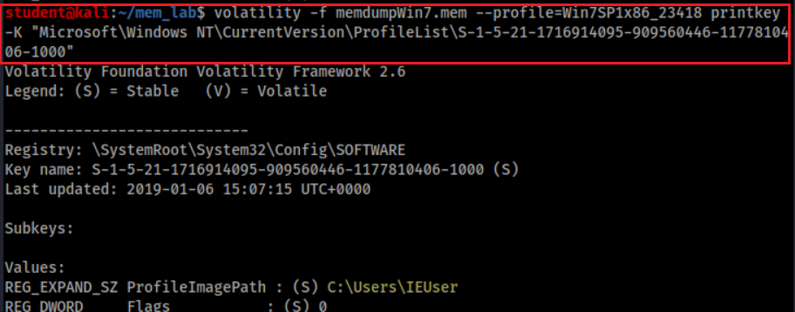
Who has SID= S-1-5-21-1716914095-909560446-1177810406-1000?
Notes:
volatility -f memdumpWin7.mem --profile=Win7SP1x86_23418 printkey -K "Microsoft\Windows NT\CurrentVersion\ProfileList\S-1-5-21-1716914095-909560446-1177810406-1000"

Slide 13
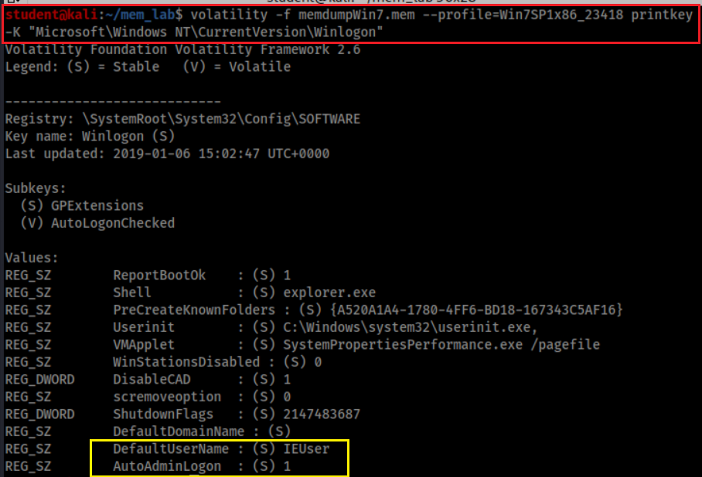
Who is the default logon user?
Default automatically log on

Slide 14
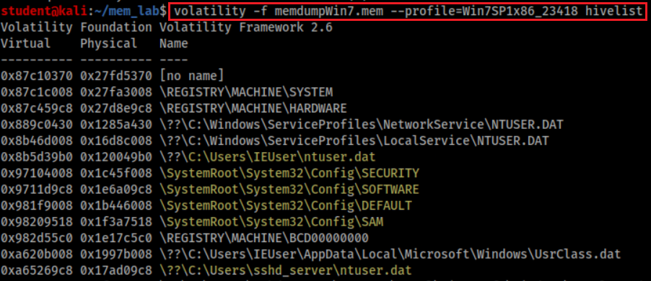
Hive overview
represents pointers to other hives, and is normal
Keys under HKLM\SYSTEM\CurrentControlSet\Control\hivelist
Point to HKEY_LOCAL_MACHINE\SYSTEM
Point to HKEY_LOCAL_MACHINE\HARDWARE
Each user has a profile (ntuser.dat)

Slide 15
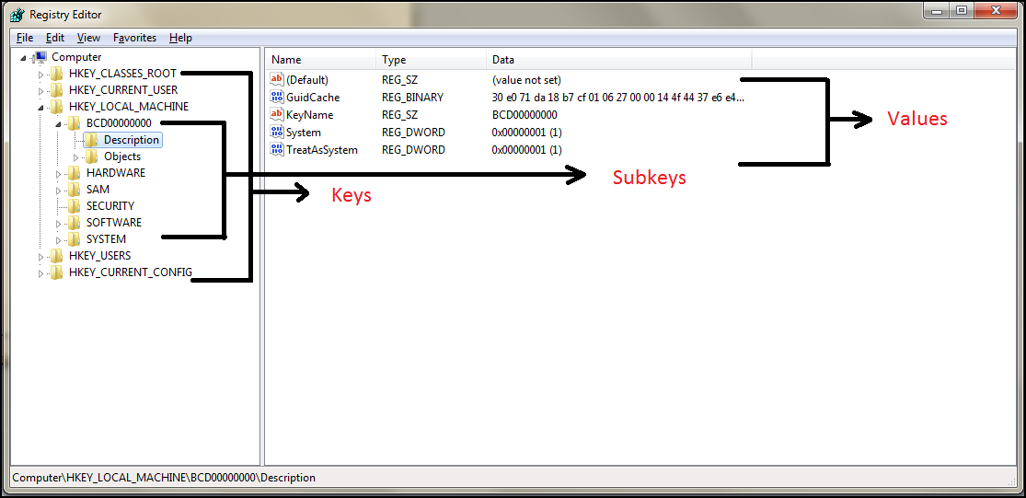
It is the time to review Registry
The five main root keys of registry are:
HKEY_CLASSES_ROOT (HKCR)
HKEY_CURRENT_USER (HKCU)
HKEY_LOCAL_MACHINE (HKLM)
HKEY_USERS (HKU)
HKEY_CURRENT_CONFIG (HKCC)

Slide 16
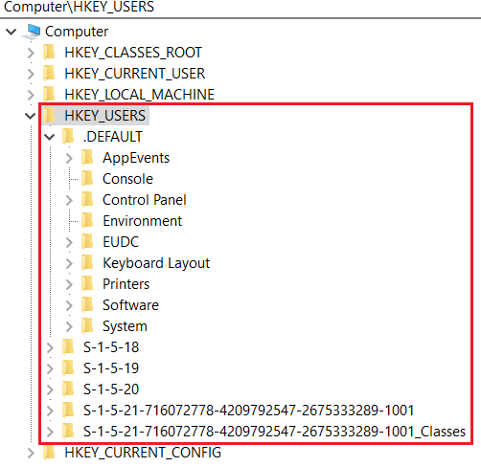
HKEY_USERS (HKU)
Contains information about all the users who logged in to the computer at some point
When log on, the current logged in user profile is linked by HKCU
Saved in each user's profile folder
C:\Users\IEUser\Ntuser.dat
C:\Users\ssh_Server\Ntuser.dat
C:\Users\Default User\Ntuser.dat
contains the base settings for new users when they first logon,

Slide 17
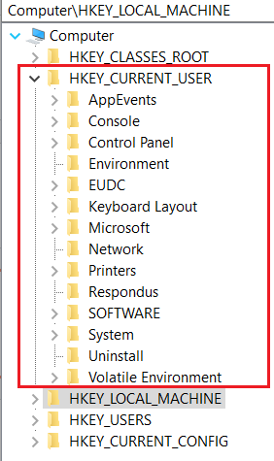
HKEY_CURRENT_USER (HKCU)
Does not contain any data
A link to the subkey of HKEY_USERS
Stores settings for currently logged-in use
Unloaded when the user logs out
If no profile is available, built from default user
Control everything of the current logged user
Environment variables
Desktop settings,
Network connections, printers,
Application preferences.
Keyboard layout
Current logged user information
Treasure for investigators

Slide 18
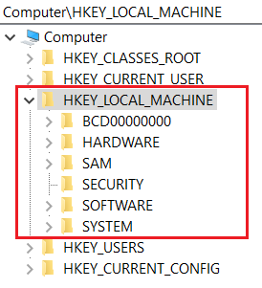
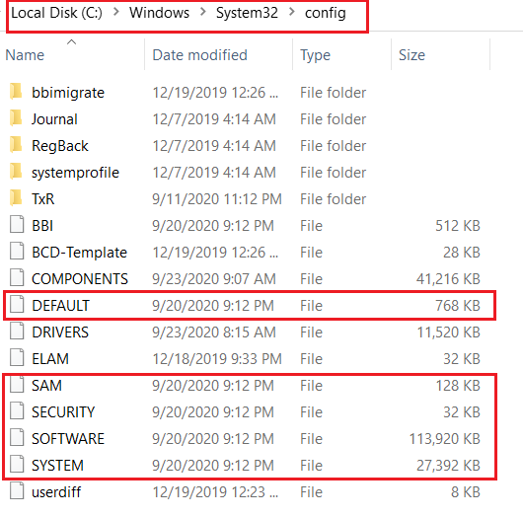
HKEY_LOCAL_MACHINE (HKLM)
Contains computer hardware and software information
Loaded at boot time from
Store Plug-and-Play devices Infor
Created dynamically, not stored in a file
Loaded at boot time from

Slide 19
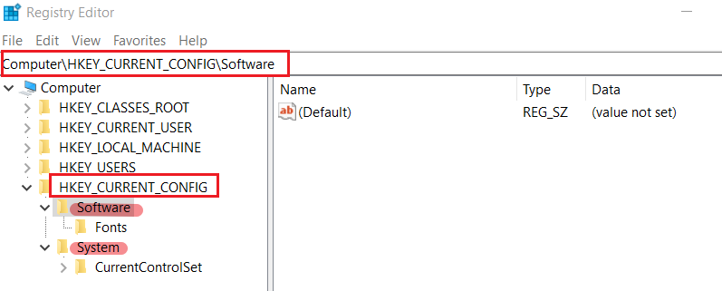
HKEY_CURRENT_CONFIG (HKCC)
It doesn't store any information itself but instead acts as a pointer, or a shortcut, to a registry key
Noting shown here, but points to other registry

Slide 20
Understand the Suspect’s PC

Slide 21
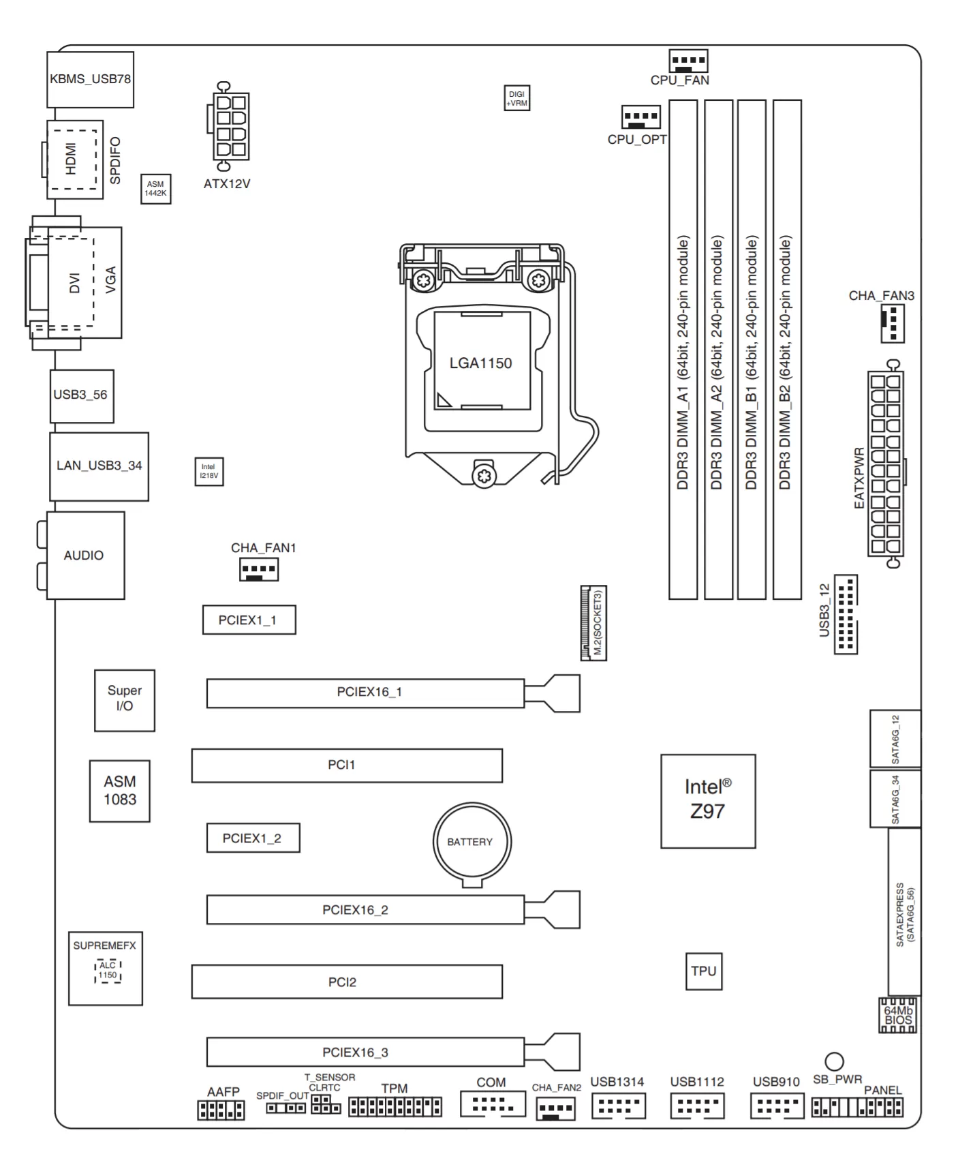
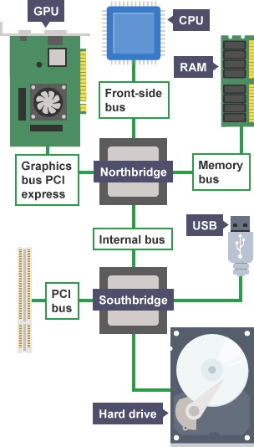
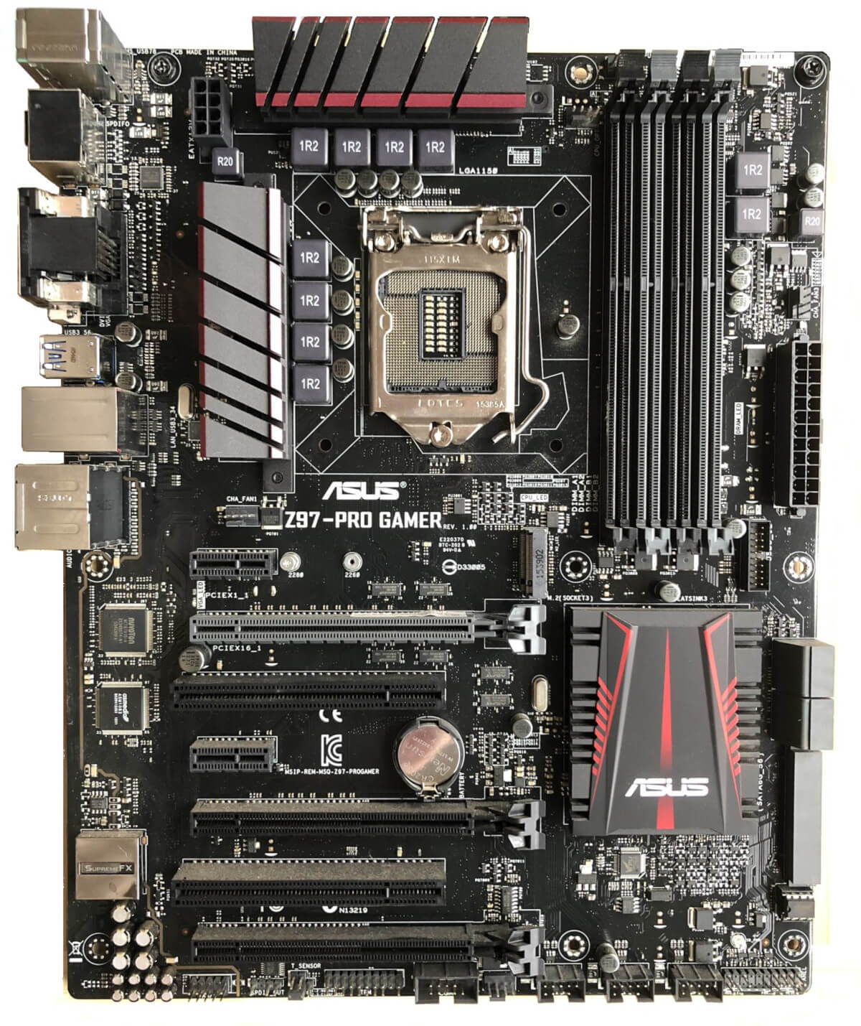
Motherboard layout
Peripheral Component Interconnect
Notes:
https://www.techspot.com/article/1965-anatomy-motherboard/
PCI is a parallel connection, and devices connected to the PCI bus appear to be a bus master to connect directly to its own bus. While PCIe card is a high-speed serial connection. Instead of one bus that handles data from multiple sources, PCIe has a switch that controls several point-to-point serial connections.

Slide 22
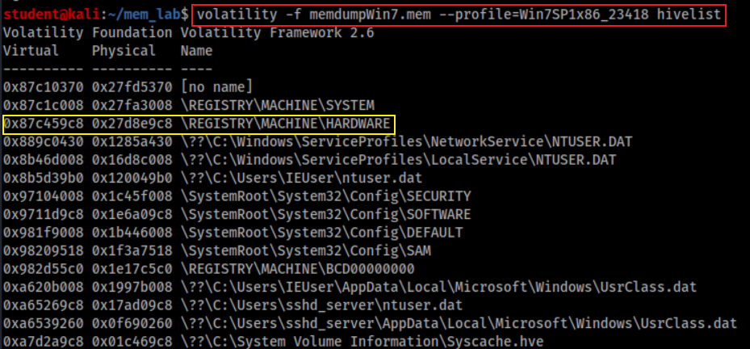
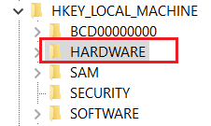
Where to find CPU of the Suspect’s PC?
Find hardware keys
Point to

Slide 23
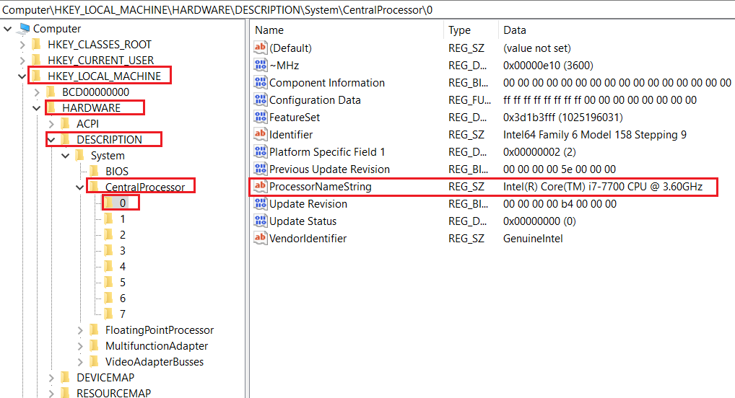
Find key = “DESCRIPTION\CentralProcessor\0”
If your system has multiple processors, they are all listed as subkeys under this key. If your system has only one processor, it is listed as processor 0.

Slide 24
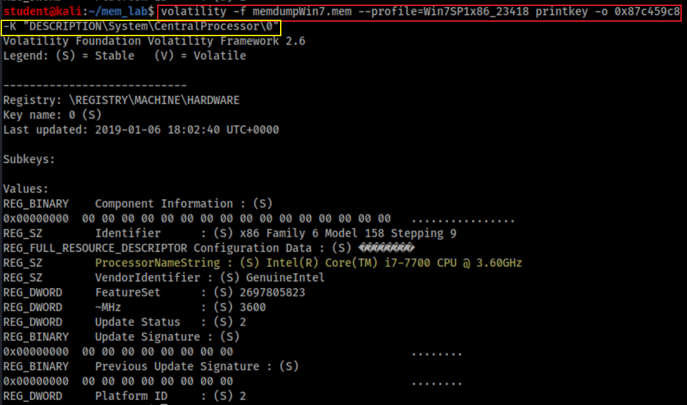
How to find CPU of the Suspect’s PC?
Print key starts from offset 0x87c459c8. Offset can be skipped

Slide 25
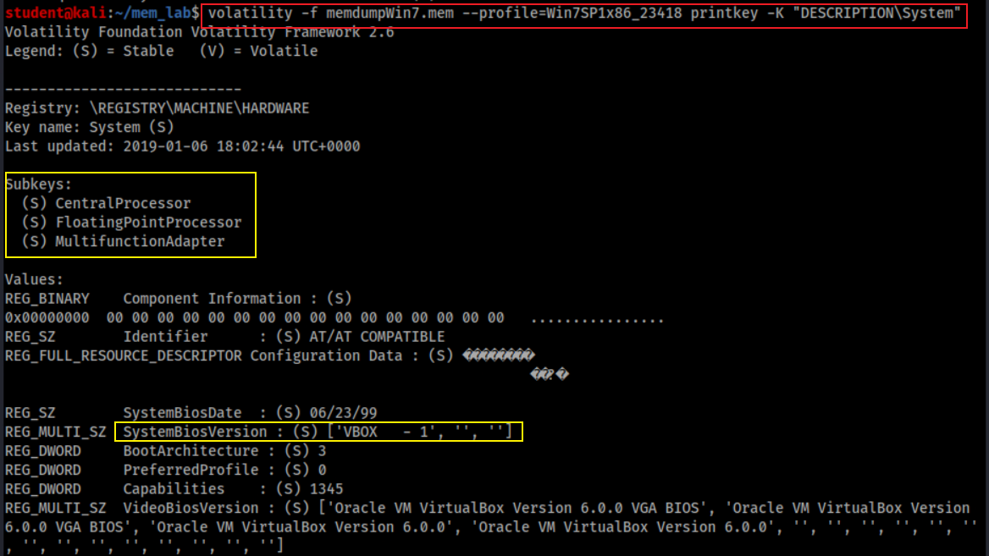
How to find other PC system information?
Show system board, system BIOS, and video BIOS, plus subkeys for the processors and bus controllers

Slide 26
How PC enumerates devices on its bus?
A bus driver services a bridge, bus controller, or adapter
A bus driver enumerates the devices on its bus
device's enumerator
Respond to Plug and Play I/O request packets (IRPs)

Slide 27
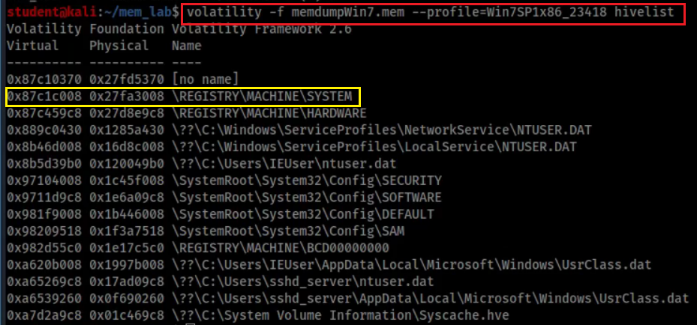
Where the enumerated devices Infor saved?

Slide 28
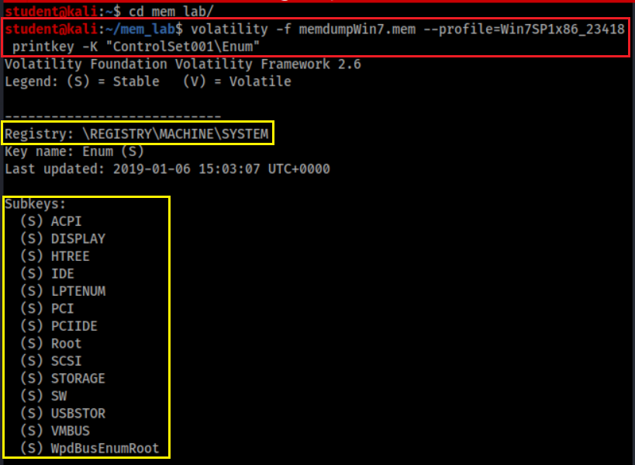
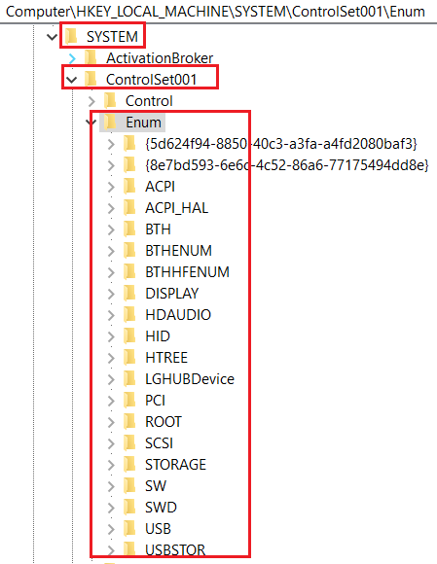
How to enumerated devices?
Enumerate devices

Slide 29
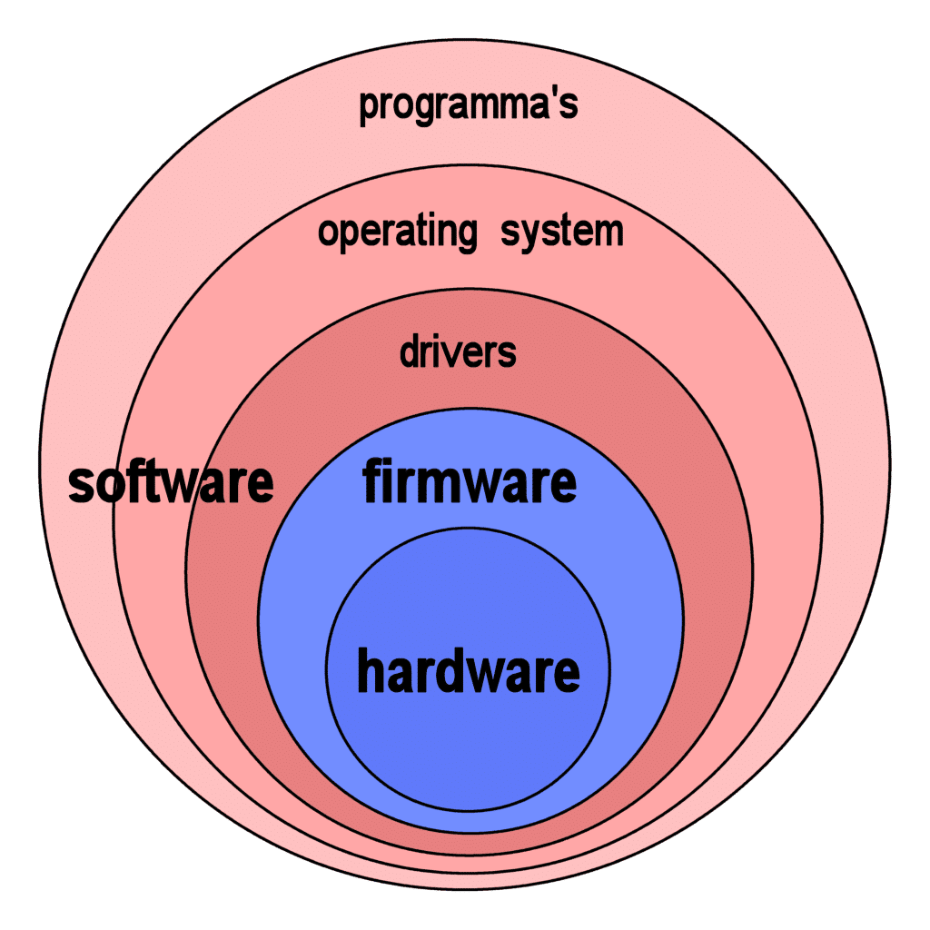
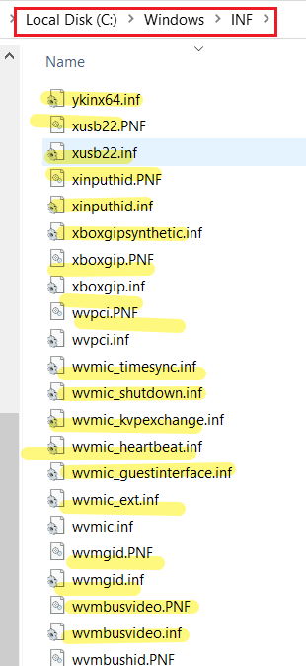
How Windows install device drivers?
Almost all electronic devices contain firmware
When plug-in, device's enumerator (e.g., PnP Bus Drivers)
Reports Device Identification Strings from device firmware
Hardware IDs - vendor-defined
Compatible IDs - vendor-defined
Windows uses Hardware IDs to
locate the information (INF) file that best matches the device
if not, uses compatible IDs
Windows uses INF file to install device drivers

Slide 30
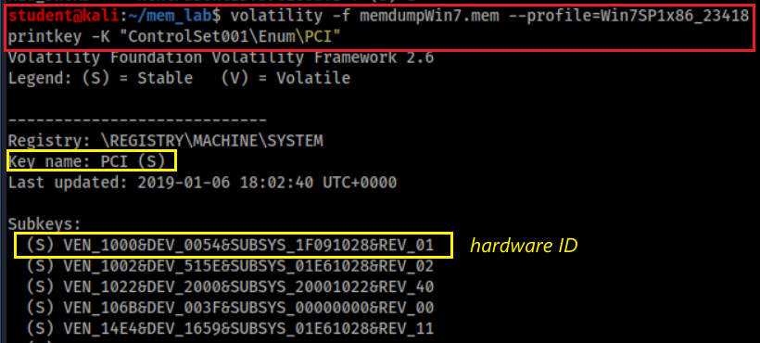
How to find devices connected to PCI?
VEN_XXXX: vendor
DEV_XXXX: model of device
Common VEN_XXXX codes:
Intel – 8086
ATI/AMD – 1002/1022
NVIDIA – 10DE
Broadcom – 14E4
Atheros – 168C
Realtek – 10EC
Creative – 1102
Logitech – 046D

Slide 31
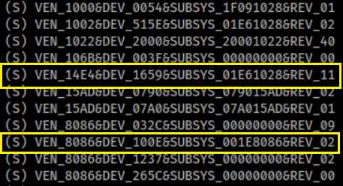
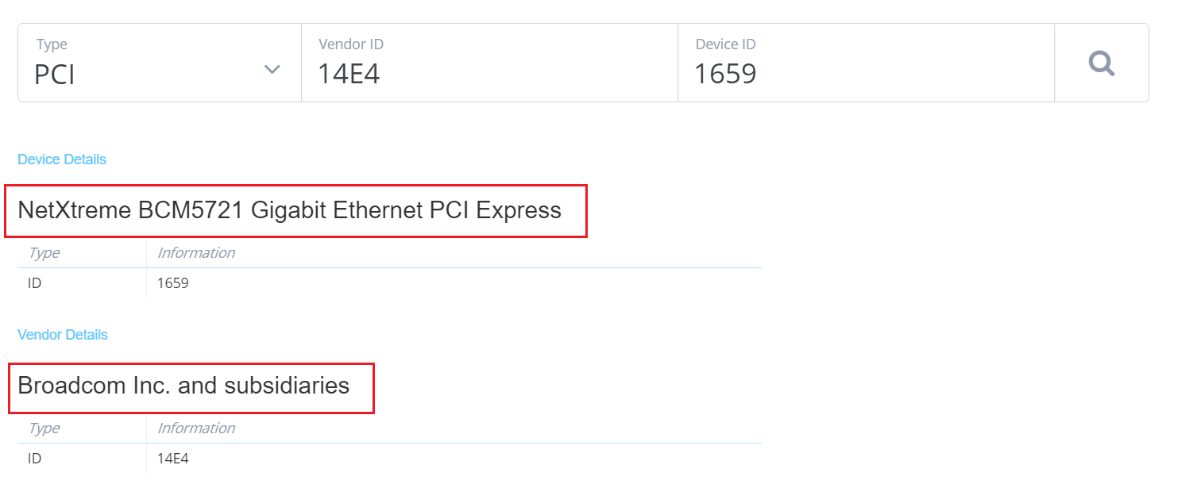
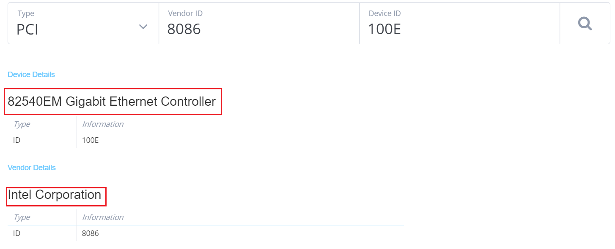
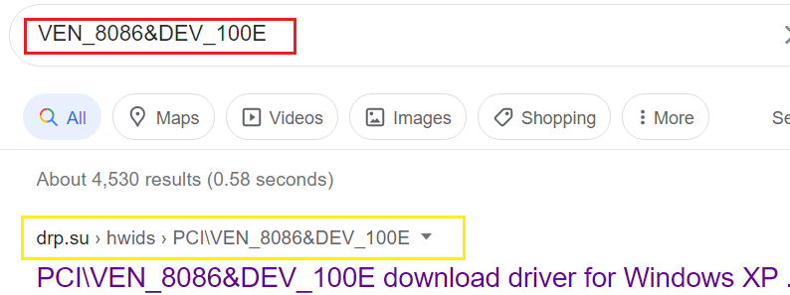
Search device: https://devicehunt.com/
Search driver based on hardware ID

Slide 32
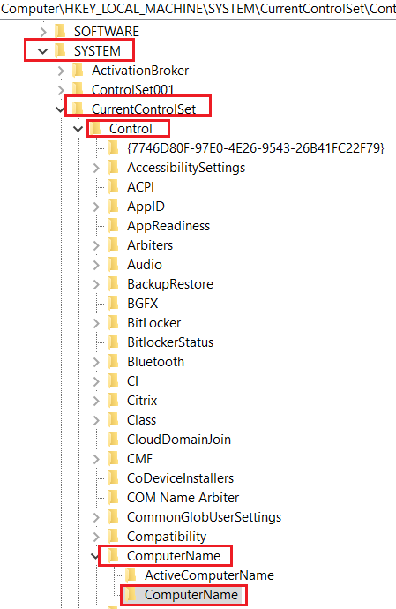
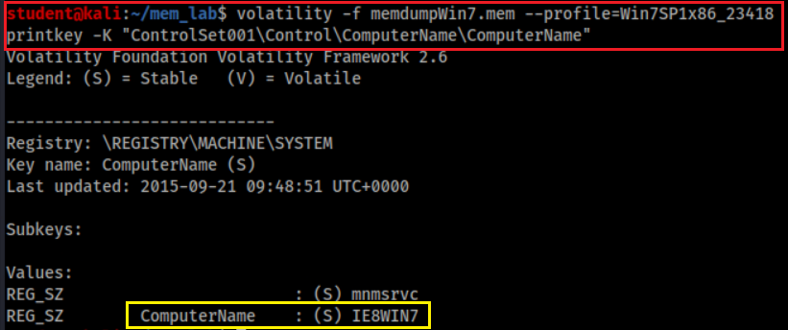
What is the name of suspect’s device?
Note: On a live registry, you will see “CurrentControlSet” instead of “ControlSet001”. Because it is not a live, we need to check ControlSet001
link to
Notes:
volatility -f memdumpWin7.mem --profile=Win7SP1x86_23418 printkey -K "ControlSet001\Control\ComputerName"

Slide 33
Network Forensics

Slide 34
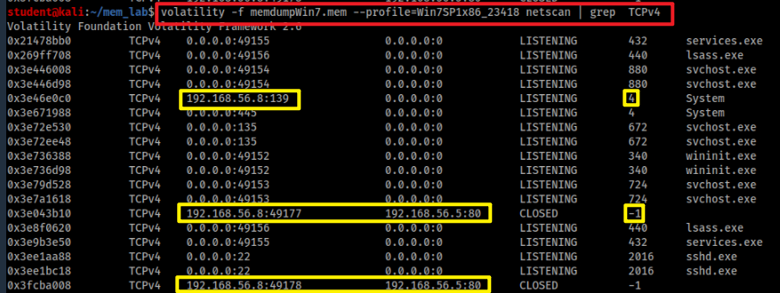
Are there suspicious IPs (processes) connect to the PC?
Scan network objects
grep: only show TCP

Slide 35
Which program that was connected to this suspicious IP address?
Find out process name of 4
Help command
Note: Module Output Options: dot, greptext, html, json, sqlite, text, xlsx

Slide 36
Which program that was connected to this suspicious IP address?
Find out process name of -1 (unidentified process) using the suspicious IP
-Y “192.168.56.5”: Define YARA pattern at IP
--output-file=any file name
YARA is a tool aimed at (but not limited to) helping malware researchers to identify and classify malware samples.

Slide 37
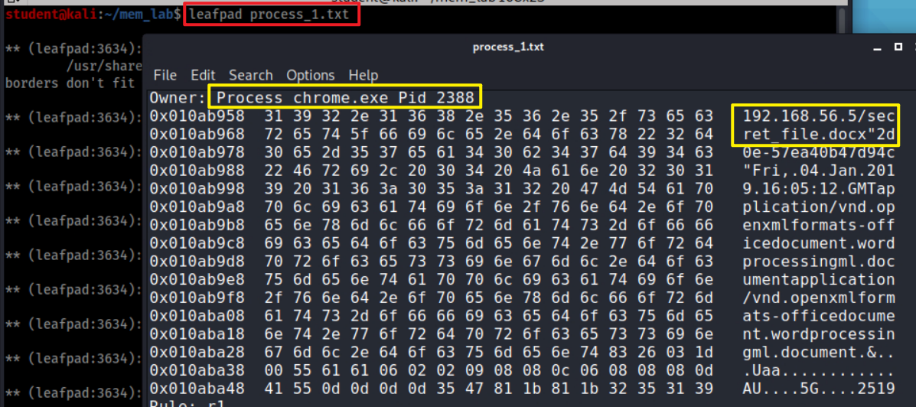
Find the application chrome.exe which PID=2388
The suspect used chrome to download file

Slide 38
Investigate Command History
cmdscan and consoles

Slide 39
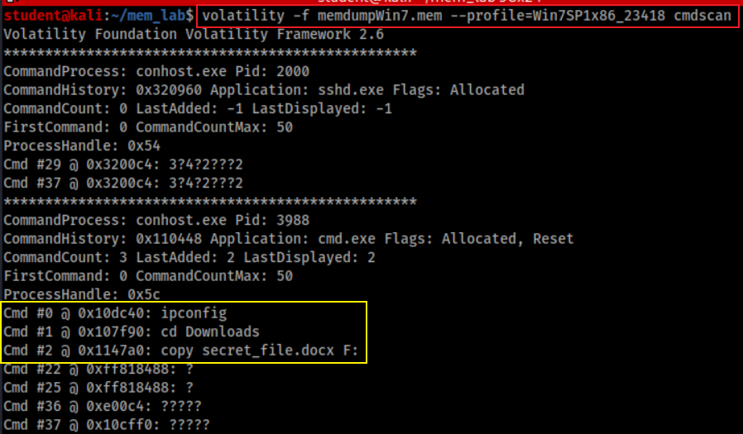
Did the suspect use commands to copy files?
Is F drive a USB?

Slide 40
When these commands are executed?
Need to find timestamps because the PID of Command Prompt
Command PID

Slide 41
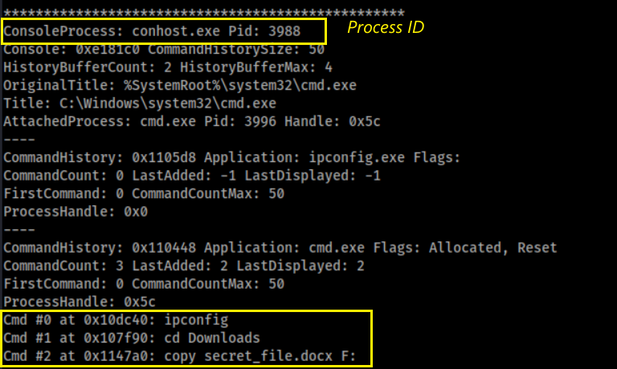
An alternate method to search command history
Process and PID found

Slide 42
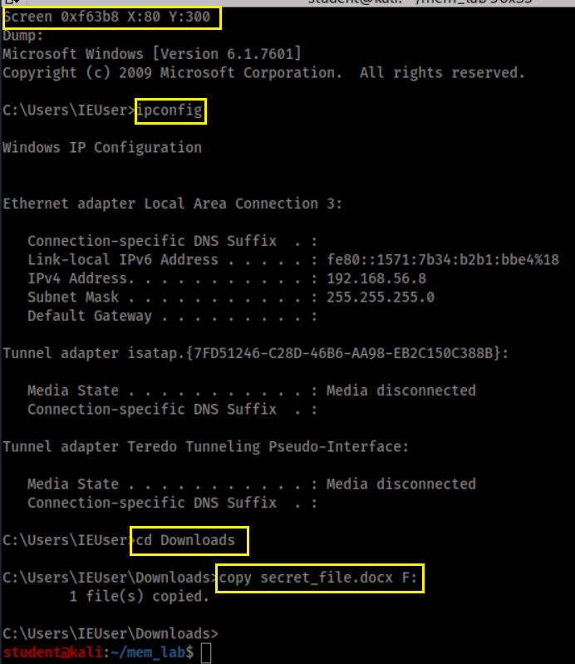
Screen captured

Slide 43
Investigate Suspect’s USB

Slide 44
How a PC recognizes a USB?
USB Mass Storage device Class (MSC) communication protocols
When a USB is plugged in, the Plug and Play (PnP) Manager finds device ID (Hardware IDs or Compatible IDs)
Receives the event => enumerates devices from firmware=> device ID
OS locates the appropriate driver for the device
Queries the device descriptor (.inf) uses Hardware IDs or Compatible IDs
OS loads that driver use .inf
Once the device has been identified
Multiple registry keys will be generated

Slide 45
Generated registry keys can be used as evidence chain
Show a USB was attached to a PC
A USB has an unique Instance ID of each device
The USB has been assigned a drive letter (D, E, F..) of the PC
The drive letter is associated with a suspect’s account
Timestamps need to be verified
Check setupapi.log (if available)

Slide 46
Show a USB was attached to a PC
USB Device interface key is add under
HKEY_LOCAL_MACHINE\SYSTEM\ControlSet001\Control\DeviceClasses
USB Device interface key have a link to
USBSTOR\Disk&Ven_General&Prod_UDisk&Rev_5.00

Slide 47
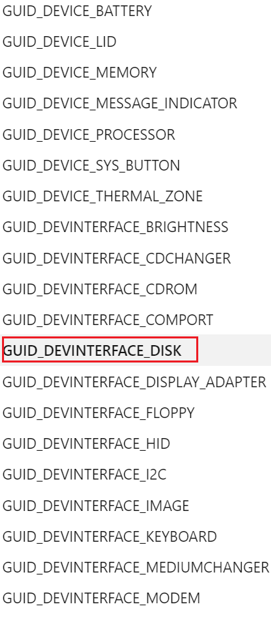
What is a Device interface GUID?
Each device has an interface with a Globally Unique Identifier (GUID)
To communicate with PC
Organized under DeviceClasses
A device interface subkey is created when a plug and play device driver is successfully loaded.
Disk interface subkey: GUID_DEVINTERFACE_DISK, or DiskClassGUID
Value=53F56307-B6BF-11D0-94F2-00A0C91EFB8B
The subkey will be removed if the device is removed
a hard disk storage (e.g., USB) device interface
Notes:
https://docs.microsoft.com/en-us/windows-hardware/drivers/install/guid-devinterface-disk
https://www.sciencedirect.com/topics/computer-science/removable-storage-device
https://docs.microsoft.com/en-us/previous-versions//ff553412(v=vs.85)?redirectedfrom=MSDN
53F56307-B6BF-11D0-94F2-00A0C91EFB8B

Slide 48
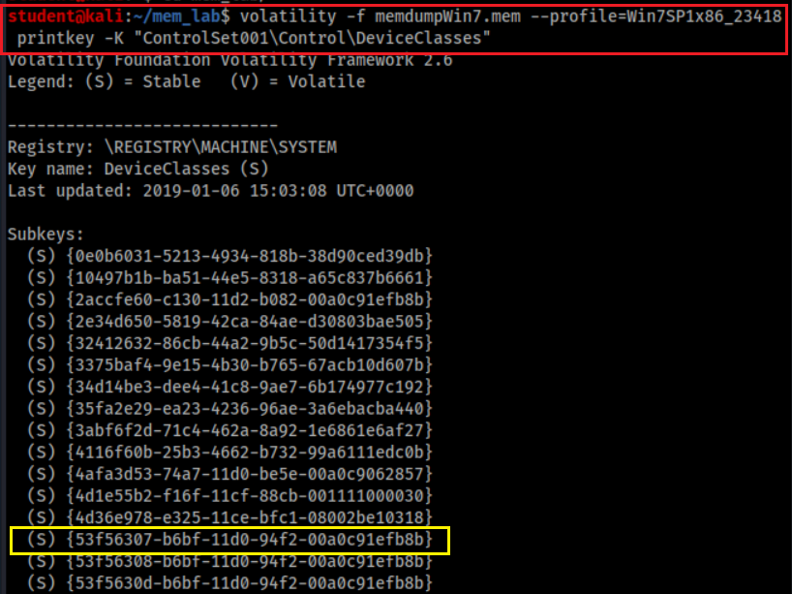
List all device interfaces
Disk interfaces
Notes:
{53f56307-b6bf-11d0-94f2-00a0c91efb8b}

Slide 49
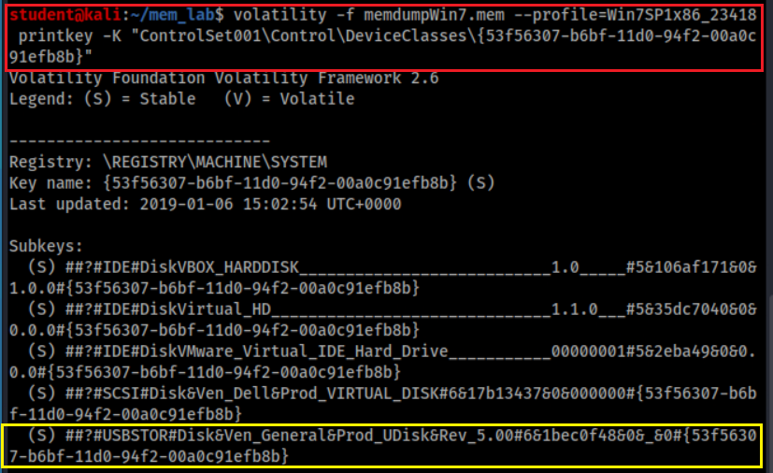
List Disk Interfaces
#USBSTOR
#Disk
&Ven_[VendorName]
&Prod_[ProductName]
&Rev_[RevisionID]
#[UID/SerialNo.]
#{DeviceInterfaceClassID}.
Notes:
volatility -f memdumpWin7.mem --profile=Win7SP1x86_23418 printkey -K "ControlSet001\Control\DeviceClasses\{53f56307-b6bf-11d0-94f2-00a0c91efb8b}"

Slide 50
Other Useful disk interfaces (1)
Tableau connected via Firewire: ##?#SBP2#Tableau&Forensic_SATA_Bridge&LUN0&REV15#000ecc01000f4063#{53f56307-b6bf-11d0-94f2-00a0c91efb8b}
eSATA attached SSD: ##?#IDE#DiskPatriot_Torqx_2_32GB_SSD________________S5FAM014#4&35e86db3&0&0.2.0#{53f56307-b6bf-11d0-94f2-00a0c91efb8b}
F-Response iSCSI disk: ##?#SCSI#Disk&Ven_FRES&Prod_FRES#1&1c121344&0&000000#{53f56307-b6bf-11d0-94f2-00a0c91efb8b}
External non generic USB Disk: \##?#USBSTOR#Disk&Ven_FUJITSU&Prod_MHT2060AH&Rev_#43527242060A&0#{53f56307-b6bf-11d0-94f2-00a0c91efb8b}
External generic USB Disk: ##?#USBSTOR#Disk&Ven_&Prod_&Rev_PMAP#07032AE8AFBE2481&0#{53f56307-b6bf-11d0-94f2-00a0c91efb8b}
Notes:
https://www.hecfblog.com/2013/08/daily-blog-67-understanding-artifacts.html

Slide 51
Other Useful disk interfaces (2)
USB attached android phone: ##?#USBSTOR#Disk&Ven_Android&Prod___UMS_Composite&Rev___00#8&d3cc3f0&0&304D1905736FB98E&0#{53f56307-b6bf-11d0-94f2-00a0c91efb8b}
Volume GUIDs: SYSTEM\\Control\DeviceClasses\{53F5630D-B6BF-11D0-94F2-00A0C91EFB8B}
MagicISO mounted image: ##?#SCSI#CdRom&Ven_MagicISO&Prod_Virtual_DVD-ROM&Rev_1.0A#1&2afd7d61&0&0000#{53f5630d-b6bf-11d0-94f2-00a0c91efb8b}
Volume of the generic USB storage device: ##?#STORAGE#VOLUME#_??_USBSTOR#DISK&VEN_&PROD_&REV_PMAP#07032AE8AFBE2481&0#{53F56307-B6BF-11D0-94F2-00A0C91EFB8B}#{53f5630d-b6bf-11d0-94f2-00a0c91efb8b}

Slide 52
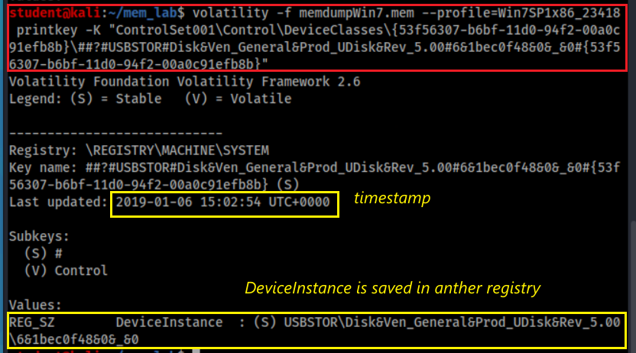
Access DeviceClass\Disk Interface\USB Interface
Notes:
volatility -f memdumpWin7.mem --profile=Win7SP1x86_23418 printkey -K "ControlSet001\Control\DeviceClasses\{53f56307-b6bf-11d0-94f2-00a0c91efb8b}\##?#USBSTOR#Disk&Ven_General&Prod_UDisk&Rev_5.00#6&1bec0f48&0&_&0#{53f56307-b6bf-11d0-94f2-00a0c91efb8b}"

Slide 53
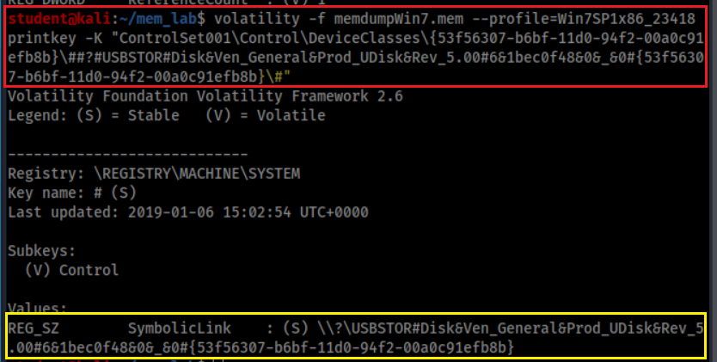
Access DeviceClass\Disk Interface\USB Interface\# SymbolicLink
USB plug-in timestamp
It is a symbolic link, we can check and verify the subkey
Notes:
volatility -f memdumpWin7.mem --profile=Win7SP1x86_23418 printkey -K "ControlSet001\Control\DeviceClasses\{53f56307-b6bf-11d0-94f2-00a0c91efb8b}\##?#USBSTOR#Disk&Ven_General&Prod_UDisk&Rev_5.00#6&1bec0f48&0&_&0#{53f56307-b6bf-11d0-94f2-00a0c91efb8b}\#"

Slide 54
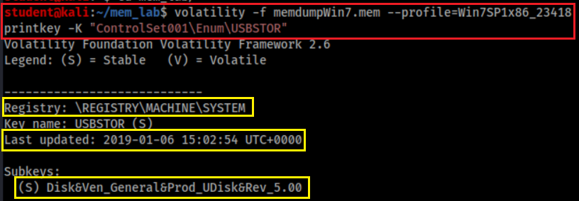
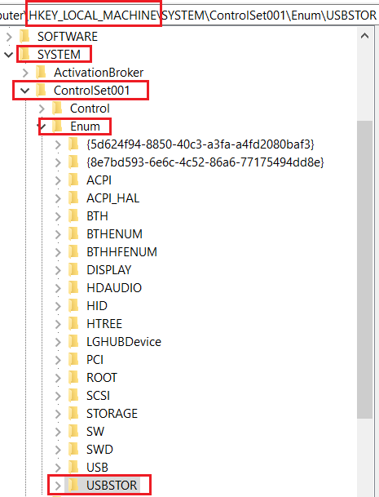
Verify USBTOR subkey and timestamp
USB Storage
Same timestamp
Ven_ [vendor name]
Prod_[product name assigned by vendor]
Rev_[revision ID]
Can we find Vendor ID and Product ID?
Notes:
volatility -f memdumpWin7.mem --profile=Win7SP1x86_23418 printkey -K "ControlSet001\Enum\USBSTOR"

Slide 55
How to find Vendor ID and Product ID?
When a USB device is connected to a Windows PC, Windows will remember its vendor and class IDs to reference the next time it is plugged in. This information is stored in:
HKEY_LOCAL_MACHINE\SYSTEM\CurrentControlSet\Enum\USB
E.g., Vid_0c55&Pid_5416
Can search device information
https://www.the-sz.com/products/usbid/
Note: Registry dumped from memory doesn’t have VID and PID
Normal registry will contain these information

Slide 56
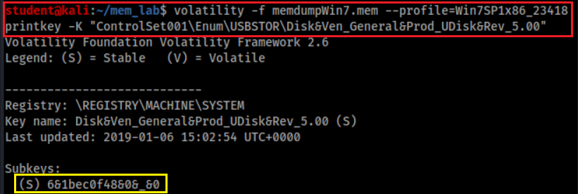
What is the Instance ID of USB?
A device identification string that distinguishes a device from other devices of the same type on a computer.
the second character is &, means
the USB doesn’t provide SN
UID is created by PnP, is only unique system wide
Notes:
volatility -f memdumpWin7.mem --profile=Win7SP1x86_23418 printkey -K "ControlSet001\Enum\USBSTOR\Disk&Ven_General&Prod_UDisk&Rev_5.00“
Although a unique serial number is required for devices that manufacturers want to qualify for the Windows Logo program (www.microsoft.com/whdc/archive/usbfaq.mspx#ERCAC), not all devices include a serial number. For devices that do not have a serial number, the PnP Manager will create a unique instance ID for that device(6&1bec0f48&0&_&0)

Slide 57
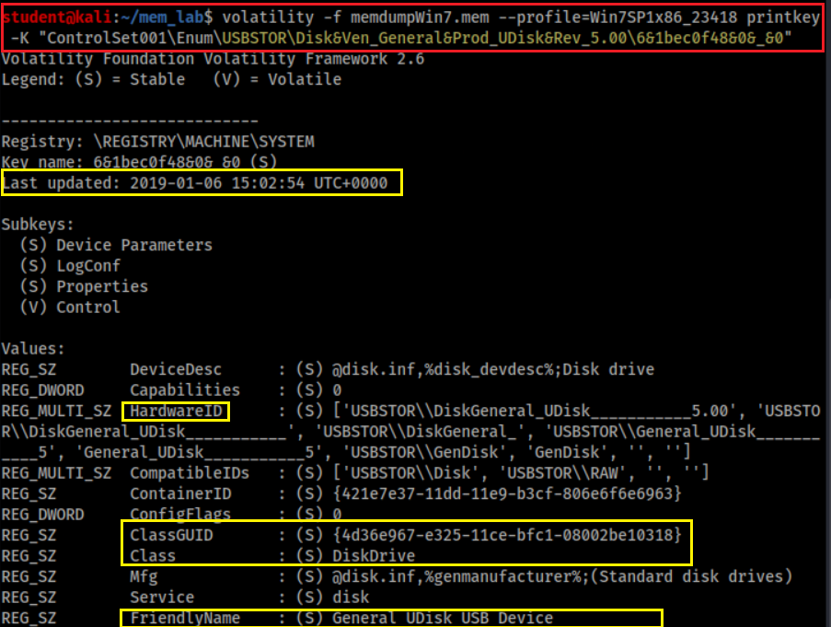
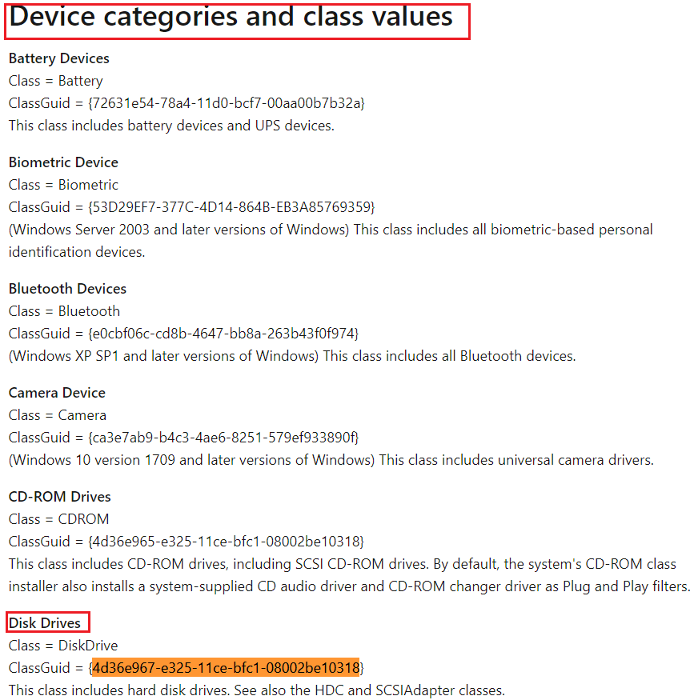
What is the friendly name of the USB?
Note: It is hardware, difference from Disk interface GUID, which is software
Notes:
volatility -f memdumpWin7.mem --profile=Win7SP1x86_23418 printkey -K "ControlSet001\Enum\USBSTOR\Disk&Ven_General&Prod_UDisk&Rev_5.00\6&1bec0f48&0&_&0“
ClassGuid = {4d36e967-e325-11ce-bfc1-08002be10318}
https://docs.microsoft.com/en-us/windows-hardware/drivers/install/system-defined-device-setup-classes-reserved-for-system-use

Slide 58
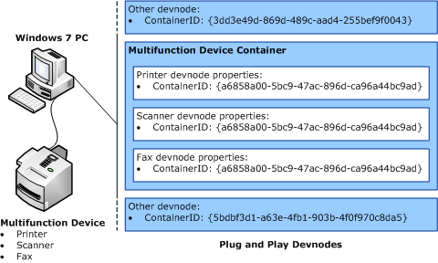
What is ContainerID?
A system-supplied device identification string
Groups the functional devices associated with a single-function or multifunction device installed in the computer.
Introduced in Windows 7
the Plug and Play (PnP) manager uses the container ID to group one or more device
All physical devices should be assigned a ContainerID – not just storage devices.
monitors, external speakers, keyboards

Slide 59
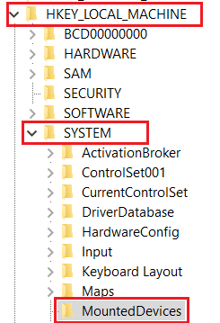
Which drive letter does the USB was assigned to?
Notes:
volatility -f memdumpWin7.mem --profile=Win7SP1x86_23418 printkey -K "MountedDevices"

Slide 60
Problem of only exam /System/MountedDevices
The registry key may not have a correct drive letter.
Windows only tracks the last device that has been assigned a particular drive letter (D, E, F, etc.)
We need to exam NTUSER.DAT
Next slide

Slide 61
Who did mount F volume to PC?
Notes:
volatility -f memdumpWin7.mem --profile=Win7SP1x86_23418 printkey -K "Software\Microsoft\Windows\CurrentVersion\Explorer\MountPoints2"

Slide 62
When the USB Last Attached to PC?
Notes:
volatility -f memdumpWin7.mem --profile=Win7SP1x86_23418 printkey -K "Software\Microsoft\Windows\CurrentVersion\Explorer\MountPoints2\F"

Slide 63
USB Evidence Source List
SYSTEM/CurrentControlSet/Enum/USBSTOR
Referened by SYSTEM\ControlSet001\Control\DeviceClasses\{53f56307-b6bf-11d0-94f2-00a0c91efb8b}\UID\
SYSTEM/MountedDevices
Drive letter or volume mounted
NTUSER.DAT/Software/Microsoft/Windows/CurrentVersion/Explorer/MountPoints2
eveal which user was logged in and active
SYSTEM/CurrentControlSet/Enum/USB
Not available in memory dump
(optional) Windows Vista+ – ROOT/Windows/inf/setupapi.dev.log
(optional) Windows XP – ROOT/Windows/setupapi.log

Slide 64
Investigate Internet History

Slide 65
Did the suspect use Internet Explore?
IE history
Control X: exit

Slide 66
Are there any activates in 2019? No
Notes:
volatility -f memdumpWin7.mem --profile=Win7SP1x86_23418 iehistory | grep 2019

Slide 67
Investigate File Explorer History
Shellbags

Slide 68
What are Shellbags?
Registry keys to track a folder window when viewed through File Explorer;
views, sizes and positions
includes network folders and removable devices
available since Windows XP
Giving the investigator great insight into
the folder
browsing history of a suspect
details for any folder that might no longer exist on a system
due to deletion, or being located on a removable device
Note: shellbags only get created when accessing the folders
copying, moving, deleted etc will not change anything.
Notes:
https://www.magnetforensics.com/blog/forensic-analysis-of-windows-shellbags/

Slide 69
What are registry keys that shellbags are structured from?
Structured from two main registry keys
BagMRU: stores folder names and records folder paths by creating the similar tree structure.
Bags: stores the view preferences such as the window size, location and view mode
Physical location (Win7 +)
%UserProfile%\NTUSER.dat
%UserProfile%\AppData\Local\Microsoft\Windows\UsrClass.dat.

Slide 70
How shellbags are structured?
Structured In hierarchy to which they are accessed through Windows Explorer
each numbered folder representing a parent or child folder of the one previous.
Notes:
https://www.sans.org/reading-room/whitepapers/forensics/windows-shellbag-forensics-in-depth-34545

Slide 71
Are there any folder access activities on 2019-01-06?
Interesting! we need to look into it.
Notes:
volatility -f memdumpWin7.mem --profile=Win7SP1x86_23418 shellbags | grep "Last updated: 2019-01-06" | sort
Last updated: 2019-01-06 14:32:21 UTC+0000
Last updated: 2019-01-06 14:32:53 UTC+0000
Last updated: 2019-01-06 14:55:45 UTC+0000
Last updated: 2019-01-06 15:04:40 UTC+0000
Last updated: 2019-01-06 15:04:40 UTC+0000
Last updated: 2019-01-06 15:04:40 UTC+0000
Last updated: 2019-01-06 15:07:03 UTC+0000

Slide 72
What are folder access activities on 2019-01-06?
Print shellbags to a file shellbags.html
Easy to review html files
Verify shellbags.html has be generated

Slide 73
A suspect accesses the download folder (twice).
First Access folder
Last Access of folder or last preference change, not the time of changing the files in the folder
Notes:
https://www.sans.org/blog/computer-forensic-artifacts-windows-7-shellbags/

Slide 74
Timeline Analysis

Slide 75
Chrome.exe downloads
2019-01-04 16:05:12 GMT
First review download folder
2019-01-06 14:49:40 UTC
USB plugged in
2019-01-06 15:02:54 UTC

Slide 76
USB assigned to F volume
2019-01-06 15:03:06 UTC
Last review download folder: 2019-01-06 15:04:40 UTC
Command Prompt with Copy command:
2019-01-06 15:06:011 UTC

Slide 77
Chrome.exe downloads:
2019-01-04 16:05:12
First review download folder
: 2019-01-06 14:49:40 UTC
USB plugged in: 2019-01-06 15:02:54 UTC
USB assigned to F volume: 2019-01-06 15:03:06 UTC
Command Prompt with Copy command
: 2019-01-06 15:06:11 UTC
Last review download folder
: 2019-01-06 15:04:40 UTC

Slide 78
Note
When a folder is deleted, the correspondent ShellBag registry keys and values will not be removed.
However, several tools have been developed to remove the ShellBag information from the registry.

Slide 79
Post-Investigation

Slide 80
What is Windows 7 password?
Dump password hashes from memory
Using John the Ripper to crack password
John the Ripper is a free password cracking software tool.
password.lst is the default password dictionary

Slide 81
Dump NTLM hash
The password to your VM IEUser is "Passw0rd!"
Save IEUser’s password hash to a file
Notes:
Administrator:500:aad3b435b51404eeaad3b435b51404ee:fc525c9683e8fe067095ba2ddc971889:::
Guest:501:aad3b435b51404eeaad3b435b51404ee:31d6cfe0d16ae931b73c59d7e0c089c0:::
IEUser:1000:aad3b435b51404eeaad3b435b51404ee:fc525c9683e8fe067095ba2ddc971889:::
sshd:1001:aad3b435b51404eeaad3b435b51404ee:31d6cfe0d16ae931b73c59d7e0c089c0:::
sshd_server:1002:aad3b435b51404eeaad3b435b51404ee:8d0a16cfc061c3359db455d00ec27035:::

Slide 82
Find the location of John’s default password.lst
/: root f: file
Search passwords contain the string “pass” ignore case
i: ignore case

Slide 83
You can add a new password string “Passw0rd!” to the dictionary
Need root privilege
Verify the password string “Passw0rd!” has been added to the dictionary

Slide 84
Find IEUser’s password

Slide 85
Try Other Plugins

Slide 86
How to download plugins
Clone a plugin repo
Show downloaded plugins
Notes:
https://github.com/cube0x8/chrome_ragamuffin.git

Slide 87
How to find chrome history?
Plugins may not work!

Slide 88
References
https://www.forwarddefense.com/pdfs/Memory-Analysis-with-Volatility.pdf
https://www.andreafortuna.org/2017/07/31/volatility-my-own-cheatsheet-part-6-windows-registry/
http://www.mrtweaks.com/regedit.htm
https://tweaklibrary.com/what-are-registry-root-keys/
https://docs.microsoft.com/en-us/windows-hardware/drivers/usbcon/usb-device-specific-registry-settings
https://docs.microsoft.com/en-us/windows-hardware/drivers/install/standard-usb-identifiers
https://www.forensicfocus.com/forums/general/usbstor-registry-entries-windows-7/
https://docs.microsoft.com/en-us/windows-hardware/drivers/install/instance-ids
http://techexe.net/computer-fundamentals/
https://docs.microsoft.com/en-us/windows-hardware/drivers/install/device-identification-strings
https://kuscholarworks.ku.edu/bitstream/handle/1808/19390/Kang_ku_0099M_14318_DATA_1.pdf;jsessionid=8069E32208405DF2EC49129DDE02DF4D?sequence=1
http://what-when-how.com/windows-forensic-analysis/registry-analysis-windows-forensic-analysis-part-5/

