Slide 1
Investigate Data Leakage Case
Keywords: Windows Security Event Logs, XML
Notes:
http://xmlstar.sourceforge.net/doc/UG/

Slide 2
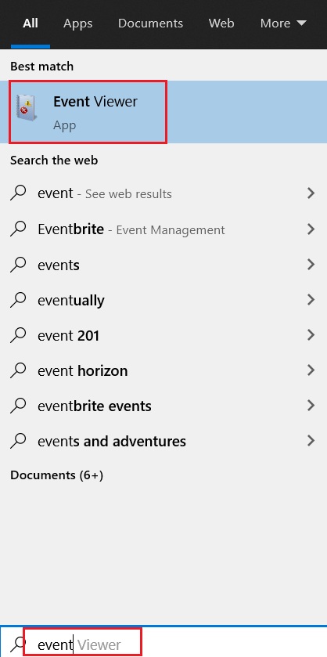
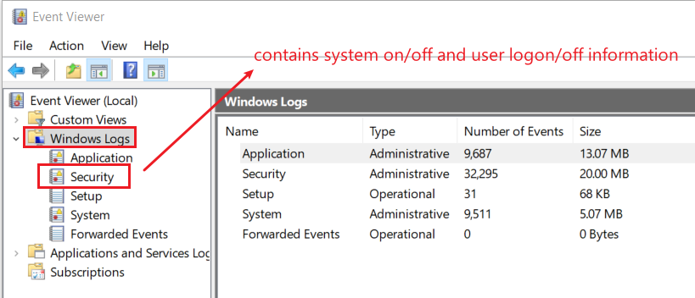
12. List all traces about the system on/off and the user logon/logoff (It should be considered only during a time range between 09:00 and 18:00 in the timezone (Eastern Time) from Question 4.
The Windows event log is a detailed record of system, security and application notifications stored by the Windows
It’s a useful tool for
  troubleshooting all kinds of different Windows problems
  forensics analysis
Notes:
evtx_dump.py Security.evtx > SecurityEvt.xml

Slide 3
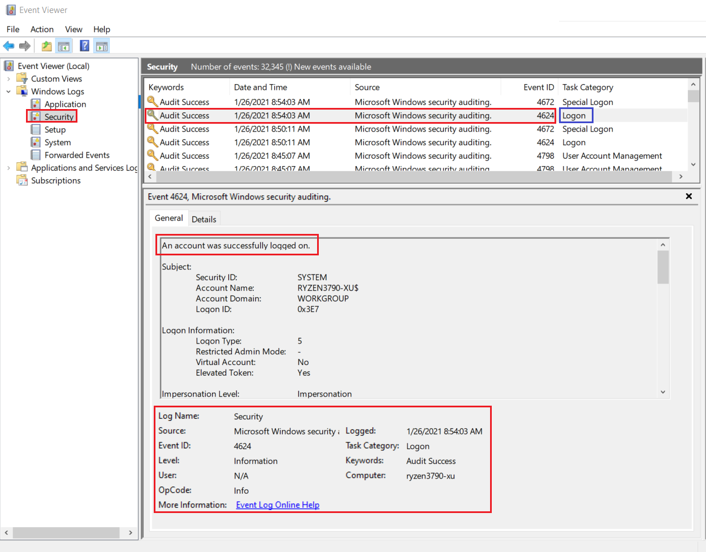
Logon event 4624

Slide 4
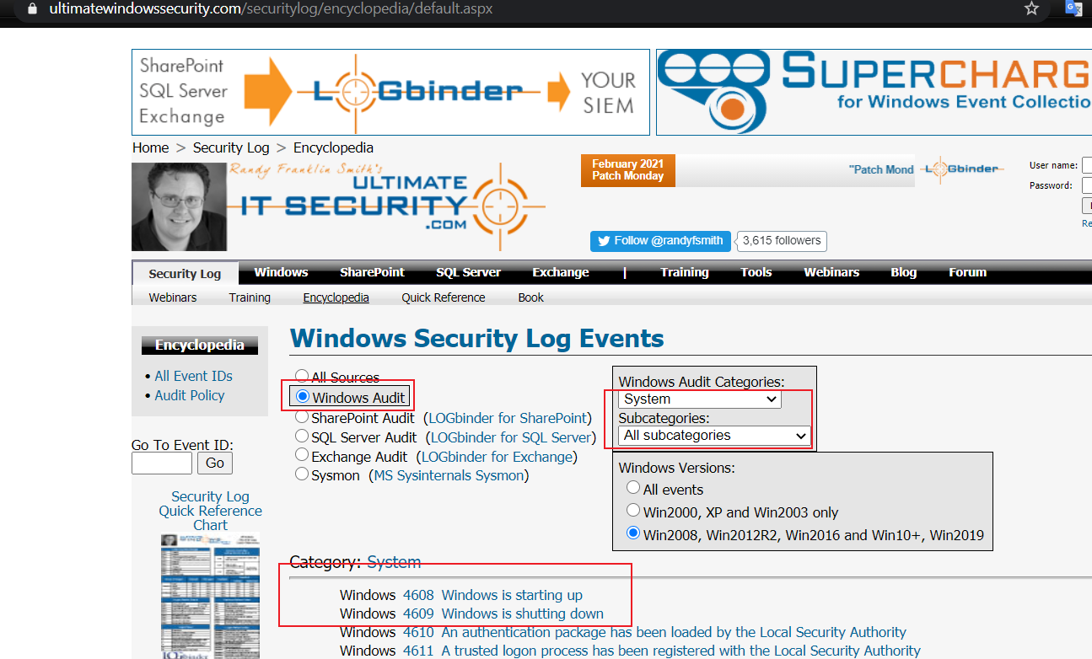
How to search events?
https://www.ultimatewindowssecurity.com/securitylog/encyclopedia/default.aspx

Slide 5
Overview
Get a copy of security event log
Analyze the event log
  Install XML parser (xmlstarlet)
  Validating Security Event Log XML documents
  Display element structure of XML document
  Format XML document
  Query XML documents
  Modify or edit XML documents

Slide 6
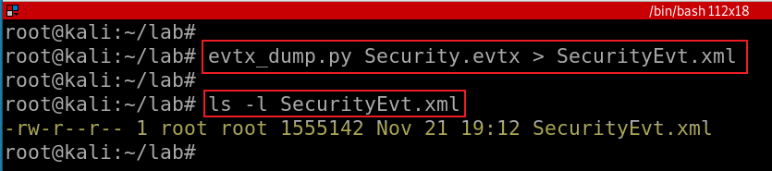
Get a copy of security event log
Exam security event logs for logon/logoff
Notes:
evtx_dump.py Security.evtx > SecurityEvt.xml

Slide 7
Install XML parser

Slide 8
xmlstarlet
Is a set of command line utilities (tools)
  transform, query, validate, and edit XML documents and files
Using simple set of shell commands
  Similar to grep, sed, awk
http://xmlstar.sourceforge.net/doc

Slide 9
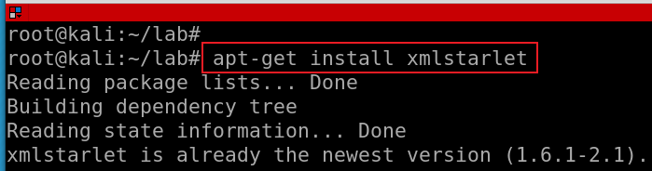
Install xmlstartlet
Notes:
apt-get install xmlstarlet

Slide 10
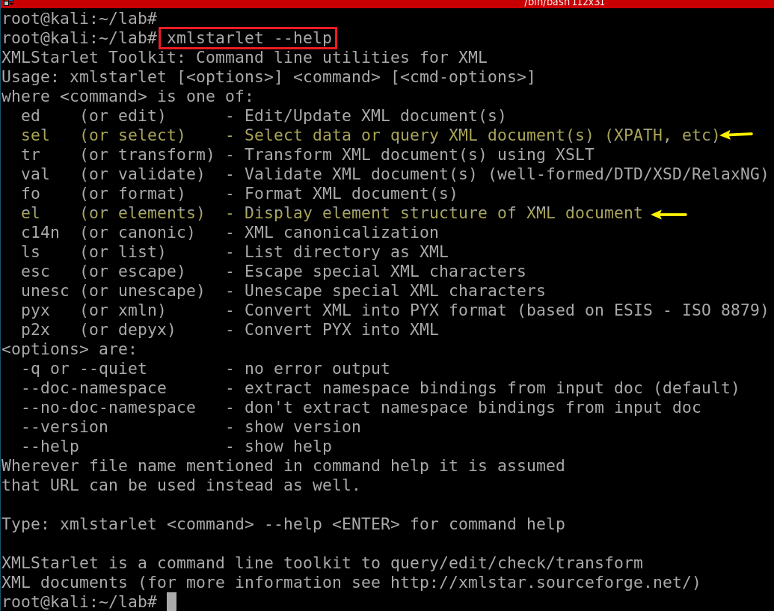

Slide 11
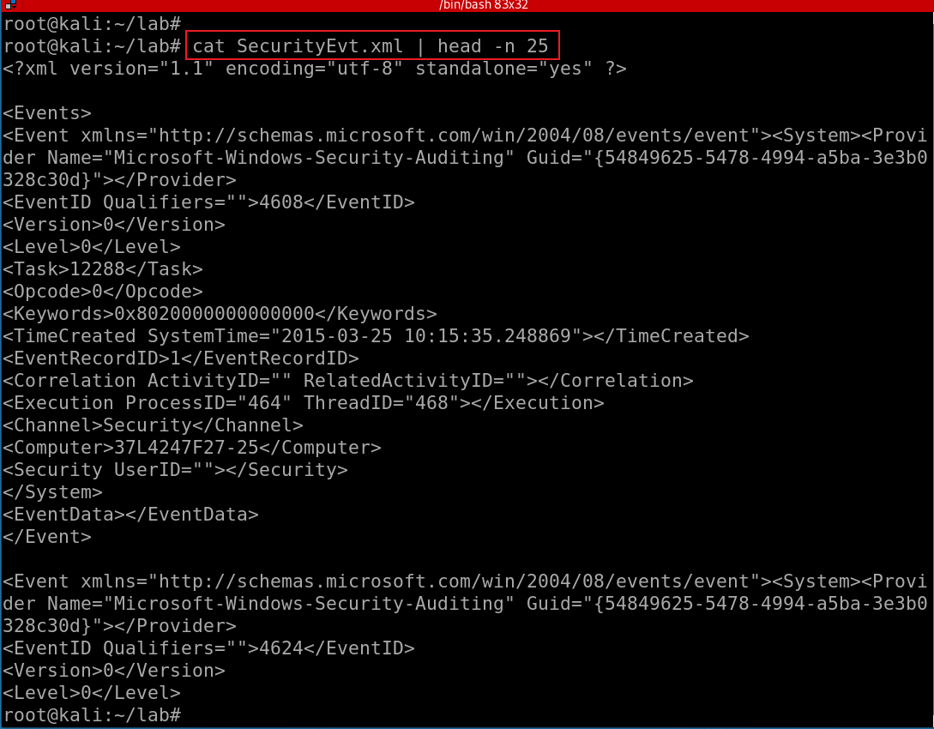
Show SecurityEvt.xml
XML Namespaces provide a method to avoid element name conflicts.
  defined by an xmlns attribute in the start tag of an element.
  xmlns:prefix="URI".
<table>
<tr>
<td>Apples</td>
<td>Bananas</td>
</tr>
</table>
<table>
<name>African Coffee Table</name>
<width>80</width>
<length>120</length>
</table
Notes:
https://www.w3schools.com/xml/xml_namespaces.asp

Slide 12
validating XML documents

Slide 13
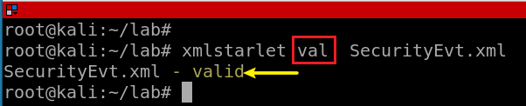
Notes:
xmlstarlet val SecurityEvt.xml

Slide 14
Display element structure of XML document
or elements

Slide 15
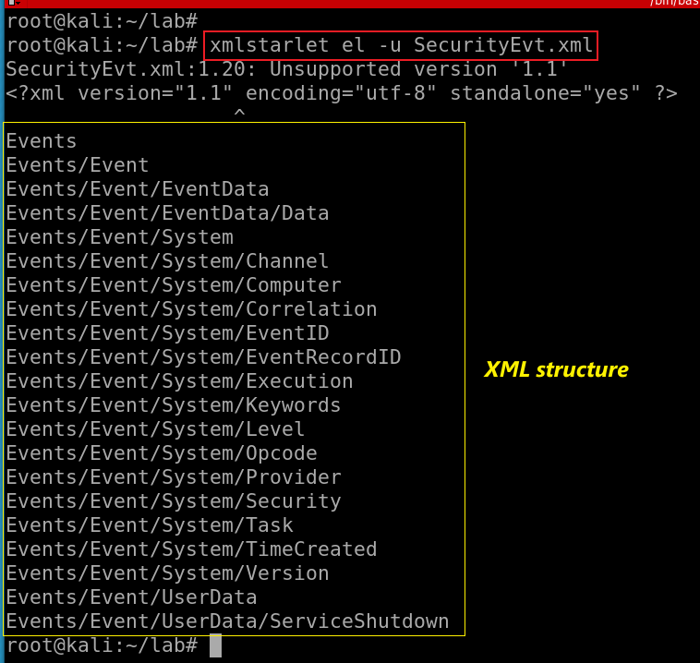
Show the element structure of SecurityEvt.xml
el: Display element structure of XML document
-u: print out sorted unique lines
Notes:
xmlstarlet el -u SecurityEvt.xml
xmlstarlet el -u SecurityEvt.xml 2>/dev/null

Slide 16
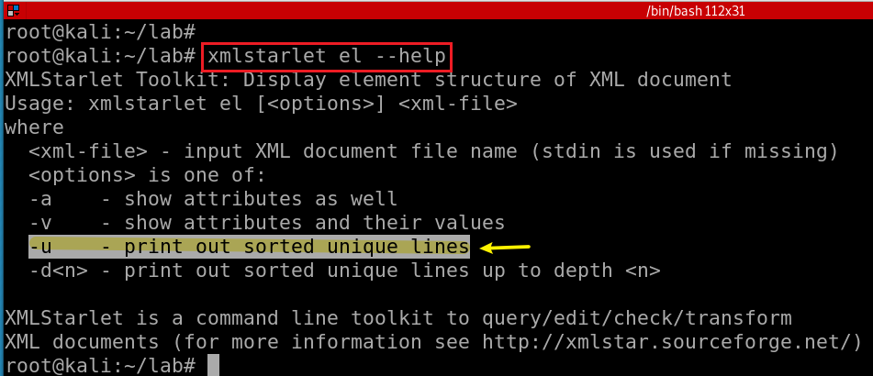
Notes:
xmlstarlet el --help

Slide 17
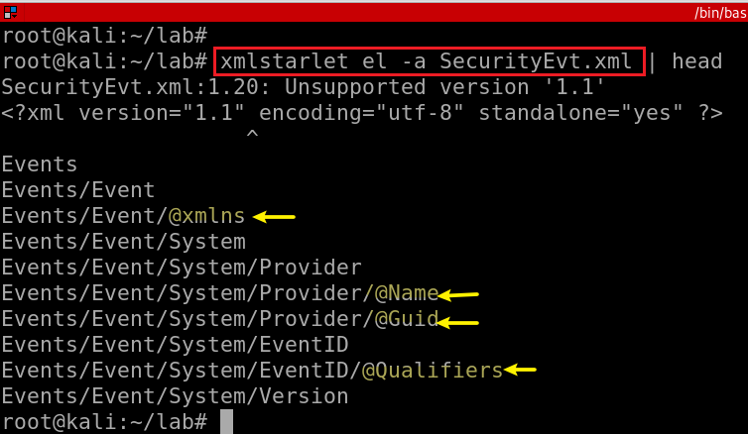
Show the element (attributes) structure of SecurityEvt.xml
-a: show attributes

Slide 18
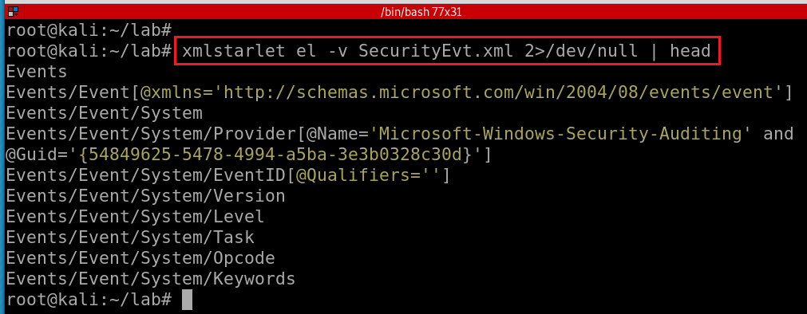
Show element attributes and their values
-v : show attributes and their values
Notes:
xmlstarlet el -v SecurityEvt.xml 2>/dev/null | head

Slide 19
format XML document

Slide 20
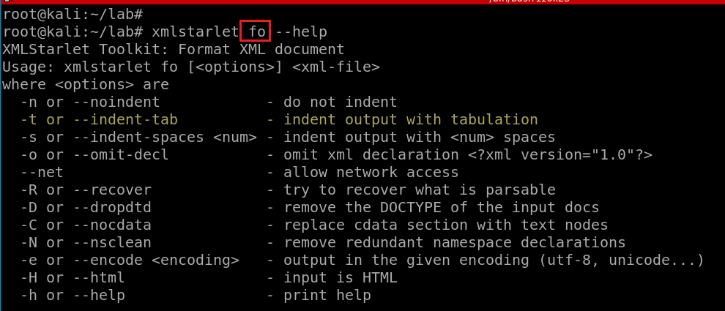

Slide 21
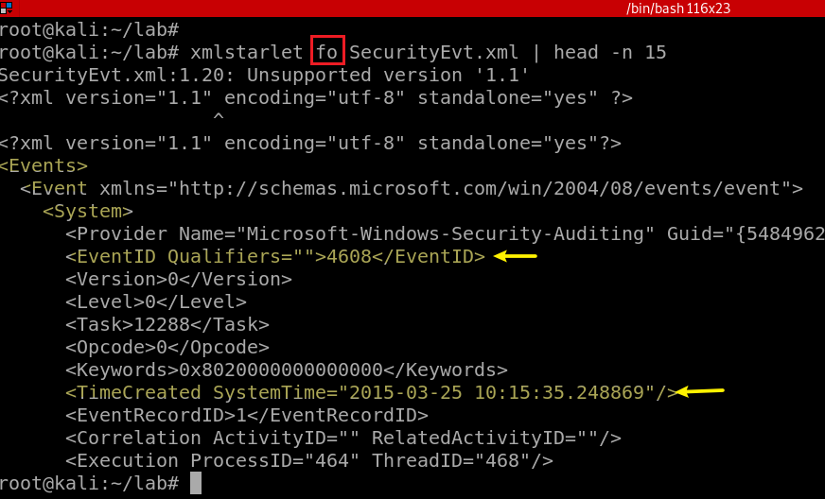
Notes:
xmlstarlet fo -n SecurityEvt.xml | head -n 15

Slide 22
select data or query XML document(s) (XPATH, etc)

Slide 23
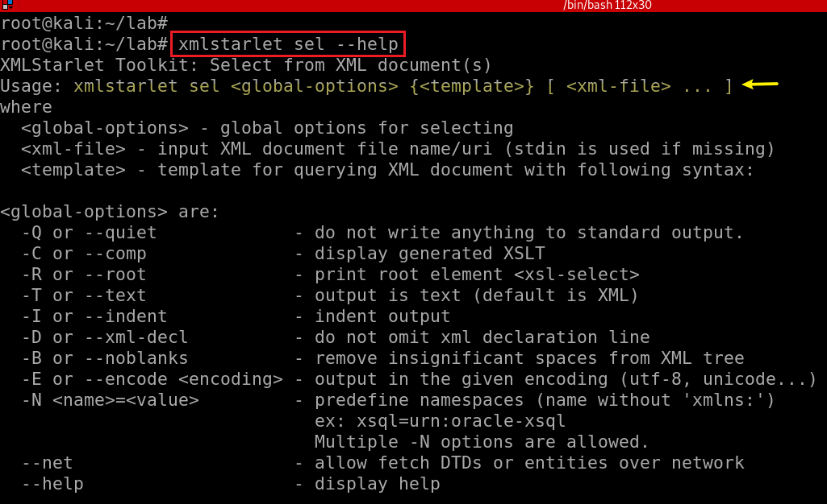

Slide 24
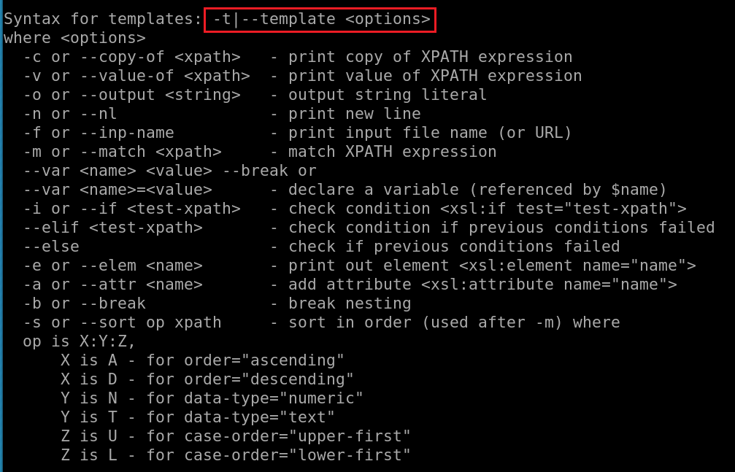
What is XPATH expression?

Slide 25
Xpath expressions
Xpath uses path expressions to select nodes or node-sets in an XML document.
Xpath expressions look very much like the expressions you see when you work with a traditional computer file system.
Must provide XML namespace for queuing data

Slide 26
Xpath expressions
“//” operator, a convenient shorthand for selecting nodes at any level in a document.
x: namespace variable, e.g., x=http://schemas.microsoft.com/win/2004/08/events/event
First Event node
  //x:Event[1]
Last event
  //x:Event[last()]
First two events
  //x:Event[position()<3]
EventID with an attribute named Qualifiers
  //x:EventID[@Qualifiers]
Notes:
https://www.marklogic.com/blog/xpath-punctuation-part-1/

Slide 27
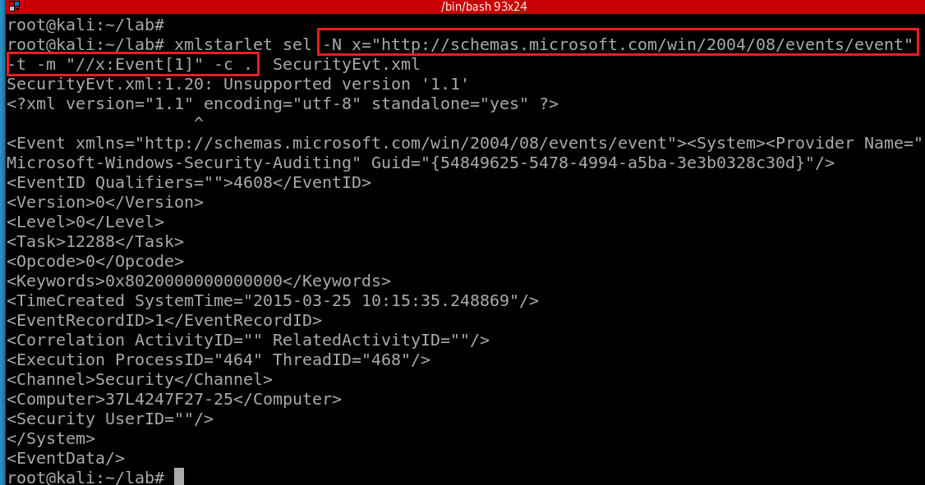
Select the first event by matching the xpath and print the context node
-N: namespace
x: namespace variable
The dot (“.”) : the “context item expression” because it refers to the context item.
  This could be a node (such as an element, attribute, or text node), or an atomic value (such as a string, number, or boolean).
  When it’s a node, it’s also called the context node.
-c or --copy-of <xpath>: print copy of XPATH expression
options
  -m: match XPATH expression
-t|--template <options>
Notes:
xmlstarlet sel -N x="http://schemas.microsoft.com/win/2004/08/events/event" -t -m "//x:Event[1]" -c . SecurityEvt.xml

Slide 28
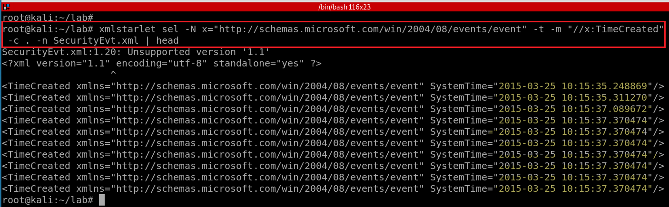
Select TimeCreated of events and print the context node
Notes:
xmlstarlet sel -N x="http://schemas.microsoft.com/win/2004/08/events/event" -t -m "//x:TimeCreated" -c . -n SecurityEvt.xml
http://xmlstar.sourceforge.net/doc/UG/xmlstarlet-ug.html#idm47077139523728

Slide 29
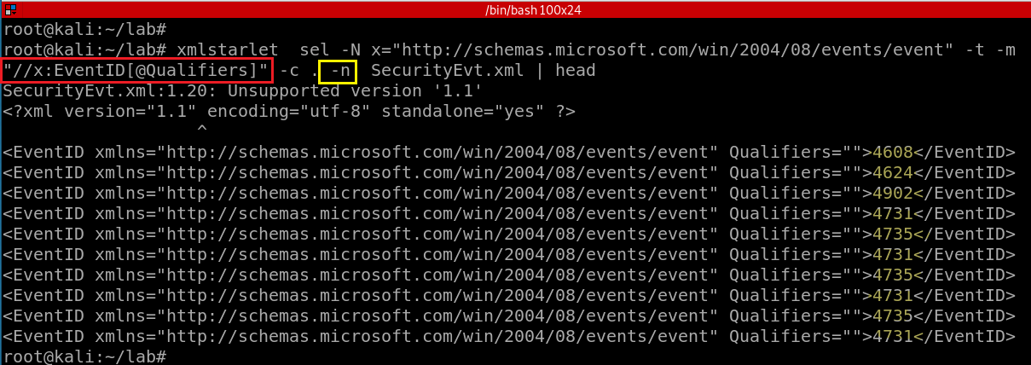
4608 (Windows is starting up)
1100 (service shutdown)
4624 (successful logon)
4634 (logoff)
4625 (logon failure)
4647 (a user initiated the logoff process)...
Select a property of EventID and print the context node
-n: print new line
Notes:
xmlstarlet sel -N x="http://schemas.microsoft.com/win/2004/08/events/event" -t -m "//x:EventID[@Qualifiers]" -c . -n SecurityEvt.xml | head

Slide 30
Substitute xmlstarlet sel results using sed
Notes:
https://www.grymoire.com/Unix/Sed.html#uh-1

Slide 31
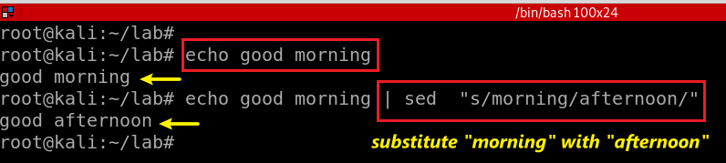
stream editor
Used to perform basic text transformations on an input stream (a file or input from a pipeline).
Can apply regular expression
Substitute morning in text stream with afternoon
Notes:
echo good morning | sed "s/morning/afternoon/"

Slide 32
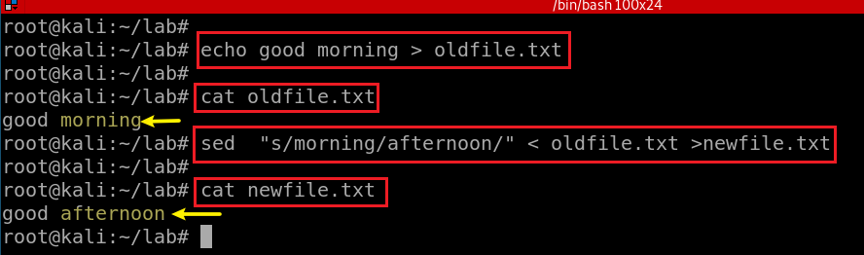
Substitute morning in text stream with afternoon

Slide 33
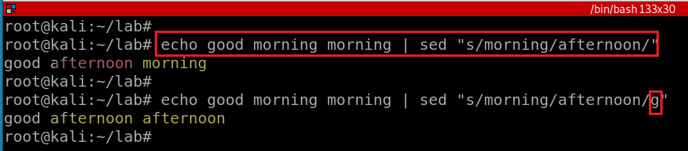
/g - Global replacement

Slide 34
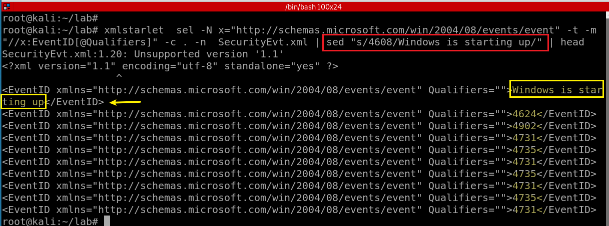
4608 (Windows is starting up)
1100 (service shutdown)
4624 (successful logon)
4634 (logoff)
4625 (logon failure)
4647 (a user initiated the logoff process)...
Notes:
https://www.grymoire.com/Unix/Sed.html

Slide 35
edit XML document(s)

Slide 36
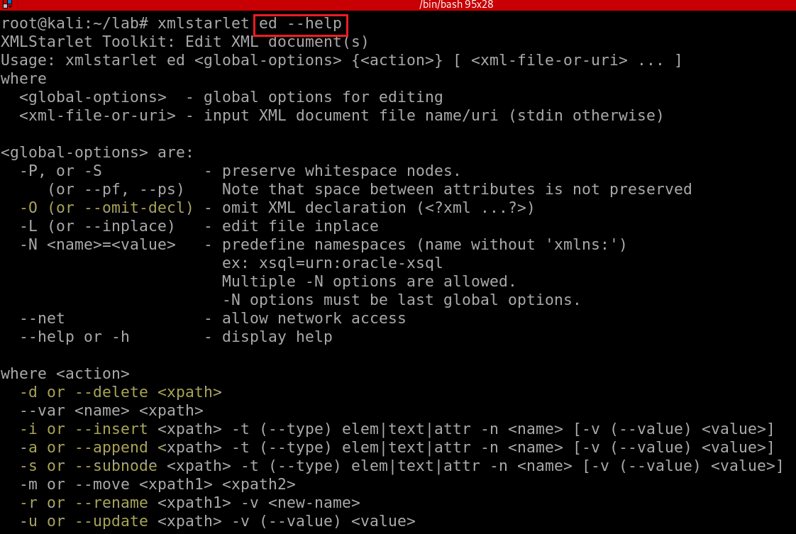
Notes:
xmlstarlet ed --help

Slide 37
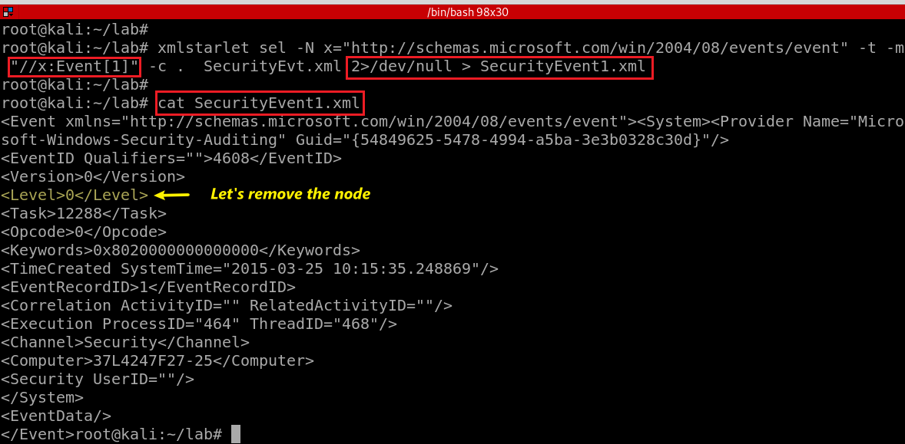
Notes:
xmlstarlet sel -N x="http://schemas.microsoft.com/win/2004/08/events/event" -t -m "//x:Event[1]" -c . SecurityEvt.xml 2>/dev/null > SecurityEvent1.xml

Slide 38
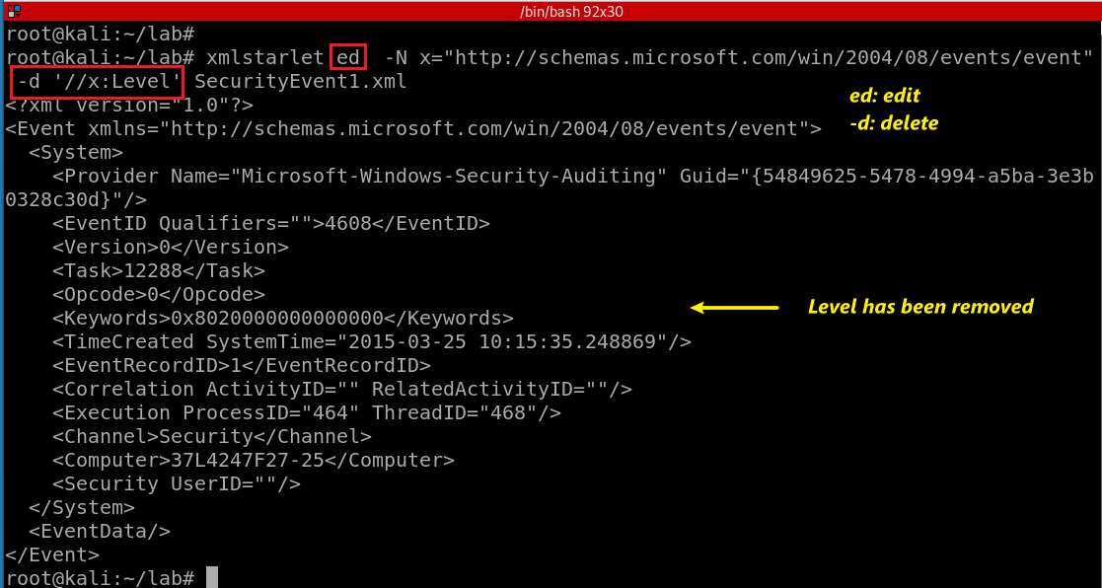
“delete” the node <Level></Level>
Notes:
xmlstarlet ed -N x="http://schemas.microsoft.com/win/2004/08/events/event" -d '//x:Level' SecurityEvent1.xml

Slide 39
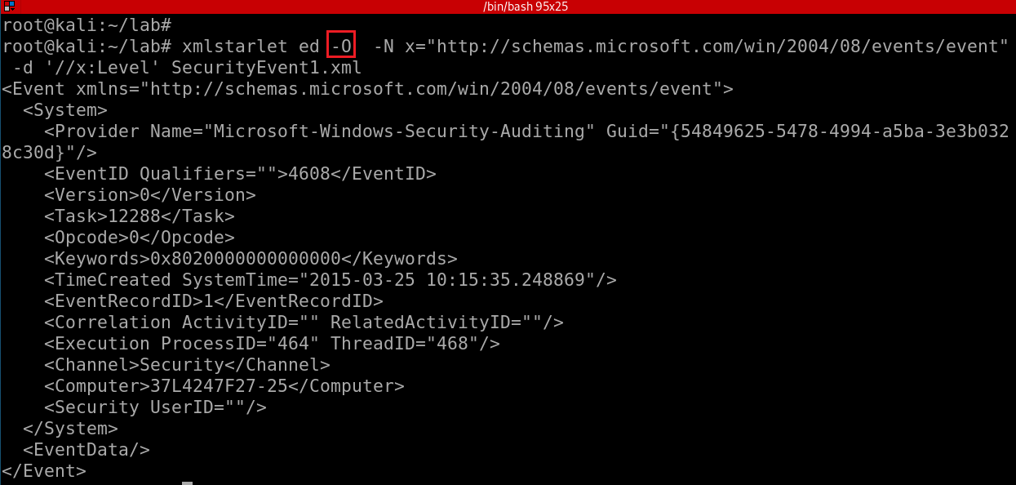
Omit XML declaration (<?xml ...?>) and “delete” the node <Level></Level>
-d: is not actually deleting the note,
only show deleted stream
How to actually delete a node?
Notes:
xmlstarlet ed -O -N x="http://schemas.microsoft.com/win/2004/08/events/event" -d '//x:Level' SecurityEvent1.xml

Slide 40
Deleting namespace declarations
Notes:
http://xmlstar.sourceforge.net/doc/UG/xmlstarlet-ug.html#idm47077139529952
xml ed -N N="http://www.c.com/xyz" -d '//N:*' ns2.xml | \ sed -e 's/ xmlns.*=".*"//g'

Slide 41
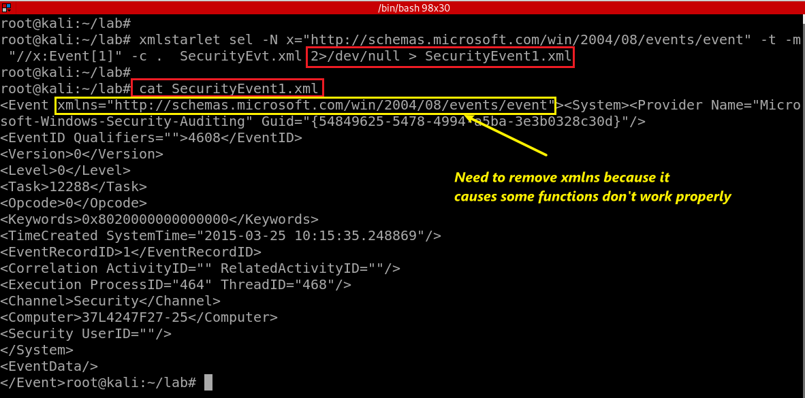
Notes:
xmlstarlet sel -N x="http://schemas.microsoft.com/win/2004/08/events/event" -t -m "//x:Event[1]" -c . SecurityEvt.xml 2>/dev/null > SecurityEvent1.xml

Slide 42
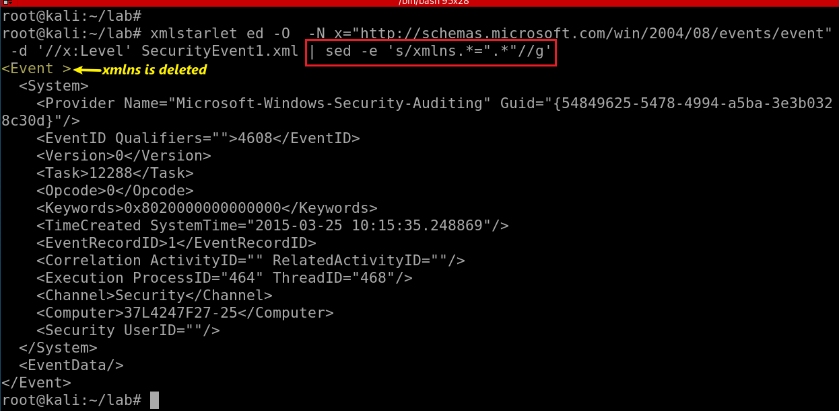
Substitute xmlns with nothing (remove xmlns)
-e: regular expression
s/e1/e2/g:
  s: substitute
  e1: regex
  e2: regex
  g: globe
Notes:
xmlstarlet ed -O -N x="http://schemas.microsoft.com/win/2004/08/events/event" -d '//x:Level' SecurityEvent1.xml | sed -e 's/xmlns.*=".*"//g'
http://xmlstar.sourceforge.net/doc/UG/xmlstarlet-ug.html#idm47077139529952

Slide 43
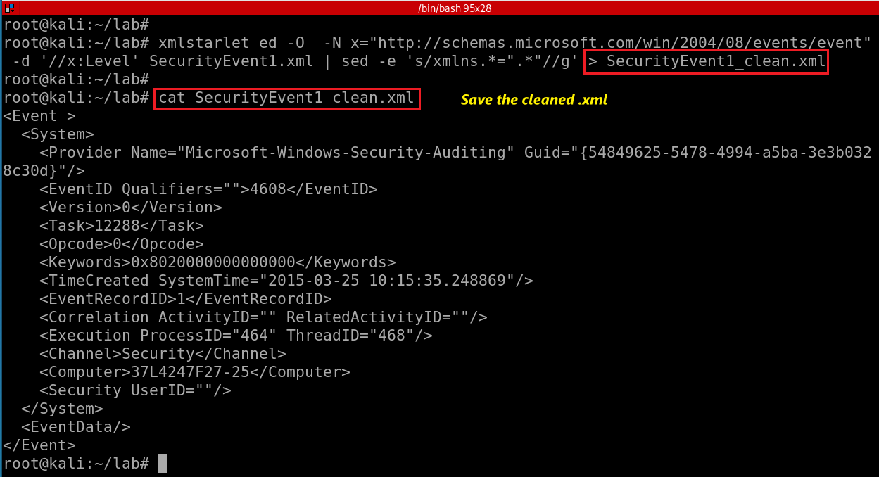
Notes:
xmlstarlet sel -N x="http://schemas.microsoft.com/win/2004/08/events/event" -t -m "//x:Event[1]" -c . SecurityEvt.xml 2>/dev/null > SecurityEvent1.xml
xmlstarlet ed -O -N x="http://schemas.microsoft.com/win/2004/08/events/event" -d '//x:Level' SecurityEvent1.xml | sed -e 's/xmlns.*=".*"//g' > SecurityEvent1_clean.xml

Slide 44
Transforming an XML Document into a CSV

Slide 45
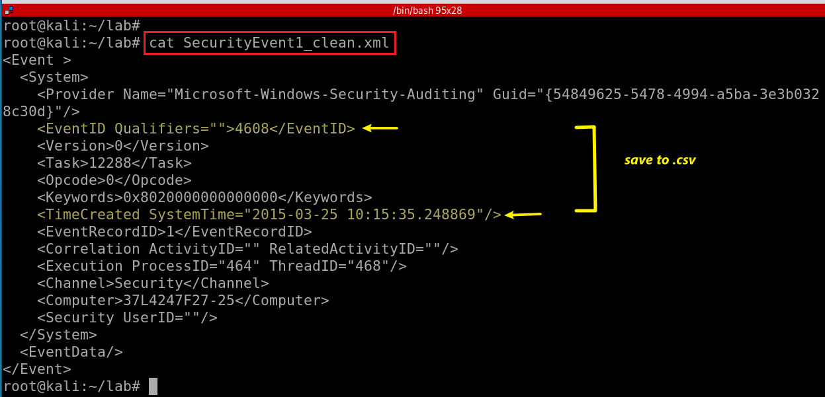
We want to save EventID and ItemCreated to .csv

Slide 46
<Event><System><Provider Name="Microsoft-Windows-Security-Auditing" Guid="{54849625-5478-4994-a5ba-3e3b0328c30d}"></Provider>
<EventID Qualifiers="">4608</EventID>
<Version>0</Version>
<Level>0</Level>
<Task>12288</Task>
<Opcode>0</Opcode>
<Keywords>0x8020000000000000</Keywords>
<TimeCreated SystemTime="2015-03-25 10:15:35.248869"></TimeCreated>
<EventRecordID>1</EventRecordID>
<Correlation ActivityID="" RelatedActivityID=""></Correlation>
<Execution ProcessID="464" ThreadID="468"></Execution>
<Channel>Security</Channel>
<Computer>37L4247F27-25</Computer>
<Security UserID=""></Security>
</System>
<EventData></EventData>
</Event>
Notes:
https://www.joyofdata.de/blog/transforming-xml-document-into-csv-using-xmlstarlet/

Slide 47
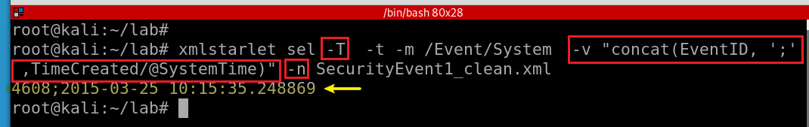
-T: output is text
-t: template
-m: template
-v: print value of xpath
-n: new line
Display EventID and ItemCreated in text
Notes:
xmlstarlet sel -T -t -m /Event/System -v "concat(EventID, ';' ,TimeCreated/@SystemTime)" -n SecurityEvent1_clean.xml

Slide 48
Assignments

Slide 49
Assignments
Convert all events to .csv
Find system on/off timestamp using XMLstartlet
Substitute eventid “4634” with “logoff”

