Slide 1
Investigate Data Leakage Case
Keywords: CD burn, $MFT, $MFT log
Notes:
http://xmlstar.sourceforge.net/doc/UG/

Slide 2
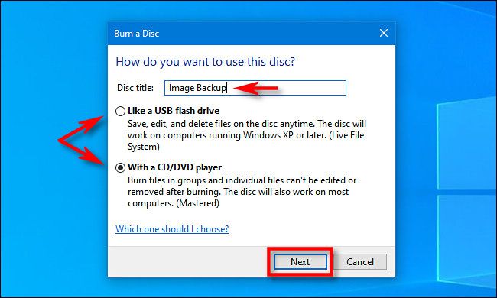
32. What a method (or software) was used for burning CD-R?
33. When did the suspect burn CD-R?
Windows 7 comes with built in support for burning CD’s and DVD’s.
When insert a blank recordable CD or DVD into your optical drive
Window titled “Burn a Disc” will appear.
This dialog asks you how you want Windows to handle writing the disc.
Notes:
https://secureartisan.wordpress.com/2012/06/04/windows-7-cddvd-burning/#:~:text=Event%20ID%20133.&text=While%20there%20is%20no%20supporting,does%20not%20trigger%20this%20event.

Slide 3
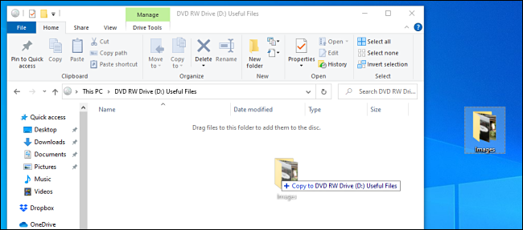
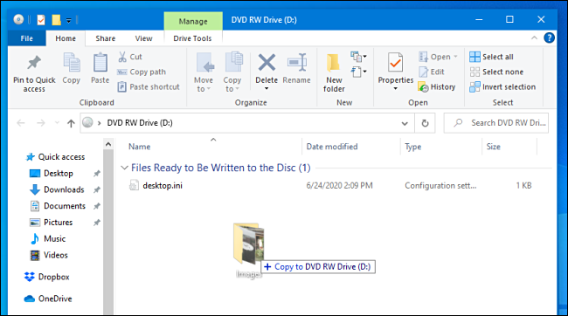
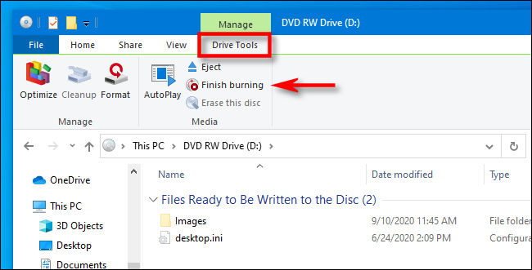
Two options for burning CD-R?
(Type 1) Like a USB flash drive: allows to write and erase files to the disc on-the-fly using a live file system without ever having to finalize or “master” the disc.
(Type 2) With a CD/DVD player: file are temporarily copied to a staging area on your hard disk first, then they are written to the disc all at once when you select “Burn” in File Explorer.
Notes:
https://www.howtogeek.com/689705/how-to-burn-a-cd-or-dvd-on-windows-10/#:~:text=Log%20into%20your%20Windows%20machine,to%20handle%20writing%20the%20disc.

Slide 4
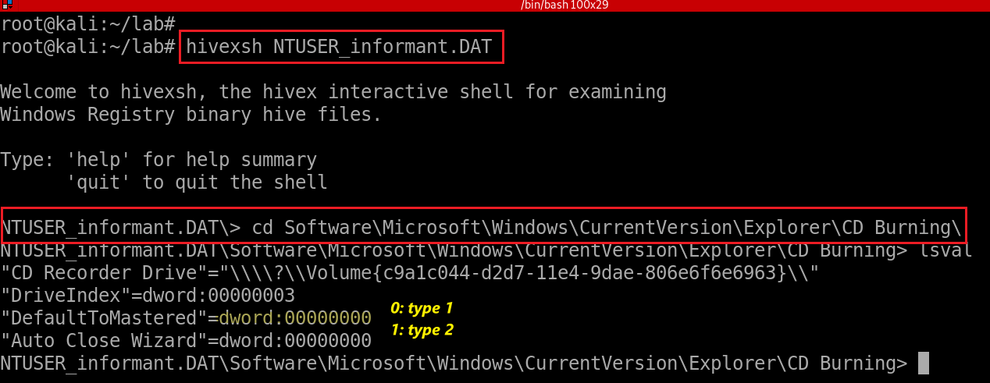
Find Last burning type from registry (type 1)
Check for last burning type from HKU\informant\Software\Microsoft\Windows\CurrentVersion\Explorer\CD Burning\
Notes:
hivexsh NTUSER_informant.DAT
cd Software\Microsoft\Windows\CurrentVersion\Explorer\CD Burning\

Slide 5
Evidence locations (for type 2 only)
System event logs for burning CD
Event IDs for Windows Vista or higher
Event ID 133. Source/Provider Name "cdrom“
Staging area: Default burning directory
\User\informant\AppData\Local\Microsoft\Windows\Burn\Burn
NTFS journal file analysis
\$LogFile
\$Extend\$UsnJrnl·$J (+ $MFT for identifying full paths of files)
DAT#####.tmp, DAT#####.tmp, FIL#####.tmp, POST#####.tmp

Slide 6
System event logs for burning CD
Copy system event to event_log folder
Extract system event
Notes:
cp /media/root/C8CA0C8DCA0C7A48/Windows/System32/winevt/Logs/System.evtx event_log/
evtx_dump.py event_log/System.evtx > event_log/System_evtx.xml

Slide 7
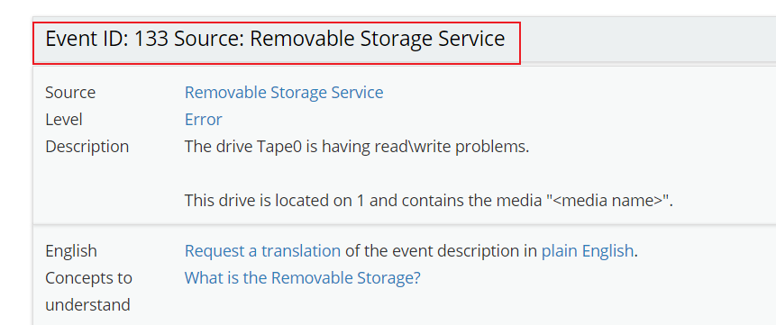
Search for event provider’s name “cdrom”
http://eventid.net/display-eventid-133-source-Removable+Storage+Service-eventno-3918-phase-1.htm
Notes:
grep -P "<Provider Name=\"cdrom\"" event_log/System_evtx.xml -B 1 -A 10 --color

Slide 8
Staging area in registry
HKEY_CURRENT_USER\Software\Microsoft\Windows\CurrentVersion\Explorer\CD Burning\ StagingInfo
Notes:
hivexsh NTUSER_informant.DAT
cd Software\Microsoft\Windows\CurrentVersion\Explorer\CD Burning\StagingInfo\Volume{c9a1c044-d2d7-11e4-9dae-806e6f6e6963}

Slide 9
Show StagingPath
The value "StagingPath" is significant. It shows the folder on the volume that is used to ‘stage’ files prior to committing them to the disc.
Notes:
cd Software\Microsoft\Windows\CurrentVersion\Explorer\CD Burning\StagingInfo\Volume{c9a1c044-d2d7-11e4-9dae-806e6f6e6963}

Slide 10
Show staging folder but nothing there because all files will be deleted after burn
Show deleted staging folder (not a completed results, see next questions)
Notes:
ls /media/root/C8CA0C8DCA0C7A48/Users/informant/AppData/Local/Microsoft/Windows/Burn/Burn/
fls -rdF -o 206848 cfreds_2015_data_leakage_pc.dd | grep -P "/Burn"

Slide 11
USN Journal file analysis (\$Extend\$UsnJrnl·$J )
DAT#####.tmp, DAT#####.tmp, FIL#####.tmp, POST#####.tmp
Show when the suspect burns CD-R with the pattern DAT#####.tmp
Notes:
grep -P "DAT.*\.tmp" UsnJrnl2Csv/UsnJrnl_2020-11-28_12-15-14.csv --color

Slide 12
34. What files were copied from PC to CD-R?
Equivalent to trace what files have been deleted from
Users\informant\AppData\Local\Microsoft\Windows\Burn\Burn\
Difficult to trace because it is possible that there is no meta data in $MFT:
$MFT is a file containing meta data for all files and directories in NTFS
A periodic garbage collection since Windows 7
In case of SSD, unallocated space is arranged by TRIM operation
Notes:
fls -o 206848 cfreds_2015_data_leakage_pc.dd
http://az4n6.blogspot.com/2015/09/whos-your-master-mft-parsers-reviewed.html

Slide 13
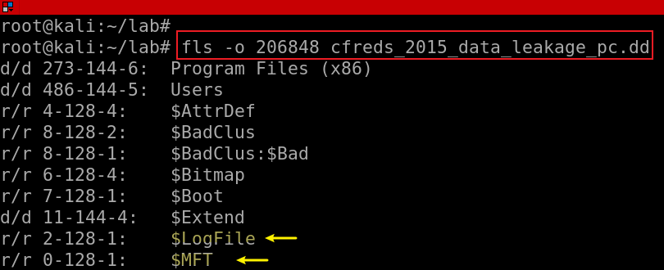
Analysis plan
$MFT
provides only last modified/access time of a file
Each $MFT entry = a file with attributes
$LogFile: transaction log of NTFS for data recovery
Save few hours of activity recorded in a $LogFile.
$LogFile associate with $MFT
$Extend$UsnJrnl·$J
using bit flags
$LogFile records transactions when
The creation of file/directory
The deletion of file/directory
The modification of $data
The modification of MFT entry
Notes:
fls -o 206848 cfreds_2015_data_leakage_pc.dd
http://az4n6.blogspot.com/2015/09/whos-your-master-mft-parsers-reviewed.html

Slide 14
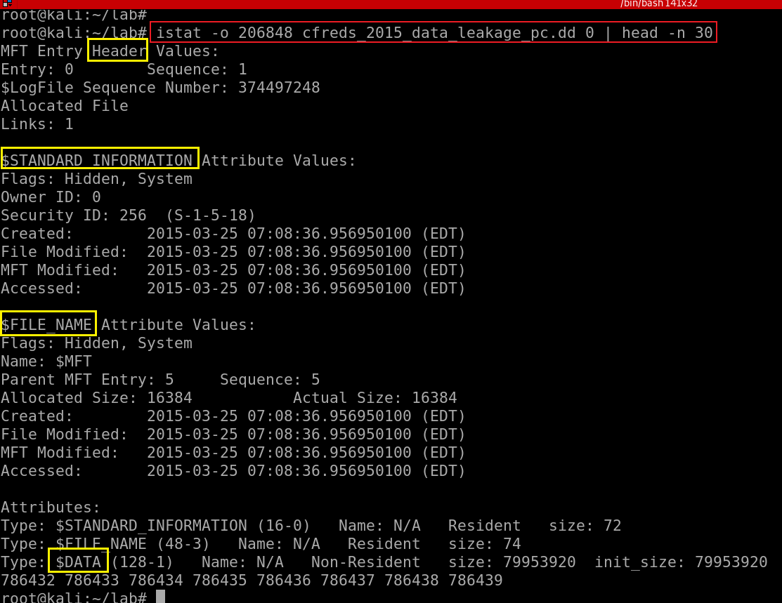
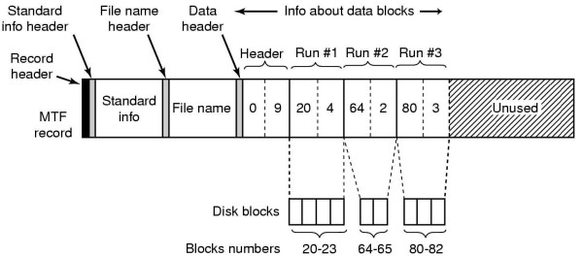
$MFT (Master File Table) Entry
0: Entry number (the $MFT itself)
One MFT entry = one file (Except file content)
Each entry size = 1K
first 16 MFT entries for special metadata files
M – Modified : When the contents of a file were last changed.
A – Accessed : When the contents of a file were accessed/read.
C – Created : When the file was created.
E – Entry Modified : When the MFT record associated with the file changed.
Notes:
https://countuponsecurity.com/2015/11/10/digital-forensics-ntfs-metadata-timeline-creation/
https://flatcap.org/linux-ntfs/ntfs/attributes/standard_information.html

Slide 16
Find Burn/Burn MFT entry ID using analyzeMFT
Extract $MFT (entry 0) from DD image
Notes:
icat -o 206848 cfreds_2015_data_leakage_pc.dd 0 > mft/mft.bin

Slide 17
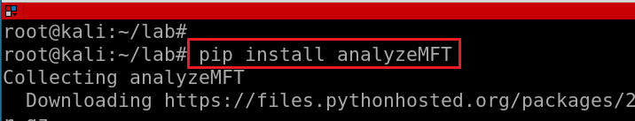
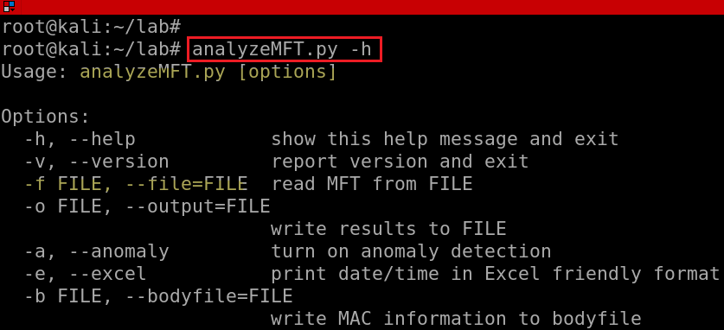
Install MFT analyze tool
Test MFT analyze tool
Notes:
pip install analyzeMFT

Slide 18
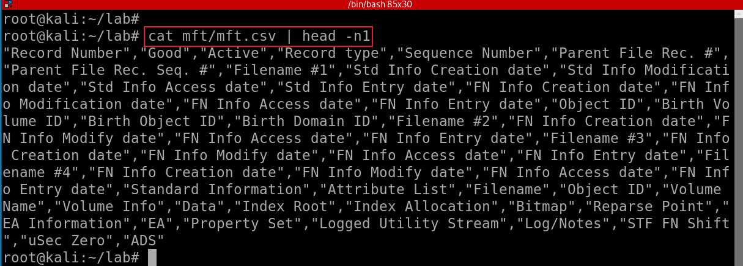
Convert $MFT to .csv
Show $MFT column names
Notes:
awk -e '$1 ~/informant.*\/Burn/ {print $1}' mft/mft.csv
"Record Number","Good","Active","Record type","Sequence Number","Parent File Rec. #","Parent File Rec. Seq. #","Filename #1","Std Info Creation date","Std Info Modification date","Std Info Access date","Std Info Entry date","FN Info Creation date","FN Info Modification date","FN Info Access date","FN Info Entry date","Object ID","Birth Volume ID","Birth Object ID","Birth Domain ID","Filename #2","FN Info Creation date","FN Info Modify date","FN Info Access date","FN Info Entry date","Filename #3","FN Info Creation date","FN Info Modify date","FN Info Access date","FN Info Entry date","Filename #4","FN Info Creation date","FN Info Modify date","FN Info Access date","FN Info Entry date","Standard Information","Attribute List","Filename","Object ID","Volume Name","Volume Info","Data","Index Root","Index Allocation","Bitmap","Reparse Point","EA Information","EA","Property Set","Logged Utility Stream","Log/Notes","STF FN Shift","uSec Zero","ADS"

Slide 19
awk '{split($0, a, “,“ ) }’
^^ ^ ^
| | |
string | fieldsep
|
array to store results
Show fields 1: Record # (Entry #), 4: record type, 6: Parent File #
Search for Burn folder
$MFT entry 21921, which indicate the folder …/Burn/Burn
8: Filename #1",“
11:Std Info Access date
Notes:
cat mft/mft.csv | head -n1 | awk '{split($0,a,","); print a[1],a[4],a[6]}‘
awk '/informant.*\/Burn/ {split($0,a,","); print a[1],a[4],a[6],a[8], a[11]}' mft/mft.csv

Slide 20
Offset|FileName|USN|Timestamp|Reason|MFTReference|MFTReferenceSeqNo|MFTParentReference|MFTParentReferenceSeqNo|FileAttributes|MajorVersion|MinorVersion|SourceInfo|SecurityId
Search for directories/files associated with entry ID /Burn/Burn 21921 in $UsnJrnl·$J
Notes:
grep -P "\|21921\|" UsnJrnl2Csv/UsnJrnl_2020-11-28_12-15-14.csv –color
https://docs.microsoft.com/en-us/windows/win32/api/winioctl/ns-winioctl-usn_record_v2?redirectedfrom=MSDN

Slide 21
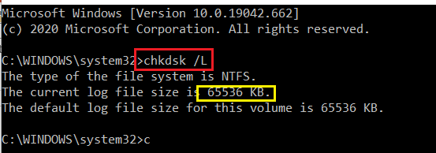
$LogFile: transaction log file of NTFS
Record all transactions of NTFS
OS recovers the status of file system in case of unexpected system shutdown due to power error or critical system failure
Each record has LSN($LogFile Sequence Number).
This LSN information increase sequentially.
64 MB in typical hard disk volume.
Can be resized
Hold 2 ~ 3 hours of activities in $LogFile records.
Notes:
http://forensicinsight.org/wp-content/uploads/2013/06/F-INSIGHT-NTFS-Log-TrackerEnglish.pdf

Slide 22
Transactions Records
A transaction operation is consist of multiple operation records sequentially
Check Point Record : the start record of transaction
Update Record : the middle records of transaction
Commit Record : the last record of transaction
LFS restart area
Logging Area
NTFS restart
Log File Records
…
LSN
100
LSN
101
LSN
102
LSN
103
LSN
104
…
LSN
117

Slide 23
The workflow when error recovery is executed (Undo)
Check Point Record
Update Record
Update Record
Update Record
Commit Record
LSN (102)
LSN(103)
LSN (104)
…
LSN (117)
Previous LSN
Previous LSN
Previous LSN
…
Previous LSN
Redo Data
Redo Data
Redo Data
…
Redo Data
Undo Data
Undo Data
Undo Data
…
Undo Data

Slide 24
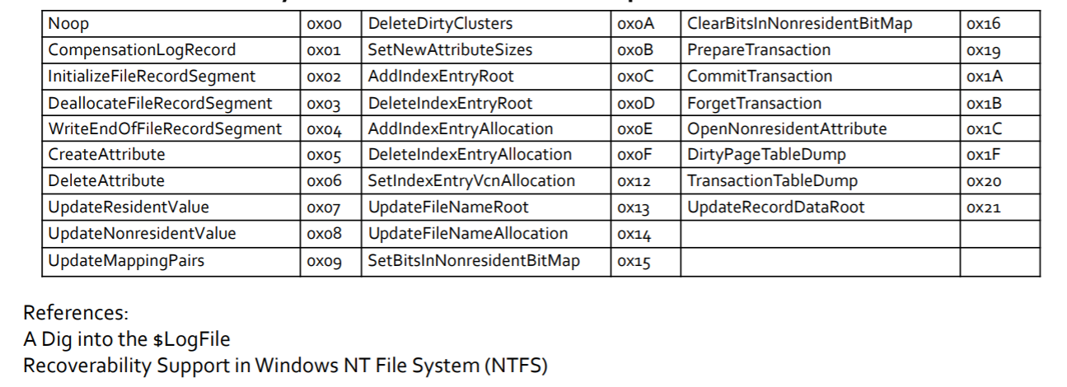
Redo/Undo Operation Code
Notes:
https://digital-forensics.sans.org/summit-archives/DFIR_Summit/File-System-Journaling-Forensics-Theory-Procedures-and-Analysis-Impacts-David-Cowen-with-Matthew-Seyer.pdf

Slide 25
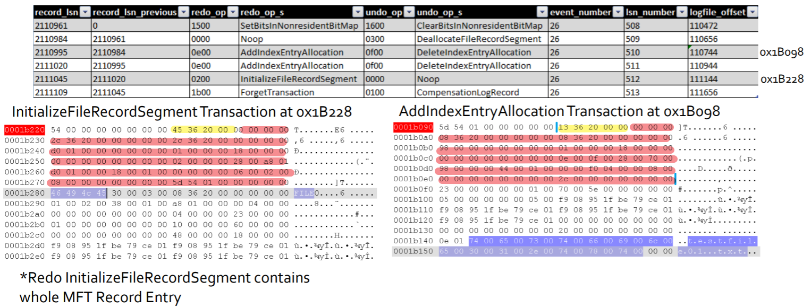
Creation testfile01.txt records
Credits: David Cowen, Matthew Seyer, G-C Partners, LLC /

Slide 26
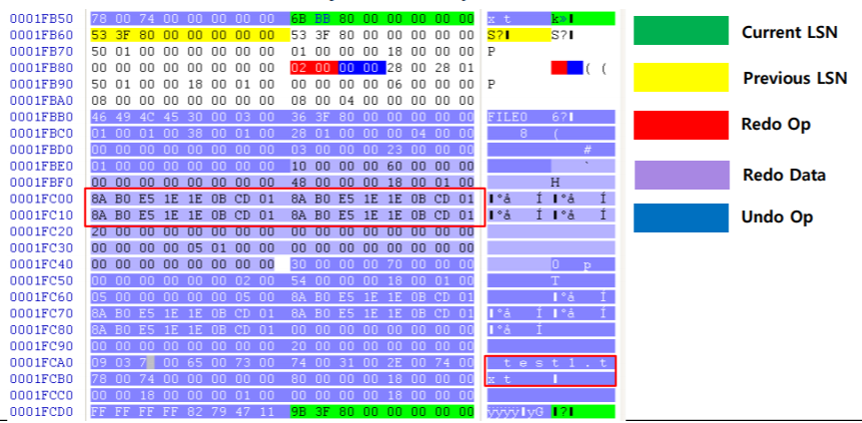
Initialize File (test1.txt) Record Segment
Notes:
http://forensicinsight.org/wp-content/uploads/2013/06/F-INSIGHT-NTFS-Log-TrackerEnglish.pdf

Slide 27
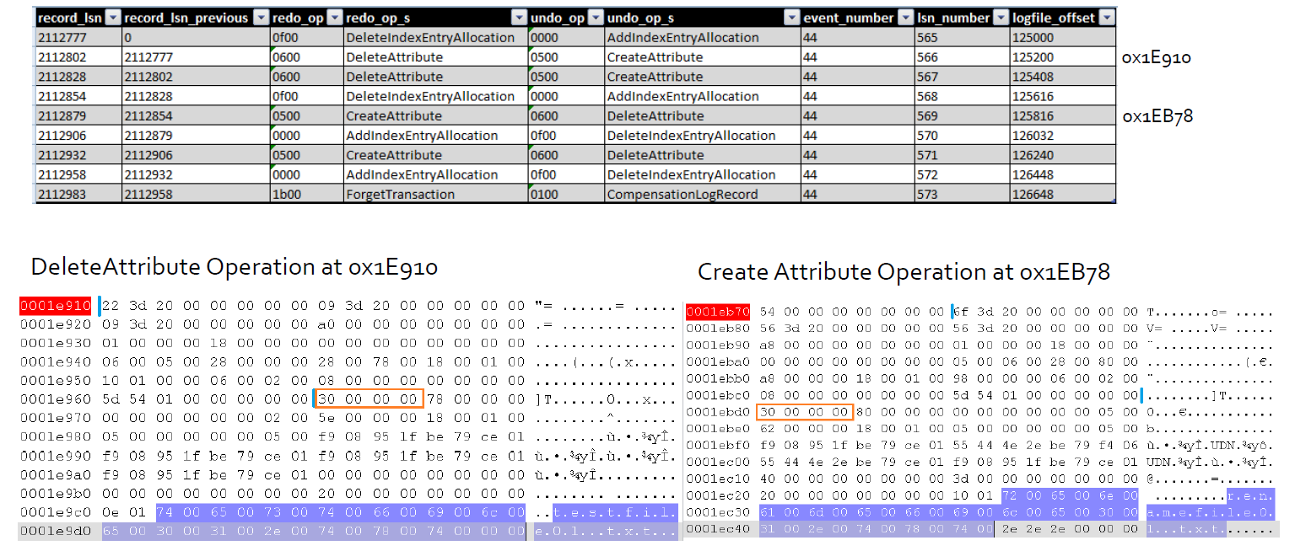
Rename testfile01.txt records

Slide 28
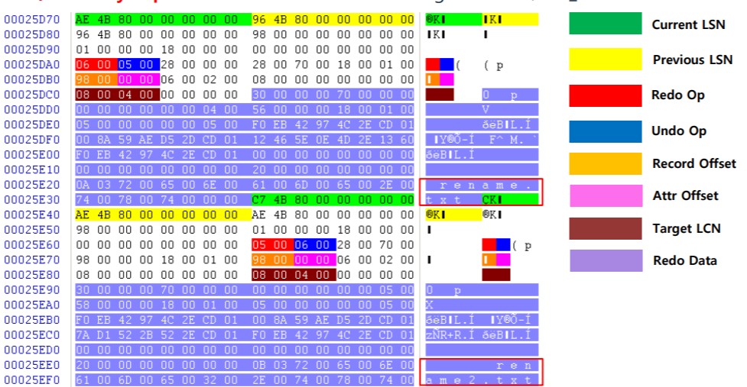
Delete Attribute(0x06) / Create Attribute(0x05)

Slide 29
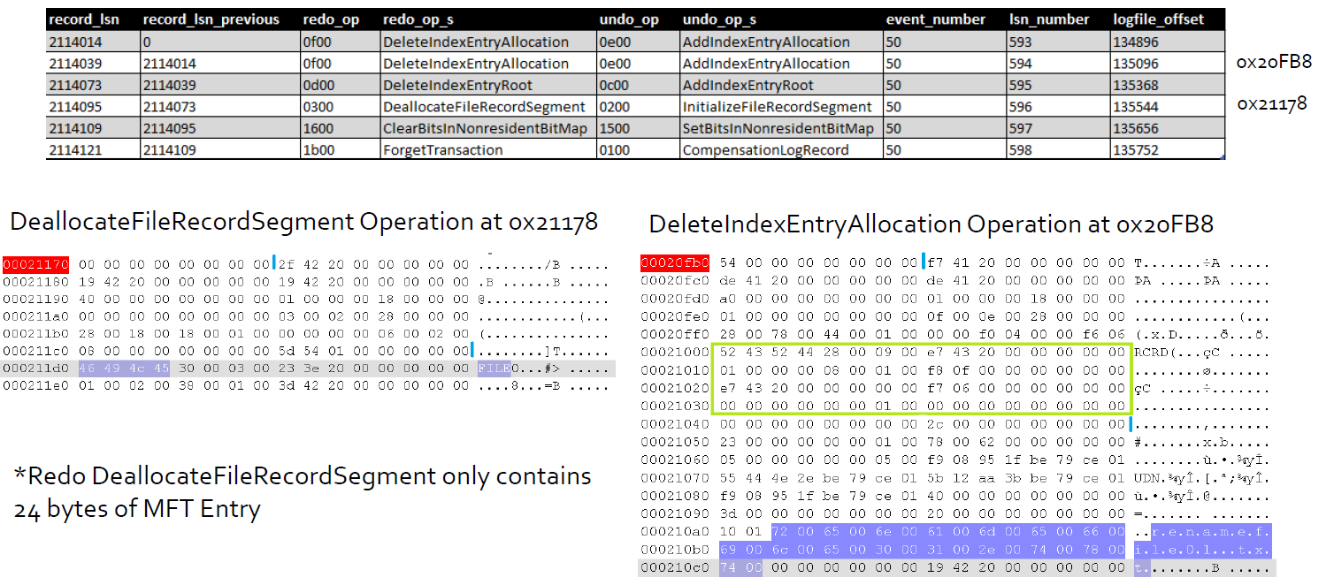
Delete testfile01.txt records

Slide 30
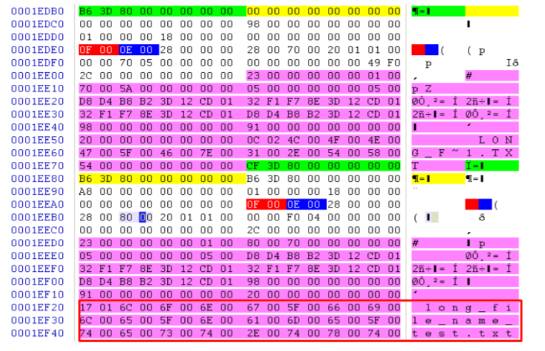
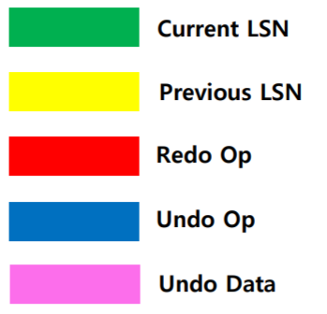
Delete Index Entry Allocation/Add Index Entry Allocation/

Slide 31
Analyze $LogFile
Install using LogFileParser
Extract $LogFile
Parse logfile.bin extracted from $Logfile

Slide 32
Install LogFileParser
Notes:
git clone https://github.com/jschicht/LogFileParser.git
wine LogFileParser/LogFileParser.exe -h

Slide 33
Extract $LogFile

Slide 34
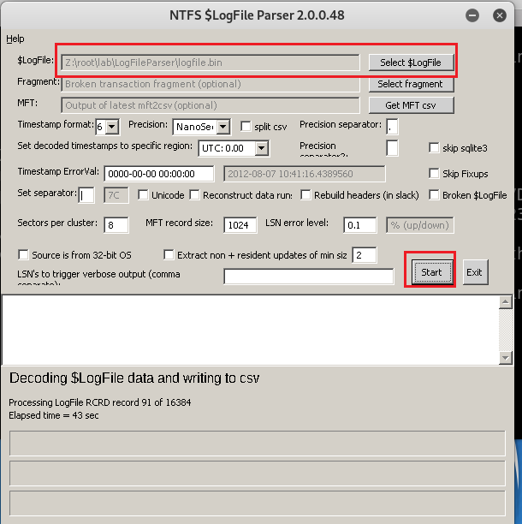
Parse logfile.bin extracted from $Logfile
Take over one hour

Slide 35
35. What files were opened from CD-R?
The mounted CD device is D:\
rip.pl –r SYSTEM –o mountdev
Recently opened file accessed using .lnk
\User\informant\AppData\Roaming\Microsoft\Windows\Recent\*.lnk
Jumplist
\User\informant\AppData\Roaming\Microsoft\Windows\Recent\AutomaticDestinations

Slide 36
Recently accessed .lnk
List all recently accessed .lnk

Slide 37
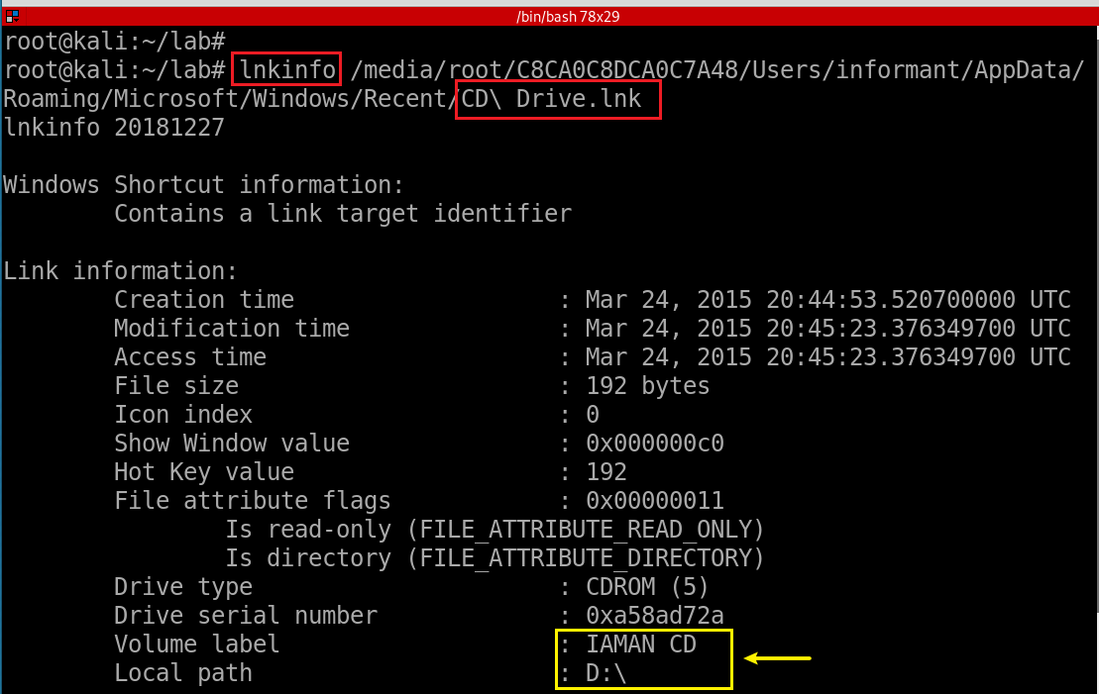
Check one of .lnk

Slide 38
Search for changed files with D:\
Need to repeat for each .lnk in the folder

Slide 39
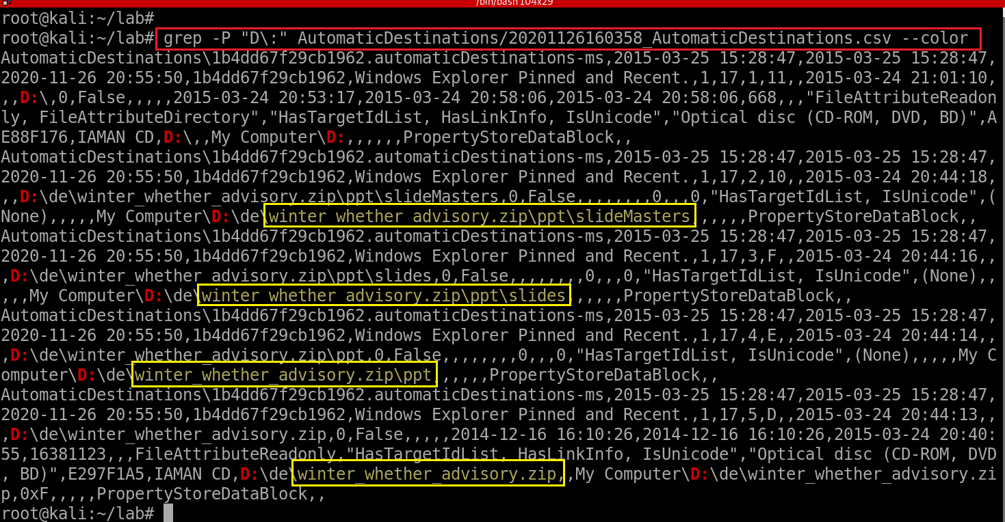
Jumplist
Notes:
grep -P "D\:" AutomaticDestinations/20201126160358_AutomaticDestinations.csv --color

