Slide 1
Rhino Hunting – Illegal Possession Investigation
Traffic Log Analysis: HTTP
Notes:
https://www.youtube.com/watch?v=6G3qm60dfA8&ab_channel=PrashantThombre

Slide 2
What is HTTP?
HTTP stands for hypertext transfer protocol and is used to transfer data across the Web
Request
Response

Slide 3
Plan of Investigation
rhino2.log
Investigating http traffics contain .jpg
Investigating http traffics contain .jif
Investigating email traffics
rhino3.log
Investigating http traffics contain .exe

Slide 4
Investigate rhino2.log
HTTP traffic forensics

Slide 5
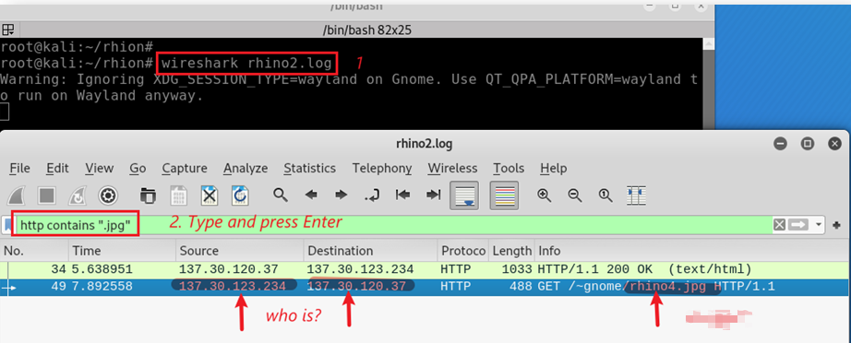
Any activities of uploading or downloading images (.jpg) using HTTP?
Search suspect’s http requests to download .jpg
GET is used to request data from a specified resource.

Slide 6
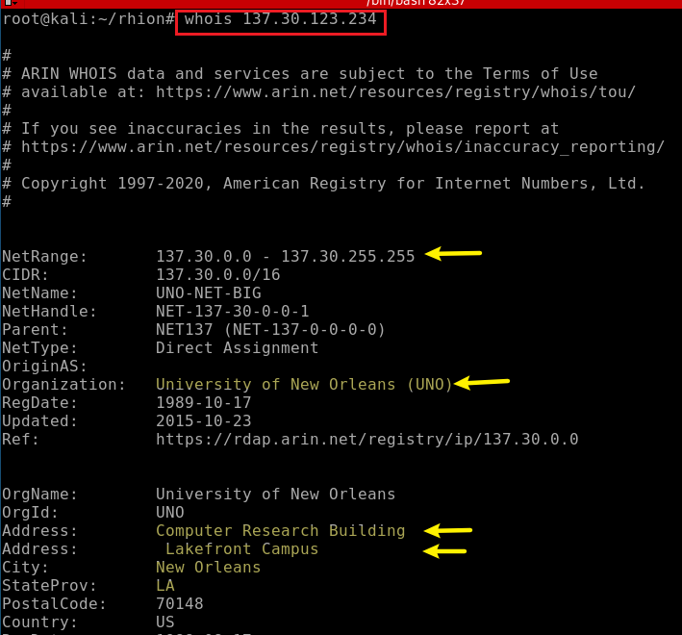
Find who owns the IP

Slide 7
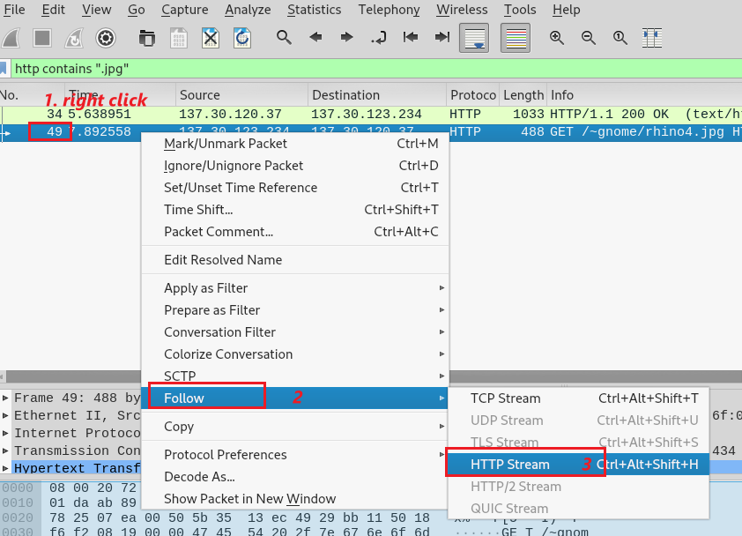
Follow rhino4.jpg HTTP traffic
Notes:
49 2004-04-28 21:08:38.073111 137.30.123.234 137.30.120.37 HTTP 488 GET /~gnome/rhino4.jpg HTTP/1.1

Slide 8
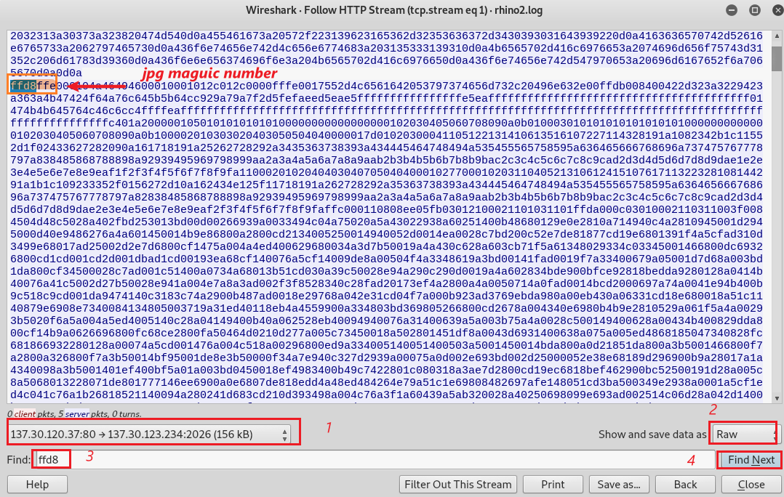
Find the rhino4.jpg magic number
Only care the packets from the server to the suspect’s machine

Slide 9
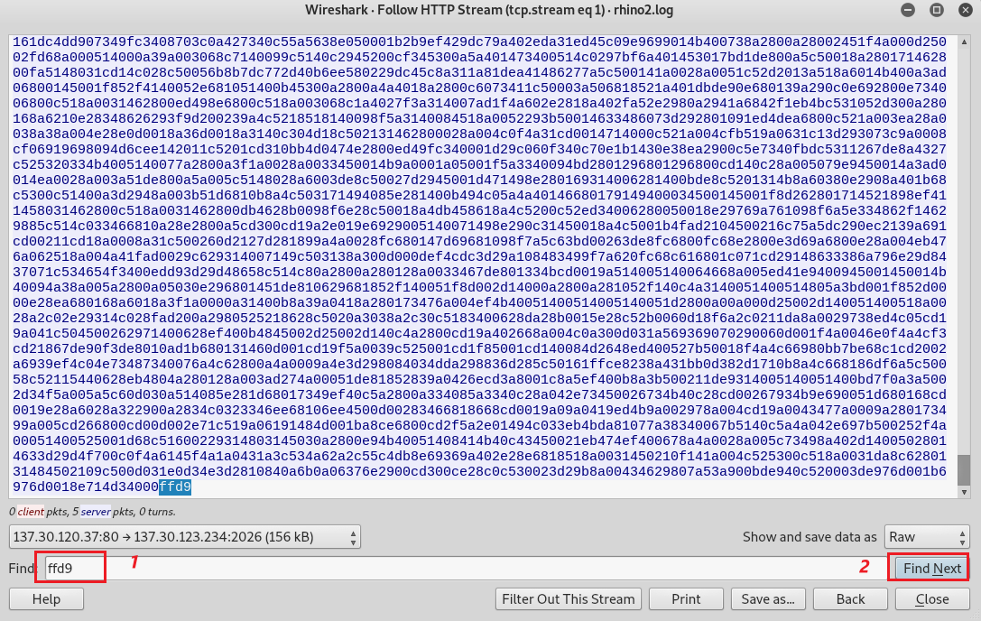
Find the end of the rhino4.jpg
End of the image

Slide 10
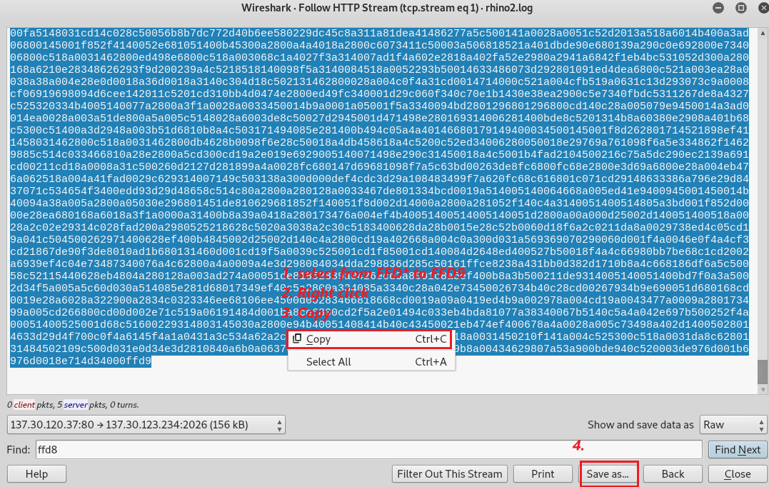
Copy the raw data of rhino4.jpg
How to select: (1) shift + click the beginning of ffd8 (2) shift + click the end of ffd9

Slide 11
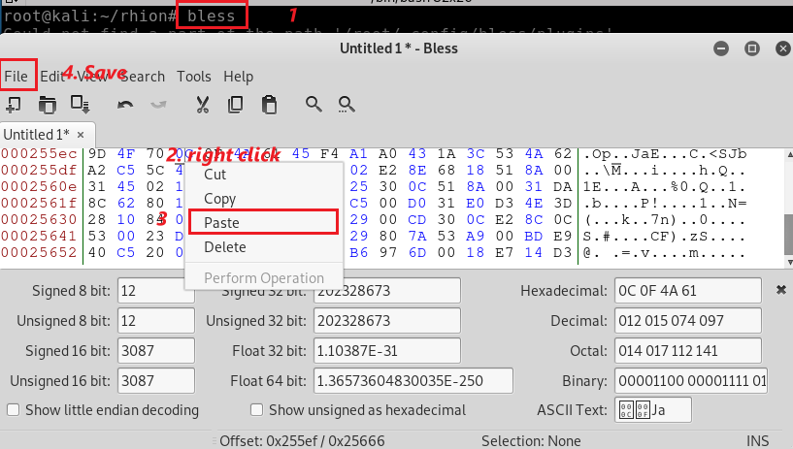
Paste to a Hex Editor

Slide 12
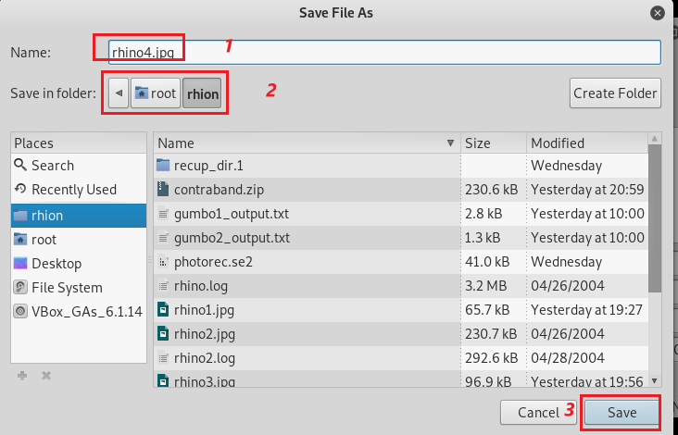
Save it as rhino4.jpg

Slide 13
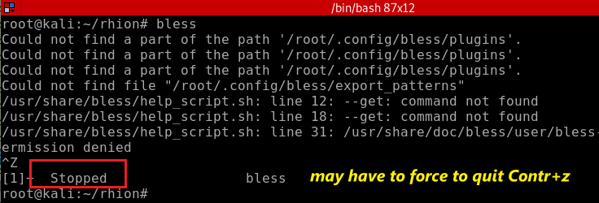
You may have to stop the Hex Editor

Slide 14
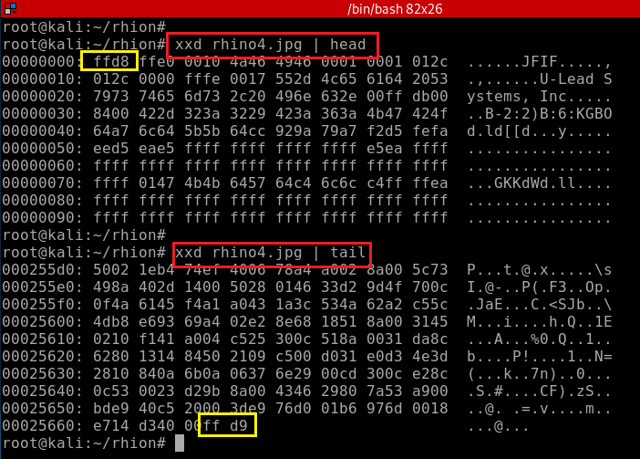
Verify rhino4.jpg magic number
Verify rhino4.jpg trailor

Slide 15
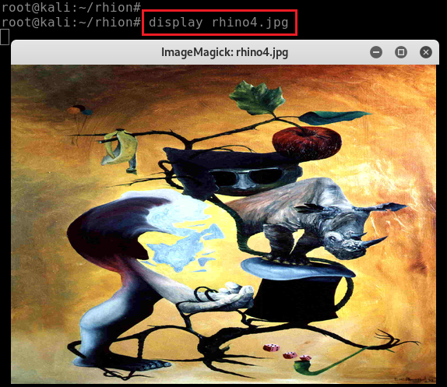
Display rhino4.jpg
7
aa64102afff71b93ed61fb100af8d52a

Slide 16
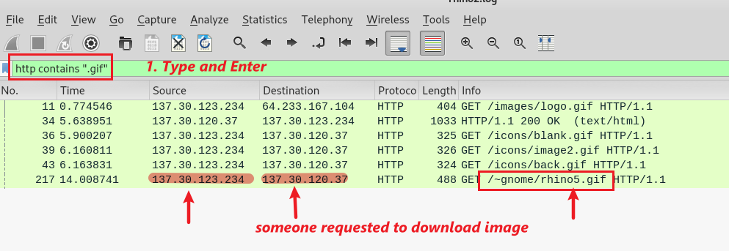
Any activities of uploading or downloading images (.gif) using HTTP?
Search .gif HTTP traffic
Note we have 5 .gif. Let’s double click rhino5.gif
Notes:
217 2004-04-28 21:08:44.189294 137.30.123.234 137.30.120.37 HTTP 488 GET /~gnome/rhino5.gif HTTP/1.1

Slide 17
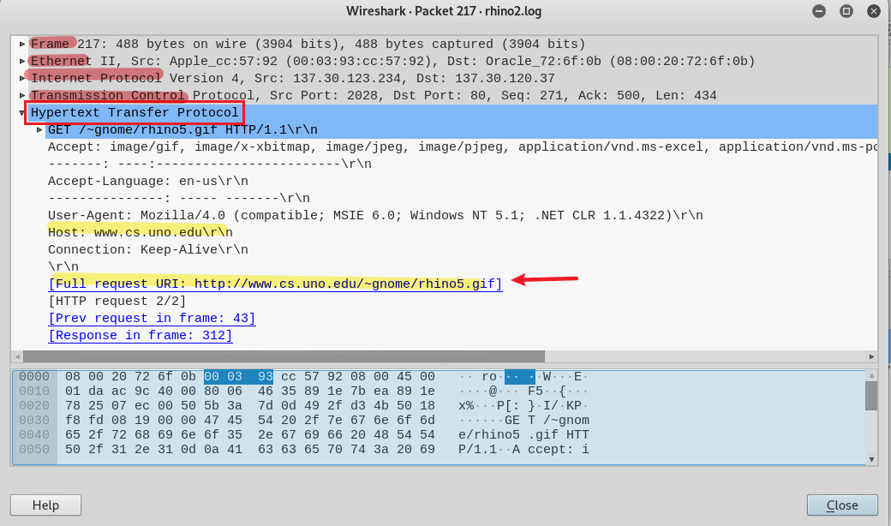
Rhino5.gif is hoted by cs.uno.edu

Slide 18
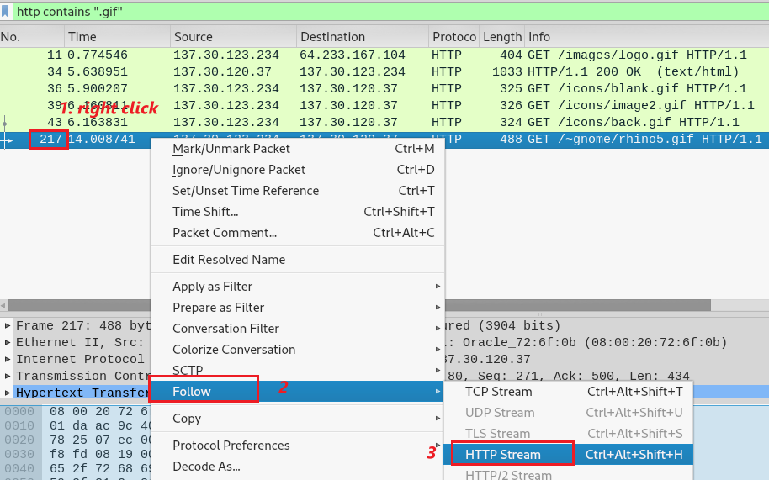
Follow HTTP traffic of rhino5.gif

Slide 19
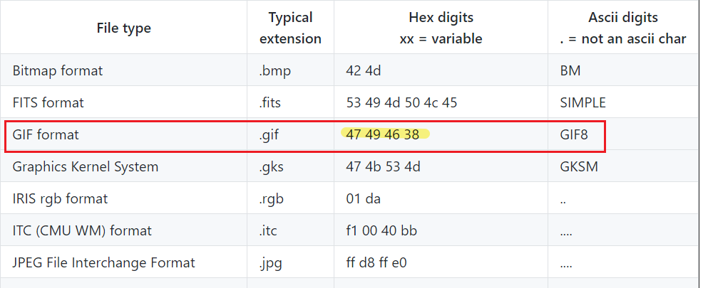
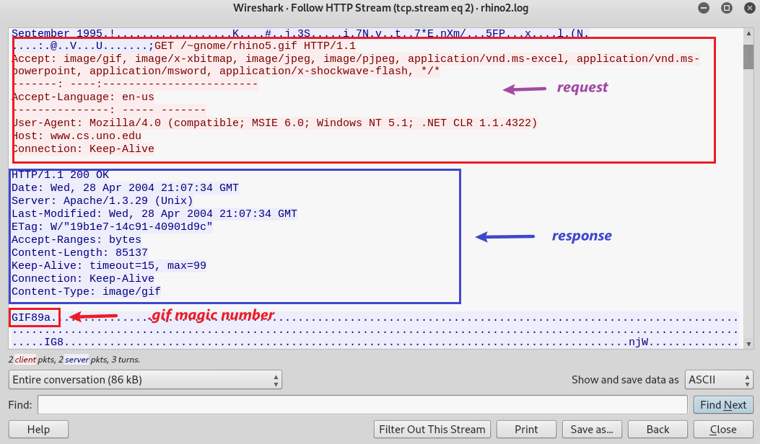
Find the packet contains rhino5.gif
You can click the magic number, which leads you to the packet. You can exit now

Slide 20
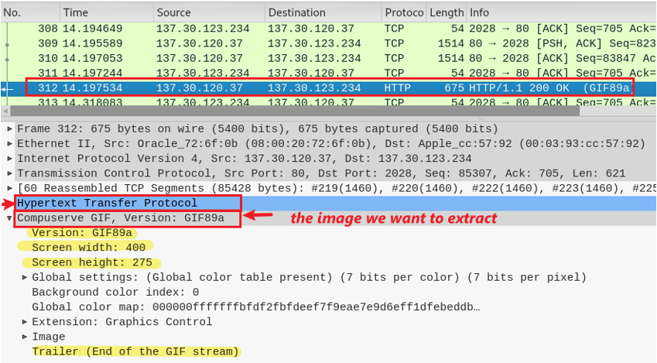
312 is the packet contains rhino5.gif
Click to show how HTTP transfers images
GIF property

Slide 21
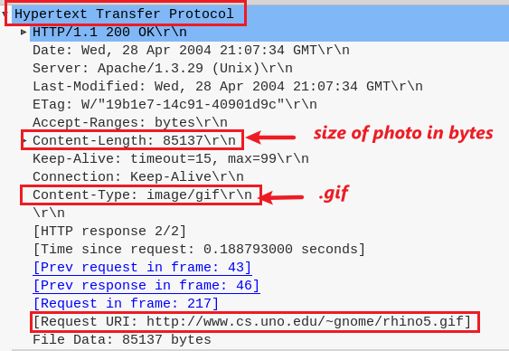
Details of how HTTP transfers images

Slide 22
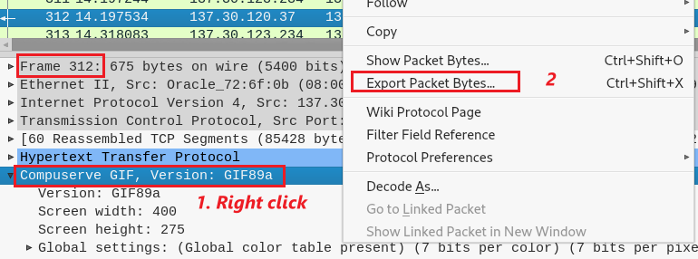
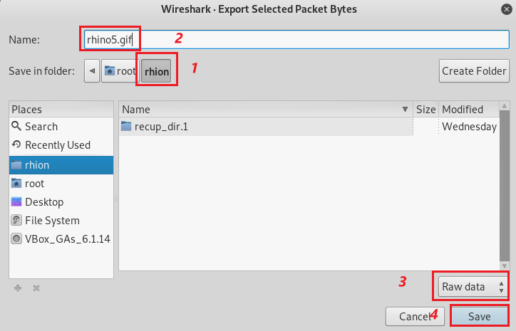
Export traffic packet to a file
Save the file as rhino5.gif

Slide 23
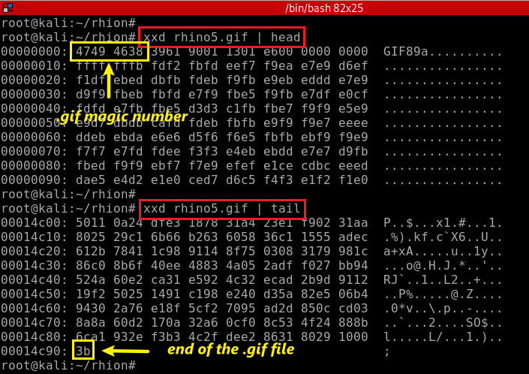
Verify the magic number of rhino5.gif
Verify the trailer of rhino5.gif

Slide 24
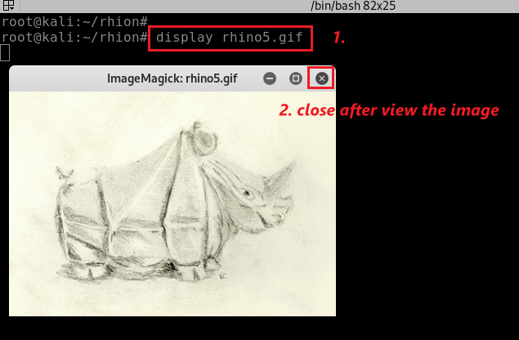
Display rhino5.gif
8
md5: 1e90b7f70b2ecb605898524a88269029

Slide 25
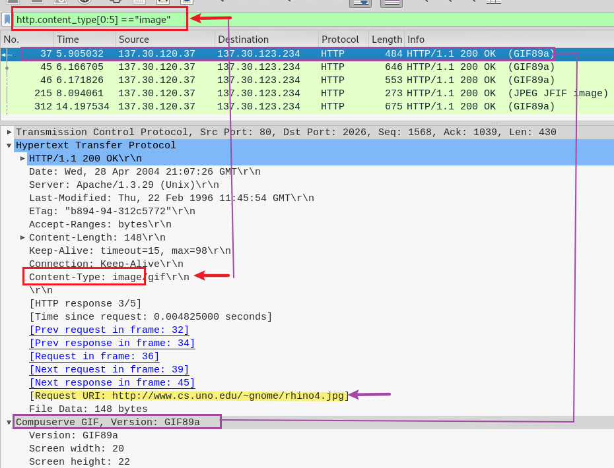
Any photos in http?
Show all http with content-type="image/(gif|jpeg|png|etc)"
5 http packets. Are there 5 photos?

Slide 26
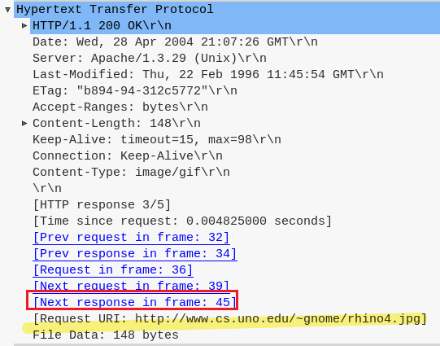
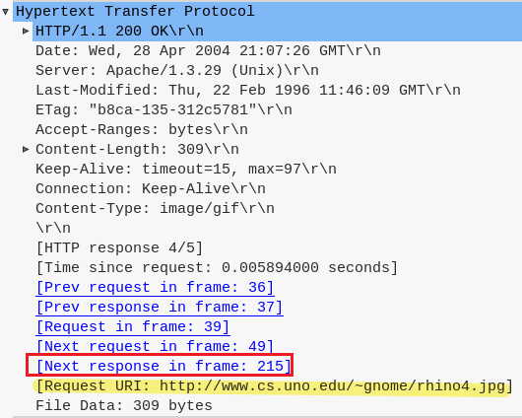
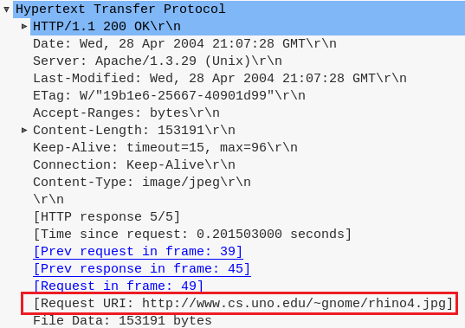

Slide 27
Investigate Email traffics
Email protocol is a standard method for exchanging information between
email clients like Thunderbird, Apple Mail, or Mailbird and
email provider’s servers like Gmail, Outlook, Yahoo, and vice versa.
SMTP
SMTP
IMAP
SMTP (Simple Mail Transfer Protocol): sending emails
IMAP (Internet Access Message Protocol): download emails

Slide 28
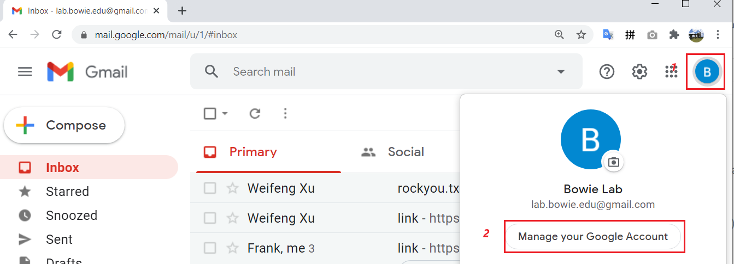

Slide 29
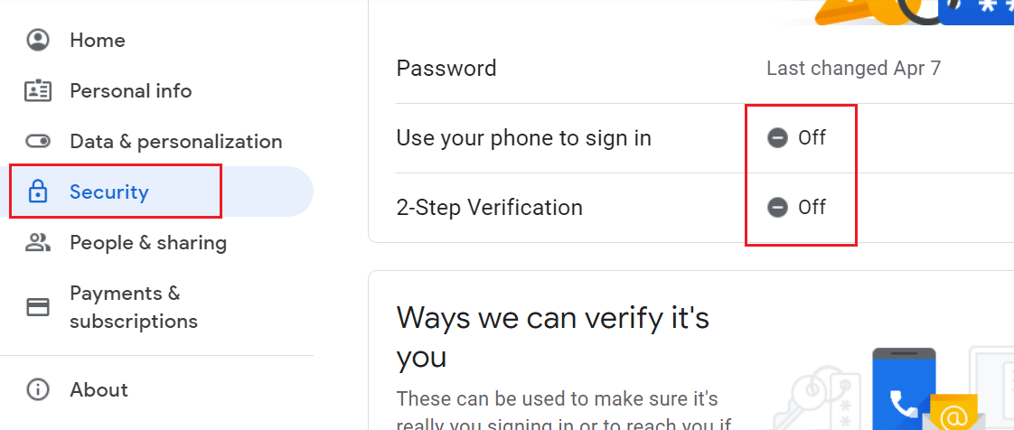

Slide 30
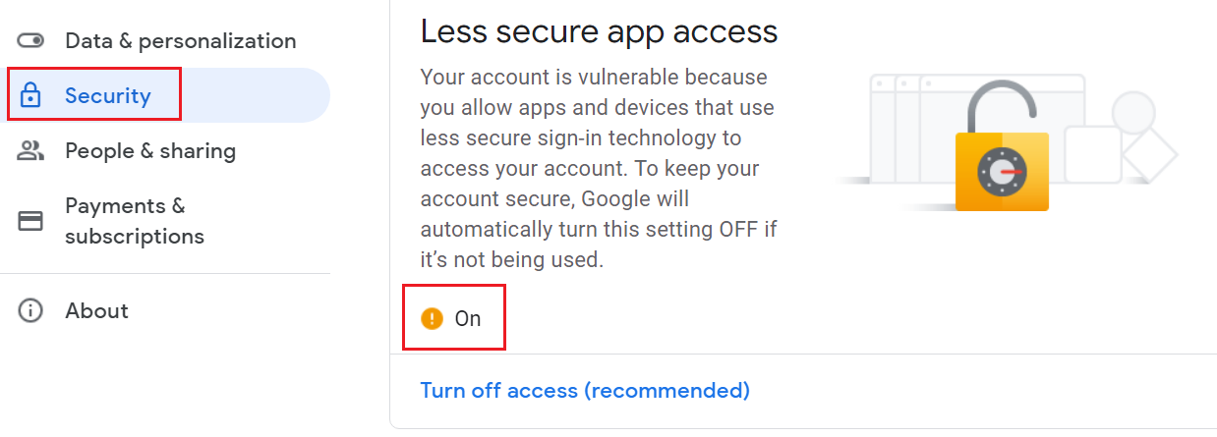

Slide 31
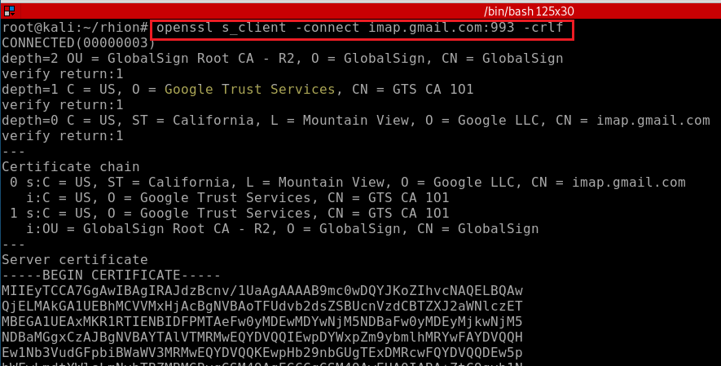

Slide 32
<tag> <command> [<arg1><arg2>…]

Slide 36
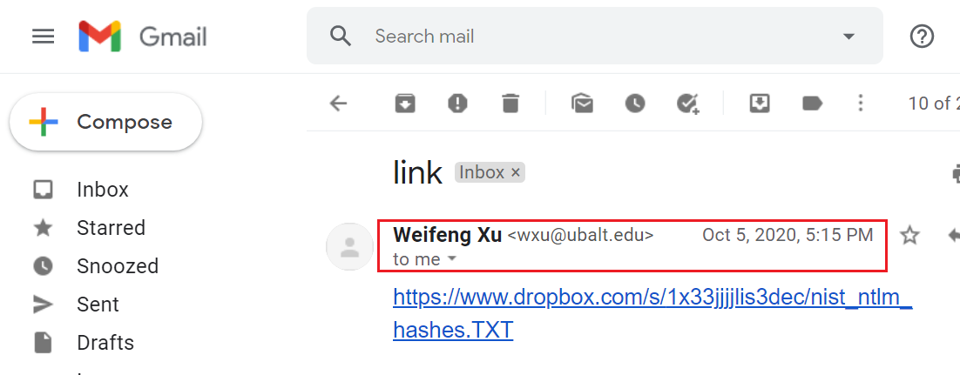
Notes:
https://www.atmail.com/blog/imap-commands/

Slide 37
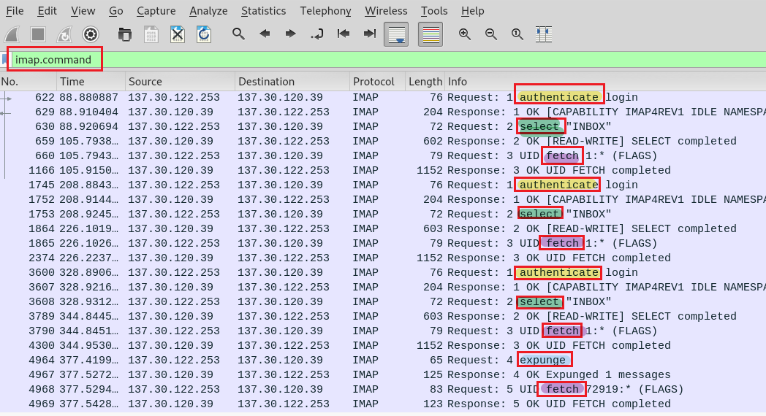
Notes:
https://www.nylas.com/blog/nylas-imap-therefore-i-am/

Slide 38
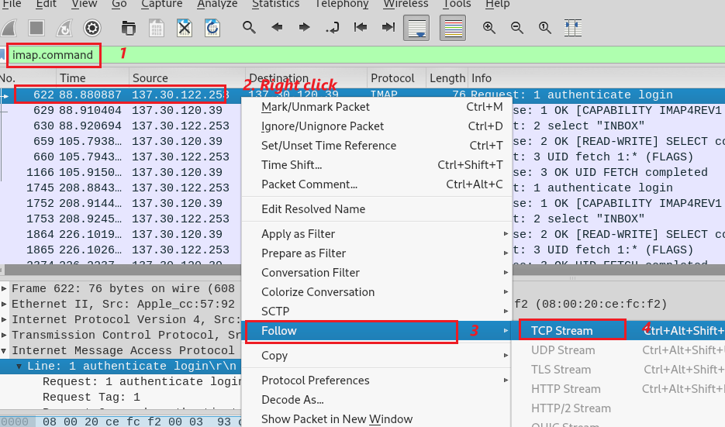

Slide 39
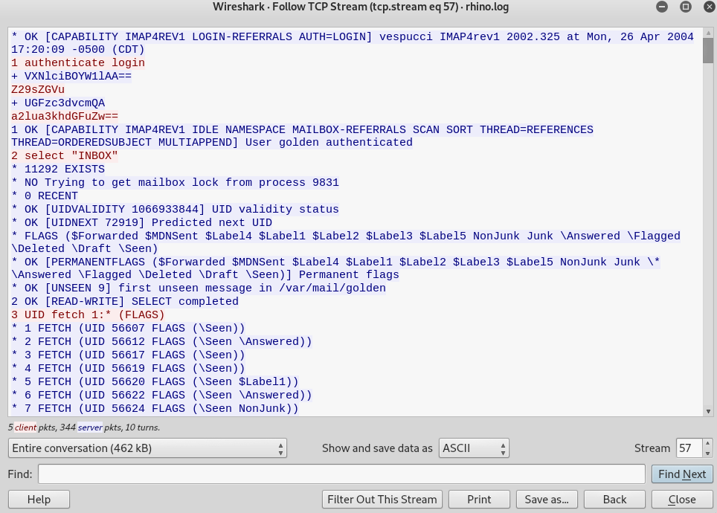
User name
golden (base 64 => ASCII)
Password
kinky!tang (base 64 => ASCII)
Nothing found!

Slide 40
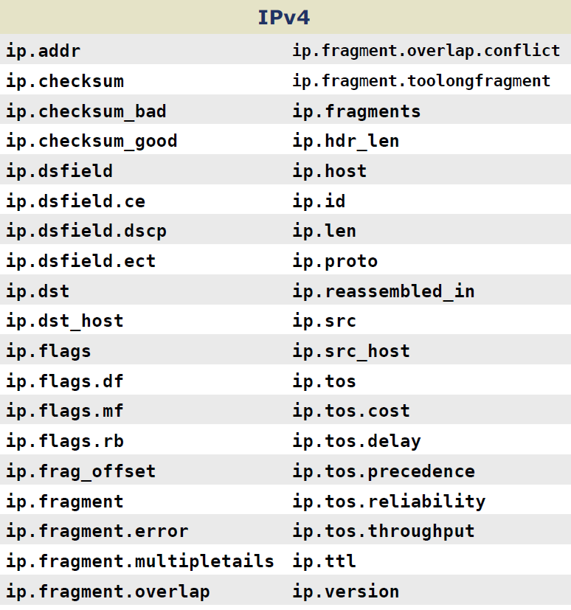
Notes:
https://packetlife.net/media/library/13/Wireshark_Display_Filters.pdf

Slide 41
Investigate rhino3.log

Slide 42
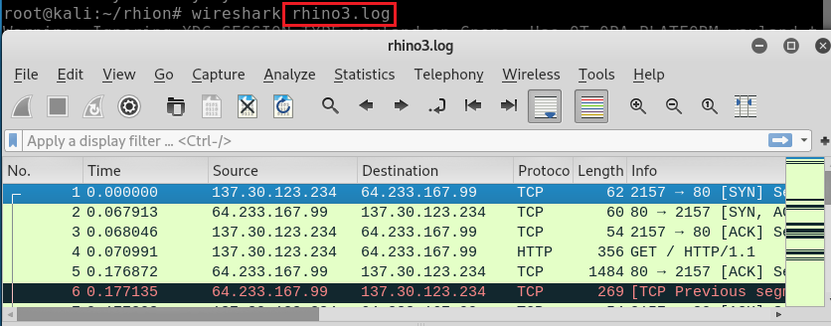
Open rhino3.log

Slide 43
Search for http traffic with .exe

Slide 44
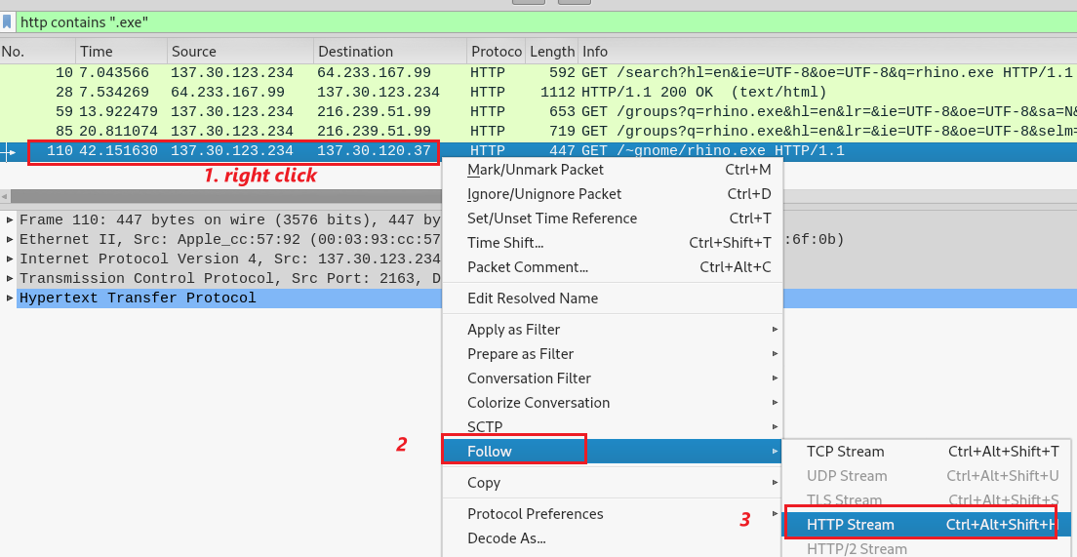
Follow HTTP stream of .exe

Slide 45
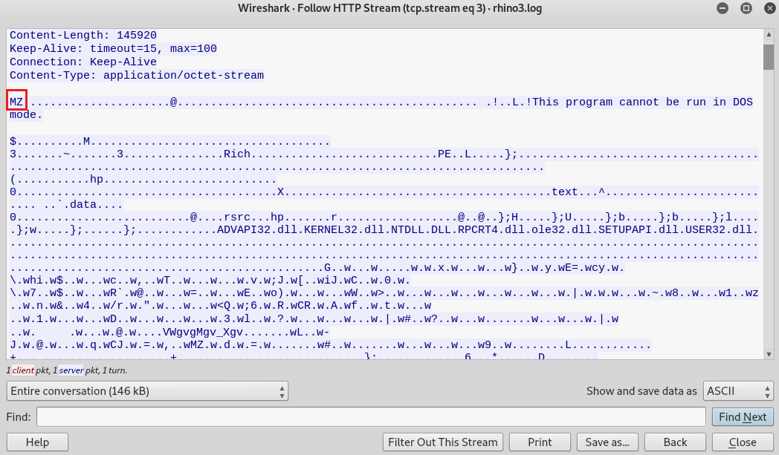
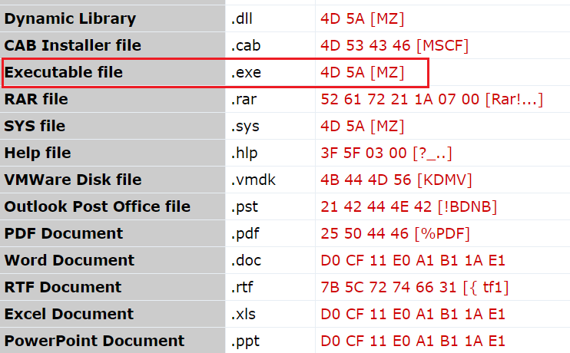
What are we looking for? Click magic number to the .exe packets

Slide 46
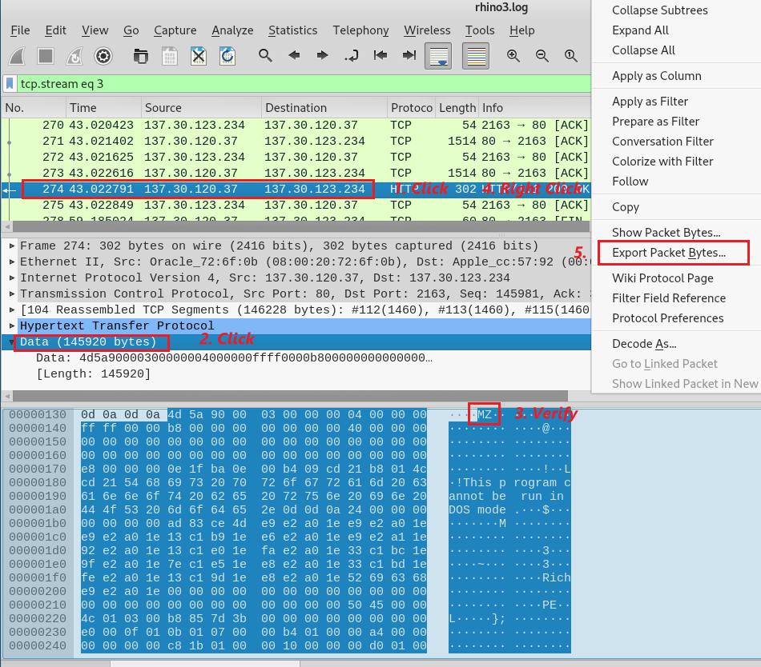
Find packets contain .exe
Verify the magic number
Export packet byte

Slide 47
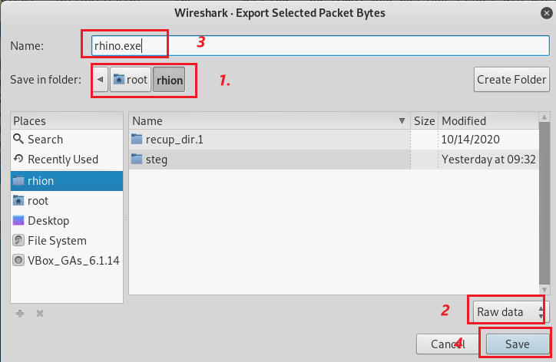
Save these traffic packets contains .exe to rhino.exe

Slide 48
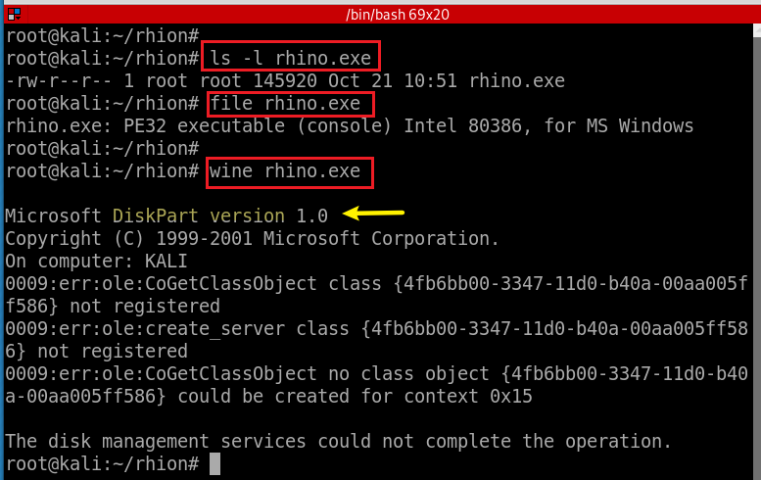
Find rhino.exe information
Execute rhino.exe

Slide 49
Calculate rhino.exe md5 hash
Search the md5 hash online
Notes:
d62d9989535c4c8db14e50b58c9f25a0

