Slide 1
Pixel3 Device Investigations
Hardware, Accounts, Mac address, Wi-Fi

Slide 2
Overview
Device information
Account information

Slide 3
Pixel 3 Device Information

Slide 4
Overview
Description | Path
Build properties | Pixel 3/product/build.prop
 | Pixel 3/system/build.prop
Carrier config | Pixel 3/data/user_de/0/com.android.providers.telephony/
Device serial number | Pixel 3/mnt/vendor
Bluetooth | Pixel 3/data/system/users/0/settings_secure.xml
Wifi | Pixel 3/data/misc/wifi/WifiConfigStore.xml

Slide 5
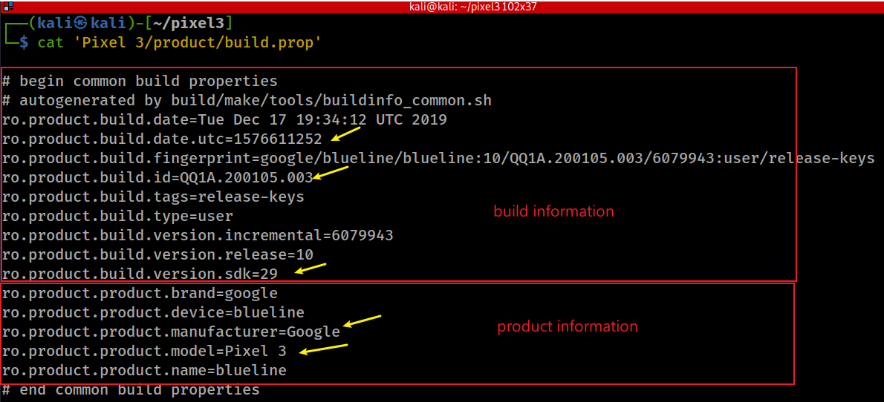
What is the product (phone) information?
build.prop
A system file that exists on every Android device.
The file contains build information and other system properties which are used throughout the operating system.
When the current ROM was compiled
software development kit: Version of the SDK used for android version
Device's codename
Notes:
cat 'Pixel 3/product/build.prop'
https://forum.xda-developers.com/t/explanation-of-build-prop-values.3069341/

Slide 6
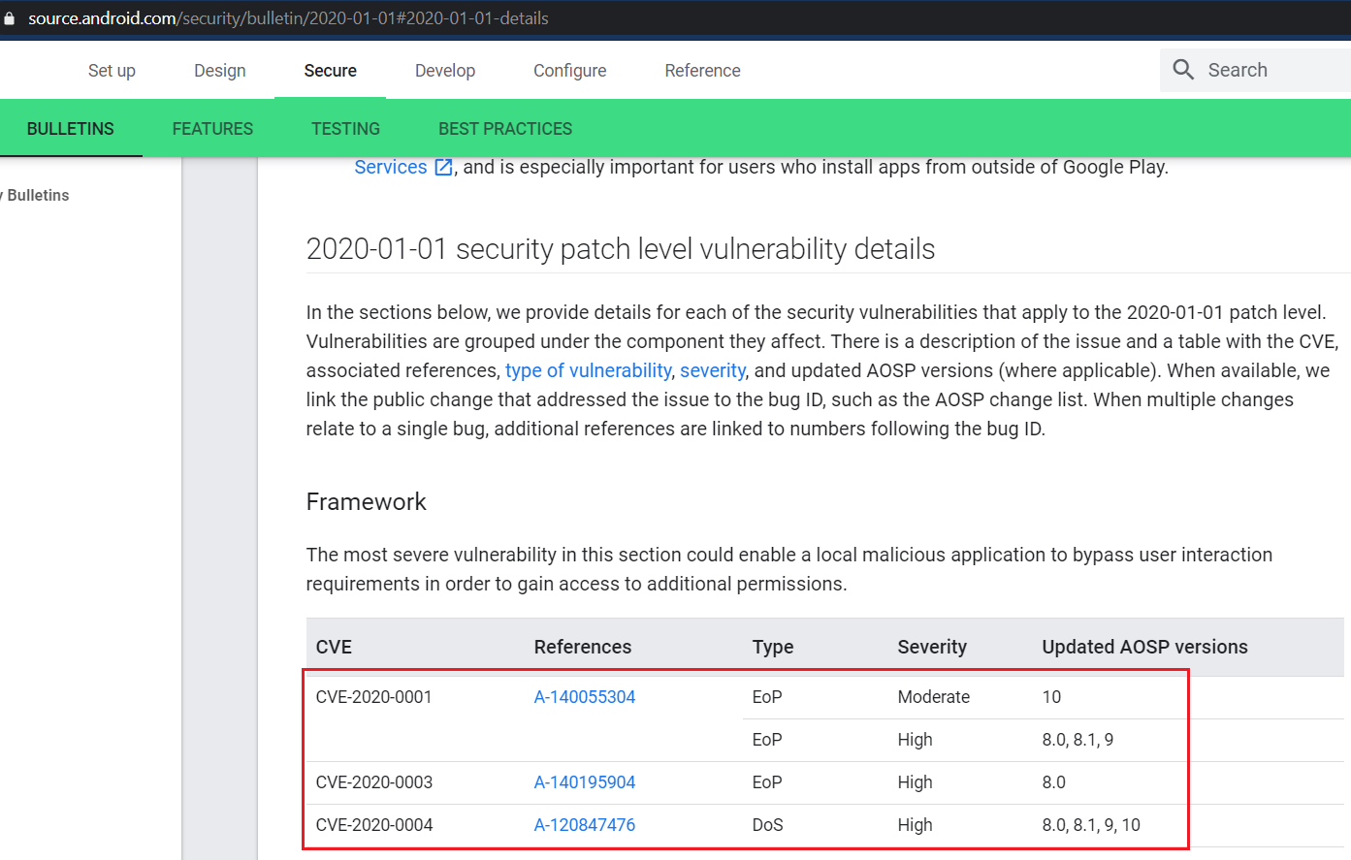
What is the latest security patch?
https://source.android.com/security/bulletin/2020-01-01#2020-01-01-details
Notes:
grep patch 'Pixel 3/system/build.prop'

Slide 7
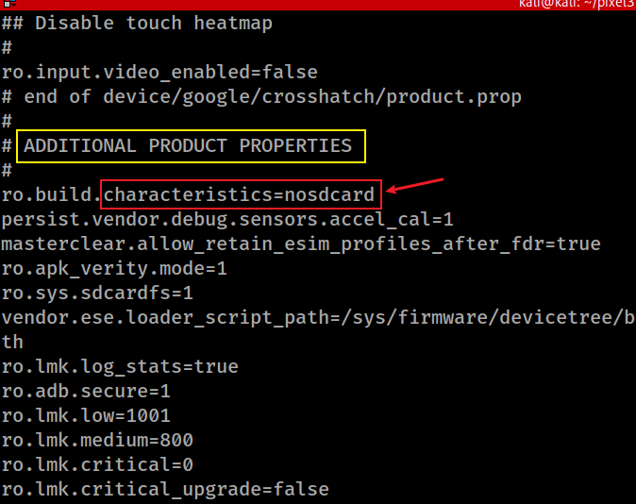
Does the Pixel have a SD card?

Slide 8
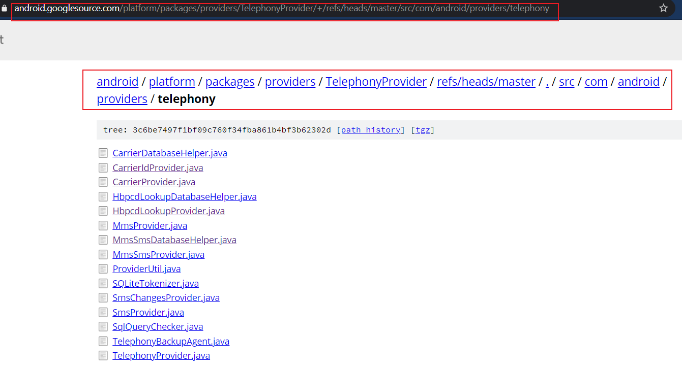
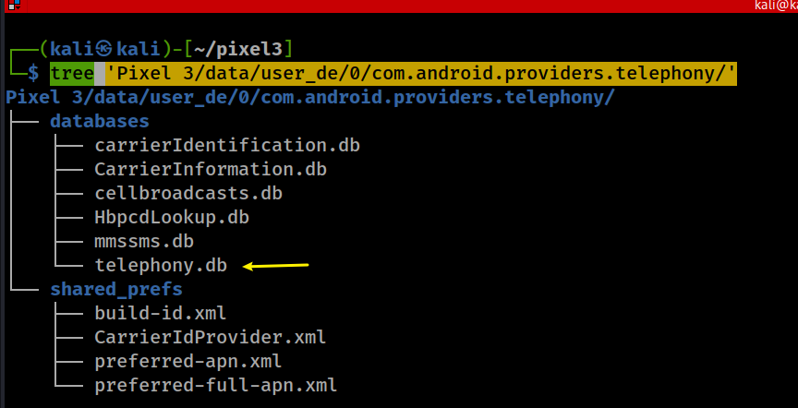
What is the mobile carrier/phone#?
Exam all files under com.android.providers.telephony folder
naming convention
all carrierIDs worldwide
QQ1A.200105.003
Notes:
tree 'Pixel 3/data/user_de/0/com.android.providers.telephony/’
https://android.googlesource.com/platform/packages/providers/TelephonyProvider/+/refs/heads/master/src/com/android/providers/telephony

Slide 9
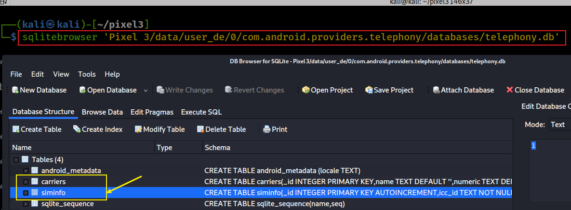
List tables on telephony.db
Notes:
sqlitebrowser 'Pixel 3/data/user_de/0/com.android.providers.telephony/databases/telephony.db'

Slide 10
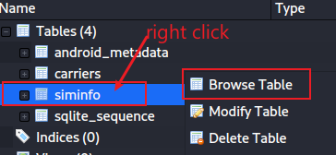
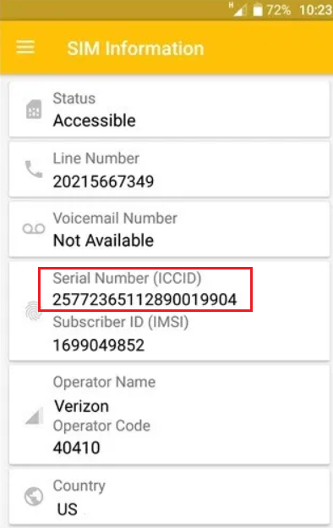
ICCID (Integrated Circuit Card Identifier) is a unique SIM card serial number.
A full ICCID number is 19 or 20 characters.
The number is printed on the back of your SIM (sometimes there in only the last 13 digits of ICCID)
you can also find it in your phone's settings. Read More about ICCID.
Based on ICCID number you can check your SIM Country and International phone code.
https://www.imei.info/iccid
mobile country code (MCC) and mobile network code (MNC) are used to find network providers
https://en.wikipedia.org/wiki/Mobile_Network_Codes_in_ITU_region_3xx_(North_America)#United_States_of_America_%E2%80%93_US
Notes:
8901260971148676693 6513381146
89011203004056803842 +19195794674

Slide 11
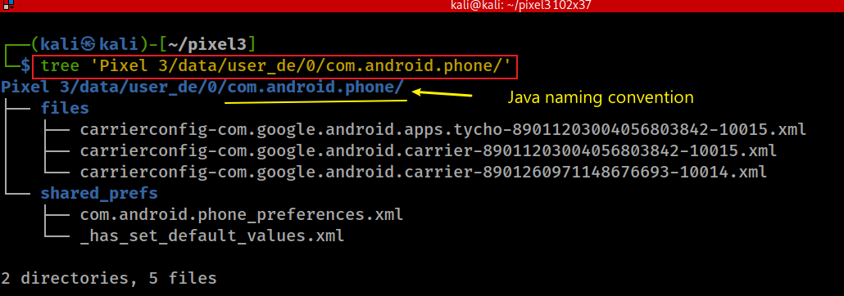
Check carrierconfig information to verify the carriers
Notes:
tree 'Pixel 3/data/user_de/0/com.android.phone/'

Slide 12
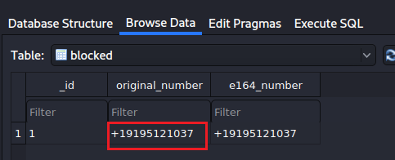
What is blocked phone number?
Show blockednumber
Notes:
ls 'Pixel 3/data/user_de/0/com.android.providers.blockednumber/databases/’
sqlitebrowser 'Pixel 3/data/user_de/0/com.android.providers.blockednumber/databases/blockednumbers.db'

Slide 13
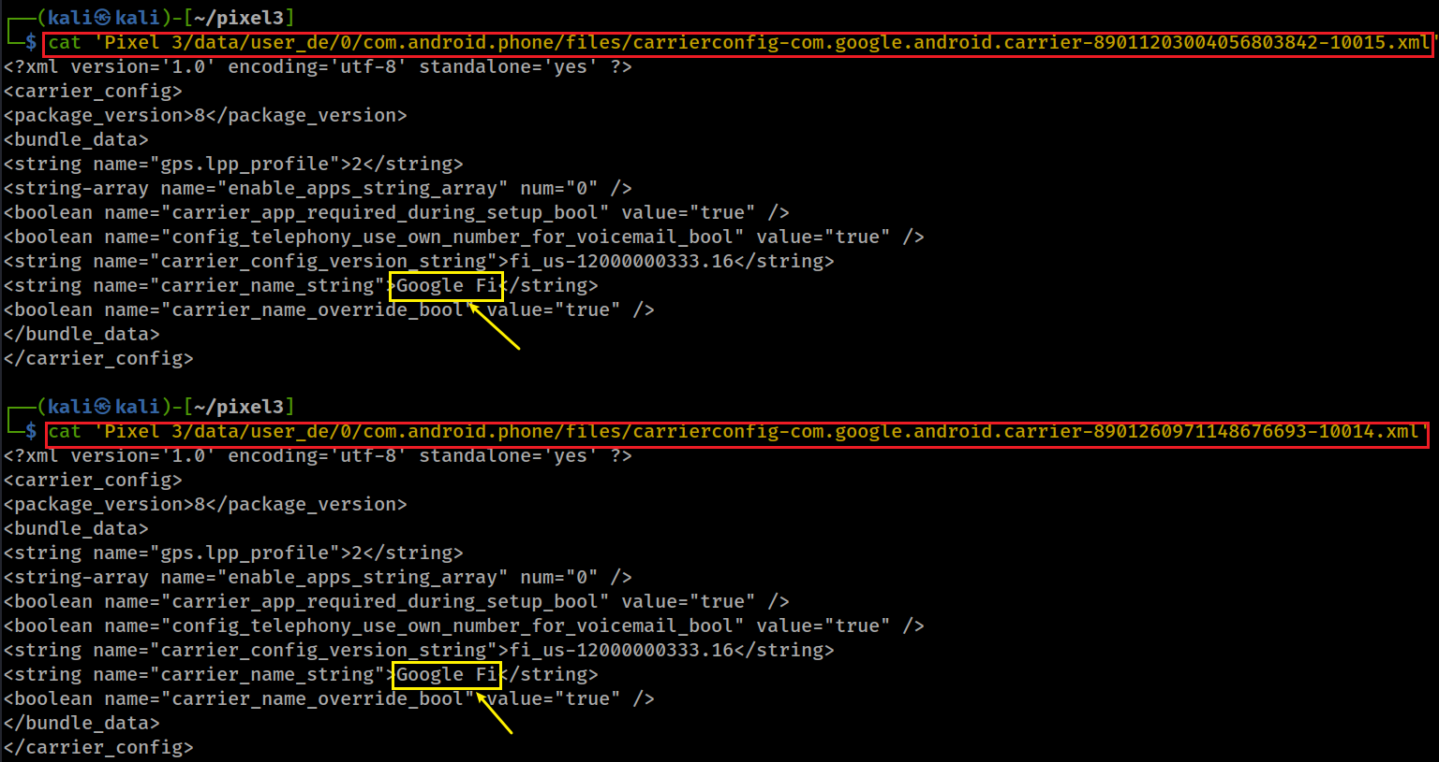
ICCID id
ICCID id
Notes:
cat 'Pixel 3/data/user_de/0/com.android.phone/files/carrierconfig-com.google.android.carrier-89011203004056803842-10015.xml’
cat 'Pixel 3/data/user_de/0/com.android.phone/files/carrierconfig-com.google.android.carrier-8901260971148676693-10014.xml'

Slide 14
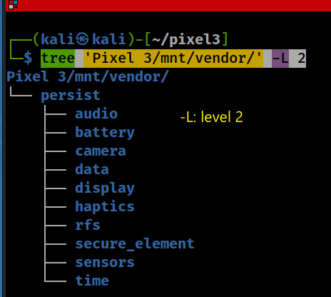
What is serial number of the device?
Hardware configurations may contain the serial number of the device
e.g., camera, audio devices configs
Find vendor specific configurations associated with hardware devices
Where are these configuration files?

Slide 15
Search key word “serial number” under the /vendor folder

Slide 16
What is Bluetooth Mac address?
Notes:
grep -i 'bluetooth' 'Pixel 3/data/system/users/0/settings_secure.xml'
7C:D9:5C:AC:A2:CE

Slide 17
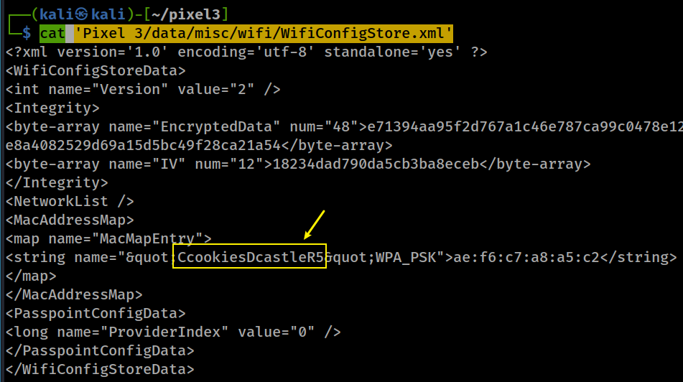
What is Wi-Fi Service Set Identifier (SSID)? (WifiConfigStore.xml)
randomized MAC address of SSID
MAC address randomization is the increasing trend of device operating systems using a random, anonymous device identifier instead of the real address when connecting to wireless networks.
Notes:
cat 'Pixel 3/data/misc/wifi/WifiConfigStore.xml’
<?xml version='1.0' encoding='utf-8' standalone='yes' ?>
<WifiConfigStoreData>
<int name="Version" value="2" />
<Integrity>
<byte-array name="EncryptedData" num="48">e71394aa95f2d767a1c46e787ca99c0478e12467241553a8551005969fd38294e8a4082529d69a15d5bc49f28ca21a54</byte-array>
<byte-array name="IV" num="12">18234dad790da5cb3ba8eceb</byte-array>
</Integrity>
<NetworkList />
<MacAddressMap>
<map name="MacMapEntry">
<string name="&quot;CcookiesDcastleR5&quot;WPA_PSK">ae:f6:c7:a8:a5:c2</string>
</map>
</MacAddressMap>
<PasspointConfigData>
<long name="ProviderIndex" value="0" />
</PasspointConfigData>
</WifiConfigStoreData>

Slide 18
For old version/other brand of Android
/data/misc/wifi/wpa_supplicant.conf (possible)
Example NOT from Pixel 3
# more wpa_supplicant.conf
ctrl_interface=eth0
update_config=1
network={
ssid="SomeWifiNetwork"
psk="MyPlaintextPassword"
key_mgmt=WPA-PSK
priority=1
}
#
Notes:
find 'Pixel 3' -iname 'wpa*’
cat 'Pixel 3/vendor/etc/wifi/wpa_supplicant.conf'

Slide 19
Account information

Slide 20
Overview
Users‘ ID, owner | Pixel 3/data/system/users/userlist.xml
User name, | Pixel 3/data/system/users/0.xml Pixel 3/data/system/users/1.xml
Gmail account | Pixel 3/data/data/com.google.android.gm/shared_prefs/Gmail.xml Pixel 3/data/data/com.google.android.gm/shared_prefs/UnifiedEmail.xml
Gmail with play store | Pixel 3/data/data/com.android.vending/cache/logs/
App account and password | Pixel 3/data/system_ce/0/account_ce.db Pixel 3/data/system_de/0/account_de.db

Slide 21
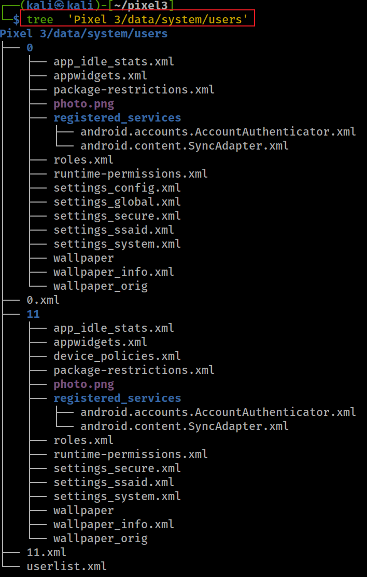
How many user accounts on the device? Two
0 - is a device owner/primary user
used for multi-user support.
keeps info on all users in the system

Slide 22
Who is the owner of the device?
Notes:
cat 'Pixel 3/data/system/users/userlist.xml’
<?xml version='1.0' encoding='utf-8' standalone='yes' ?>
<users nextSerialNumber="12" version="7">
<guestRestrictions>
<restrictions no_sms="true" no_install_unknown_sources="true" no_config_wifi="true" no_outgoing_calls="true" />
</guestRestrictions>
<deviceOwnerUserId id="-10000" />
<user id="0" />
<user id="11" />
</users>

Slide 23
When did the device owner last time log in?
blueline: Android codename
Notes:
cat 'Pixel 3/data/system/users/0.xml’
cat 'Pixel 3/data/system/users/11.xml’
<?xml version='1.0' encoding='utf-8' standalone='yes' ?>
<user id="0" serialNumber="0" flags="19" created="0" lastLoggedIn="1581695517124" lastLoggedInFingerprint="google/blueline/blueline:10/QQ1A.200105.003/6079943:user/release-keys" icon="/data/system/users/0/photo.png" profileBadge="0">
<name>This Is</name>
<restrictions />
</user>
<?xml version='1.0' encoding='utf-8' standalone='yes' ?>
<user id="11" serialNumber="11" flags="16" created="1581644358241" lastLoggedIn="1581684601922" lastLoggedInFingerprint="google/blueline/blueline:10/QQ1A.200105.003/6079943:user/release-keys" icon="/data/system/users/11/photo.png" profileBadge="0">
<name>User 2</name>
<restrictions />
</user>

Slide 24
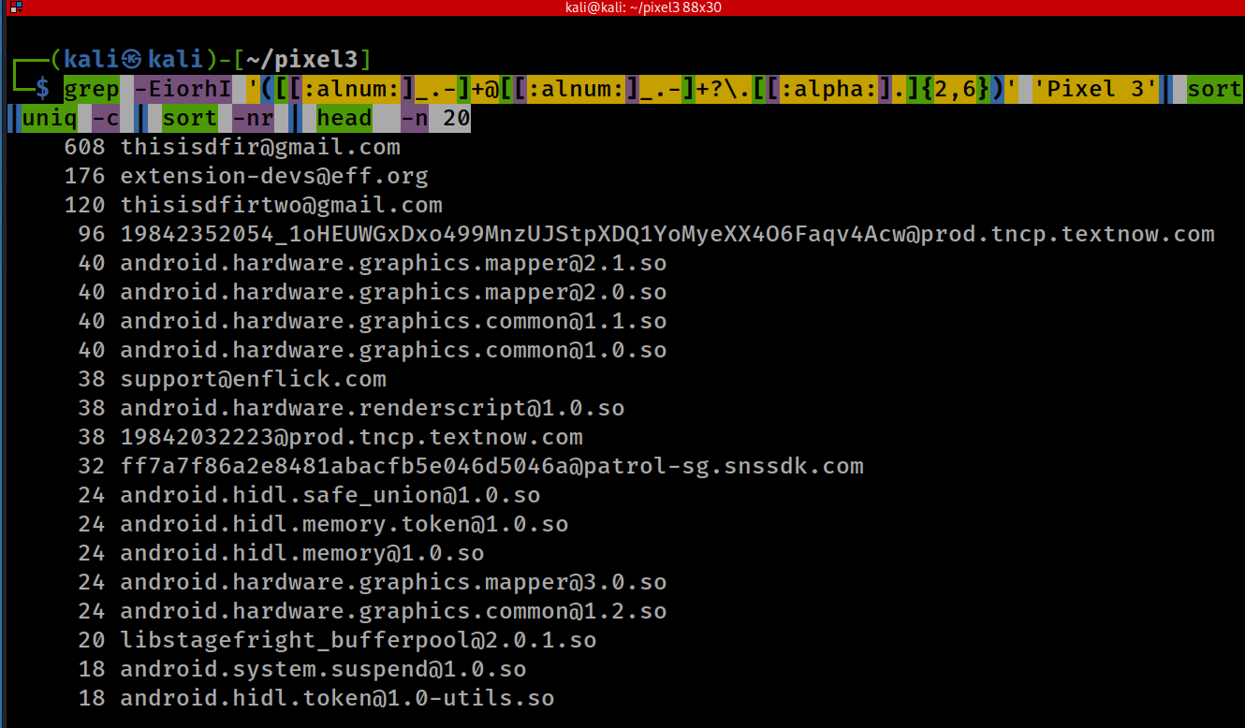
How many email addresses you can find on the image?
-E: Extended Regular Expression
-i: ignore case
-o: show only match, not whole lines
-r: recursive
-h: don’t show file name
-I: ignore binary files
list top 20 email
Count all emails
Notes:
grep -EiorhI '([[:alnum:]_.-]+@[[:alnum:]_.-]+?\.[[:alpha:].]{2,6})' 'Pixel 3'| sort|uniq -c | sort -nr | head -n 20
grep -EiorhI '([[:alnum:]_.-]+@[[:alnum:]_.-]+?\.[[:alpha:].]{2,6})' 'Pixel 3'| sort|uniq -c | sort -nr | wc –l
608 thisisdfir@gmail.com
176 extension-devs@eff.org
120 thisisdfirtwo@gmail.com
96 19842352054_1oHEUWGxDxo499MnzUJStpXDQ1YoMyeXX4O6Faqv4Acw@prod.tncp.textnow.com
40 android.hardware.graphics.mapper@2.1.so
40 android.hardware.graphics.mapper@2.0.so
40 android.hardware.graphics.common@1.1.so
40 android.hardware.graphics.common@1.0.so
38 support@enflick.com
38 android.hardware.renderscript@1.0.so
38 19842032223@prod.tncp.textnow.com
32 ff7a7f86a2e8481abacfb5e046d5046a@patrol-sg.snssdk.com
24 android.hidl.safe_union@1.0.so
24 android.hidl.memory.token@1.0.so
24 android.hidl.memory@1.0.so
24 android.hardware.graphics.mapper@3.0.so
24 android.hardware.graphics.common@1.2.so
20 libstagefright_bufferpool@2.0.1.so
18 android.system.suspend@1.0.so
18 android.hidl.token@1.0-utils.so

Slide 25
What is the App ID of Gmail?
Every Android app has a unique application ID
looks like a Java package name, such as com.example.myapp
Android app ID never changes
If upload a new version of app, the application ID (and the certificate you sign it with) must be the same as the original APK
if you change the application ID, Google Play Store treats the APK as a completely different app.
Good for forensic analysis
Easy to identify apps in a device
Notes:
https://developer.android.com/studio/build/application-id.html

Slide 26
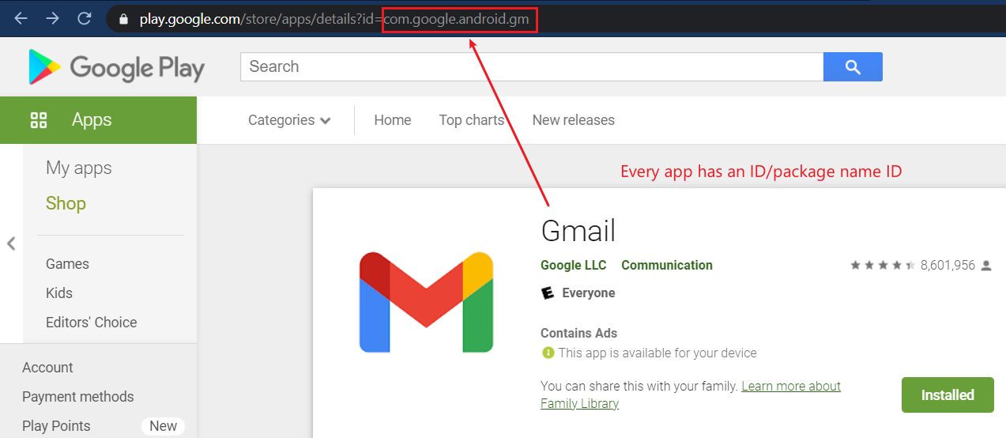
Notes:
https://play.google.com/

Slide 27
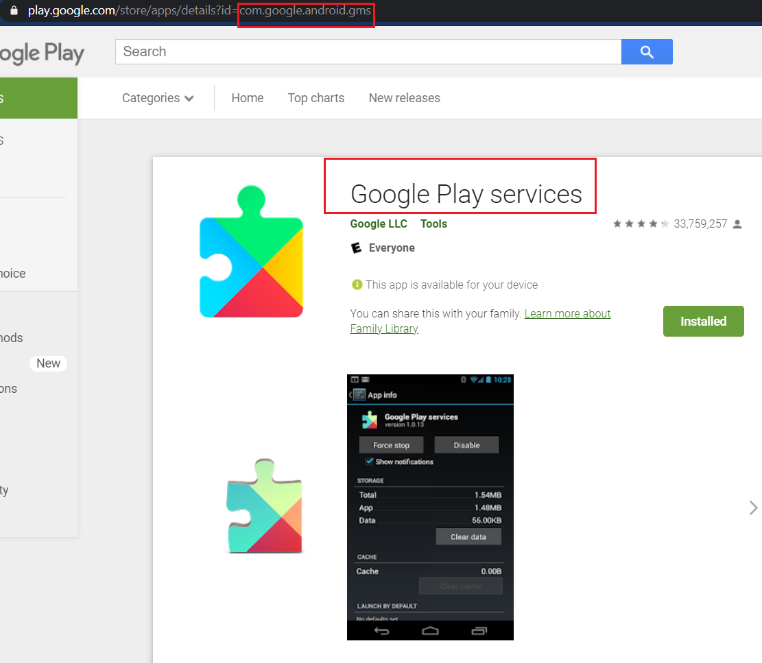
What is the App Google Play Services ID?
https://play.google.com/store/apps/details?id=com.google.android.gms
Google Play Services helps integrating Google’s advanced functionalities with other applications.
It is one of the most important parts of Android
Core functionalities
Authentication to your Google service
Synchronized contacts,
Access to all the latest user privacy settings, and
Higher quality, lower-powered location based services, maps
Offline search
don’t /can’t delete it!

Slide 28
Google Maps API: This API allows other applications to access Google Maps without leaving the app. If you have used an app to book a cab or navigate to a booked hotel, then you must have used this service.
Location APIs: Location API can be used to perform automatic actions when a user enters or leaves a specific geographic boundary. Fused Location provider means to reduce power usage while using location services.
Google Drive API: If you have Google Drive installed on your device, sharing and storing files from other apps is made easier with this API.
Google Play Game Services: These services are used to create a more competitive and immersive experience in multiplayer gaming sessions through leaderboards and achievements. Moreover, Saved Games API ensures that you do not lose your progress in a game by syncing and saving your game data.
Google+ platform: You must have come across apps that provide you with “Sign-in with Google+” login option. This service allows you to use a single username and password to access multiple accounts on multiple apps.
Google Cast Android API: It allows Android applications to cast content on-screen to other devices via Google Cast.
Google Mobile Ads: Google Mobile Ads is used to integrate advertisements into applications and display intelligent ads such as those based on location or browsing history. This is how thousands of app developers monetize their app.
Other service: Google Wallet, Google Play Protect, Google Fit API, Google account authentication methods
Notes:
https://fossbytes.com/google-play-services-necessity/

Slide 29
Find all Gmail addresses appeared in the phone?
Notes:
grep -EiorhI '([[:alnum:]_.-]+@gmail\.com)' 'Pixel 3'| sort|uniq -c | sort -nr | head
608 thisisdfir@gmail.com
120 thisisdfirtwo@gmail.com
10 nc_1_mail_thisisdfir@gmail.com
6 feature_list_thisisdfir@gmail.com
4 ncg_1_account_thisisdfirtwo@gmail.com
4 ncg_1_account_thisisdfir@gmail.com
4 flagsLastLogged-thisisdfir@gmail.com
2 waa-enabledthisisdfir@gmail.com
2 user-settings-cachethisisdfir@gmail.com
2 toc-cookiethisisdfir@gmail.com

Slide 30
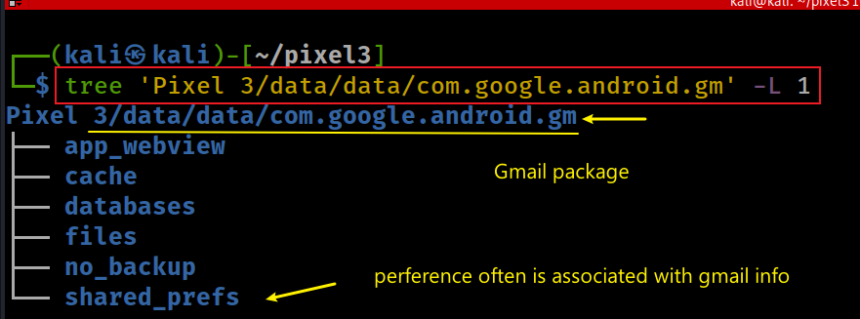
Which Gmail is registered for google service for Pixel 3?
Google use Gmail credential as a Single Sign-On (SSO)
for all the service they provide
Search for generated data by Gmail application
Gmail package com.google.android.gm
Exam all generated data/config of Gmail
Notes:
tree 'Pixel 3/data/data/com.google.android.gm' -L 1

Slide 31
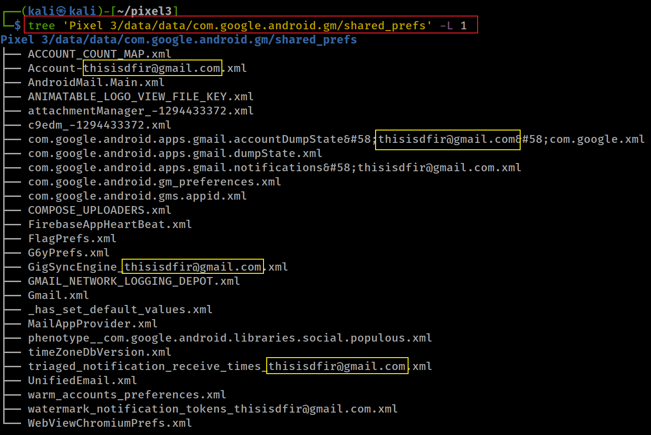
Show shared preference/configurations

Slide 32
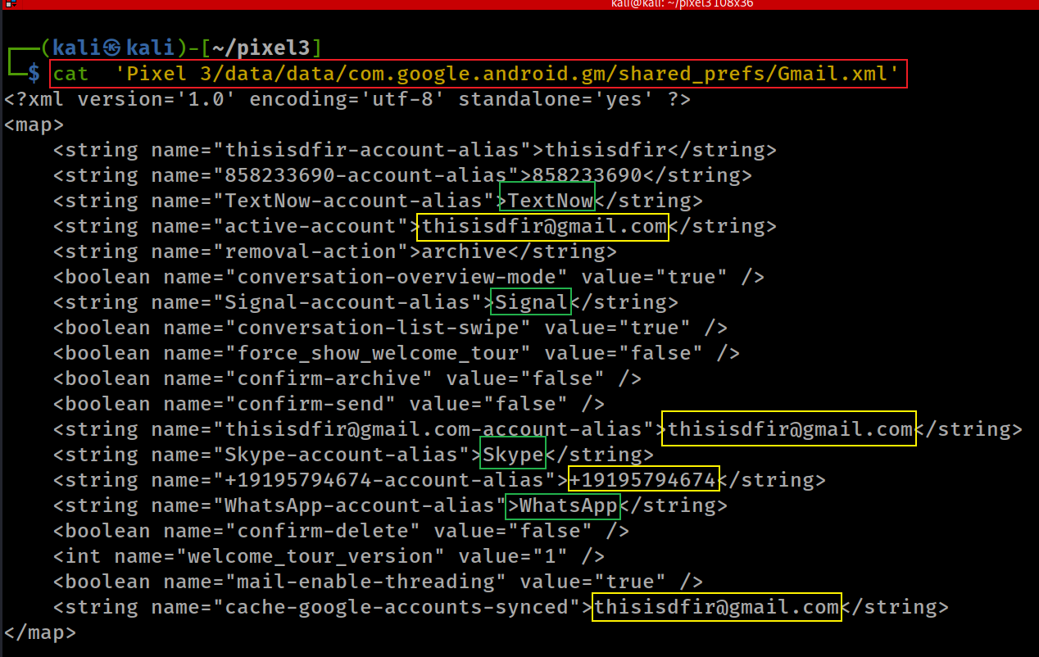
Check Gmail preference setting
Gmail is associated with
phone
apps: Textnow, Signal, Skyper, whatapp
Notes:
cat 'Pixel 3/data/data/com.google.android.gm/shared_prefs/Gmail.xml'

Slide 33
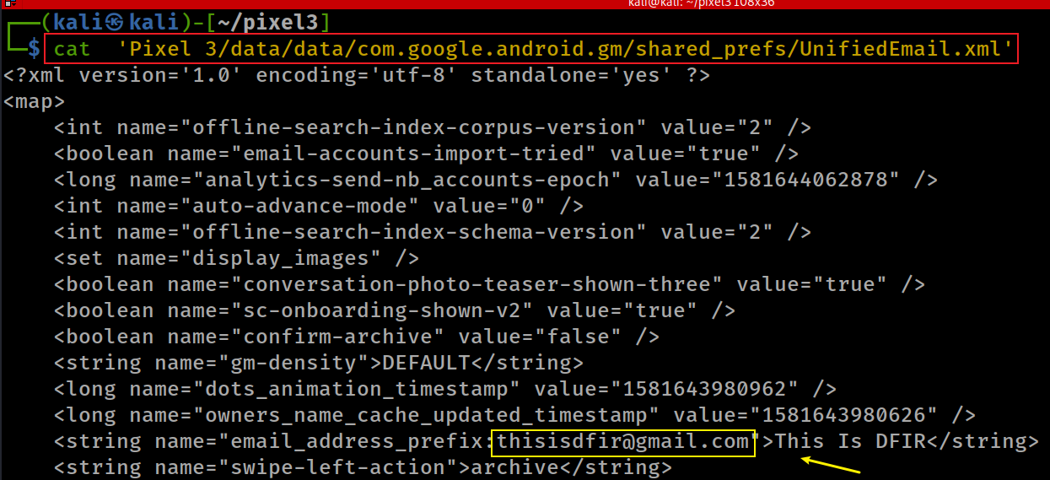
Notes:
cat 'Pixel 3/data/data/com.google.android.gm/shared_prefs/UnifiedEmail.xml'

Slide 34
Which Gmail is registered in Play store?
Check Gmail information fro Play store cache
We can’t find/don’t know anything from play_metalog.log
Notes:
tree 'Pixel 3/data/data/com.android.vending/cache/logs/'

Slide 35
Which Gmail used for scheduling Jobs?
A Job in Android is a background tasks, e.g.,
receive a message
read data from a database
Android provides a JobScheduler
It allows you to specify conditions for running work
e.g., a big downloading job is to run when the device is plugged in and has a WIFI connection.
Job-Info is stored in /data/system/job/jobs.xml
Job-info has a list of job objects
Each job contains forensic information
Notes:
https://www.intertech.com/android-development-tutorial-job-scheduler/
https://www.zoftino.com/android-job-scheduler-example

Slide 36
Job object information
* all time related parameters are specified in milliseconds
make the job periodic (a repeating job within a given period)
the interval between periodic job runs
the maximum execution delay – how long to wait to kick of the job (not a parameter for a periodic job task)
the minimum amount of time delay before starting the job (not a parameter for a periodic job task)
the device must be plugged in and charging in order to run the job
the device must be idle (“in an idle maintenance window”) in order to run the job
the device must have a network connection (either WIFI, unmetered, or any)
the device must not be connected to a network
the job should be rescheduled if the device reboots (called a “persistent” job).
Extra: account name/Gmail maybe associated with the job
Notes:
https://developer.android.com/reference/android/app/job/JobInfo.html
https://www.intertech.com/android-development-tutorial-job-scheduler/
https://medium.com/google-developers/scheduling-jobs-like-a-pro-with-jobscheduler-286ef8510129

Slide 37
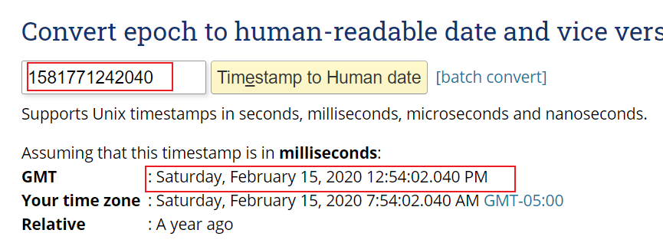
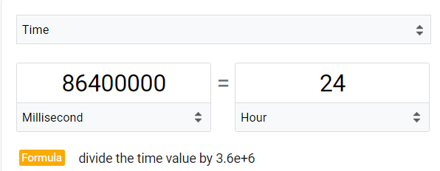
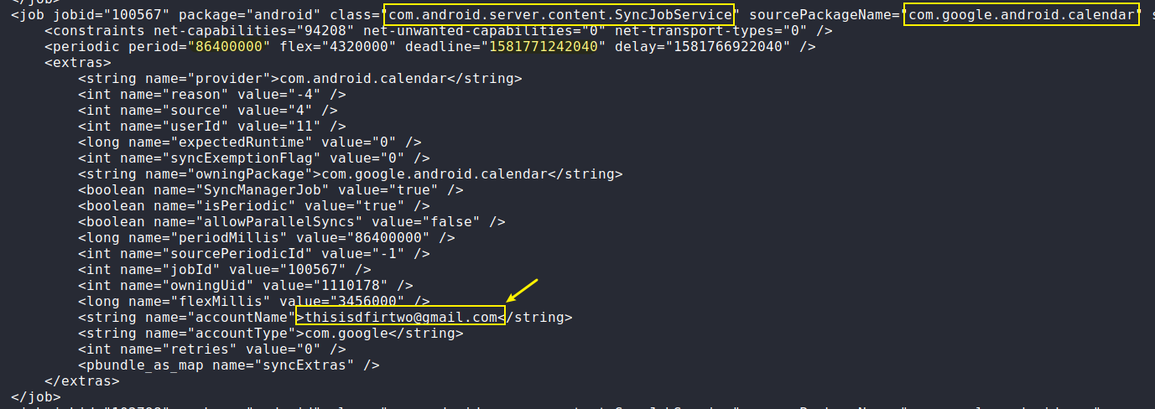
a calendar activities is running on background. The activity is associated with thisisdfirtwo@gmail.com
Extra:
If your job needs some information from your app to perform its work, you can pass along primitive data types as extras in the JobInfo.
Notes:
https://www.epochconverter.com/

Slide 38
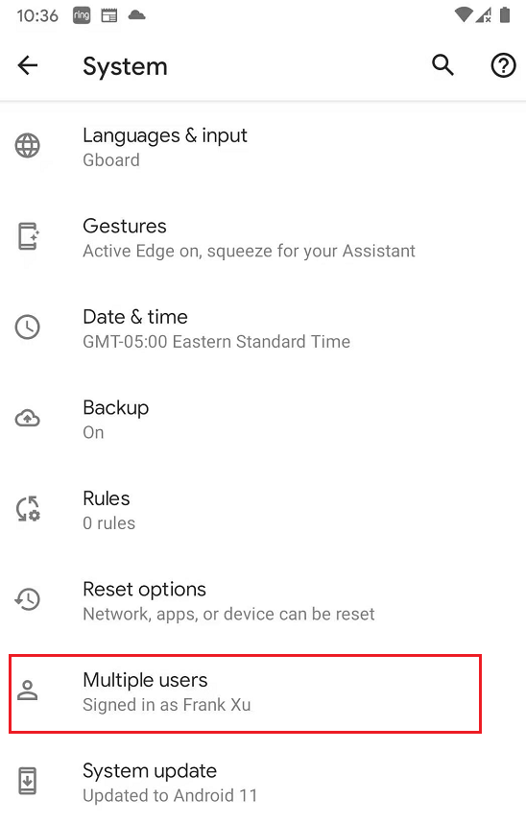
Android 10 allows to add multiple users to share the phone space, customized screens, apps. That is the reason you may see multiple Gmail associated with jobs
Find two emails that are associated with scheduled jobs
Notes:
grep -Eio '([[:alnum:]_.-]+@[[:alnum:]_.-]+\.[[:alpha:].]{2,6})' 'Pixel 3/data/system/job/jobs.xml' | sort | uniq -c

Slide 39
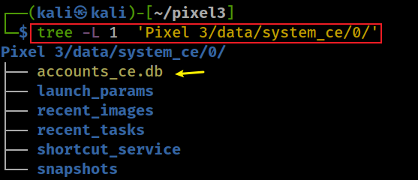
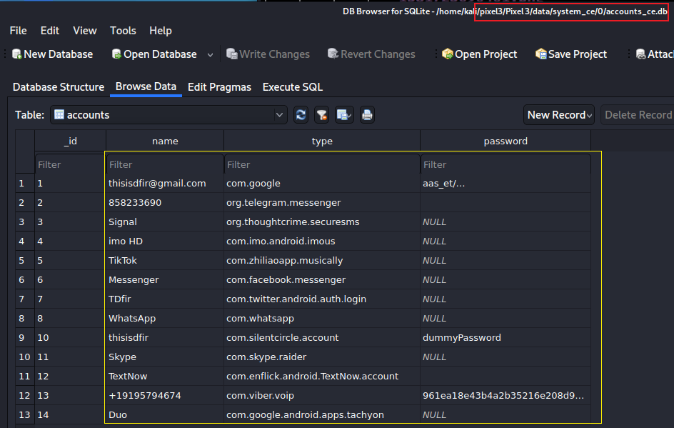
List possible apps username and password (account_ce.db/accounts)
Notes:
tree -L 1 'Pixel 3/data/system_ce/0/'

Slide 40
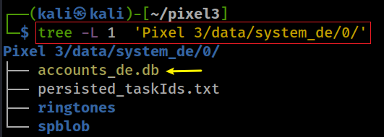
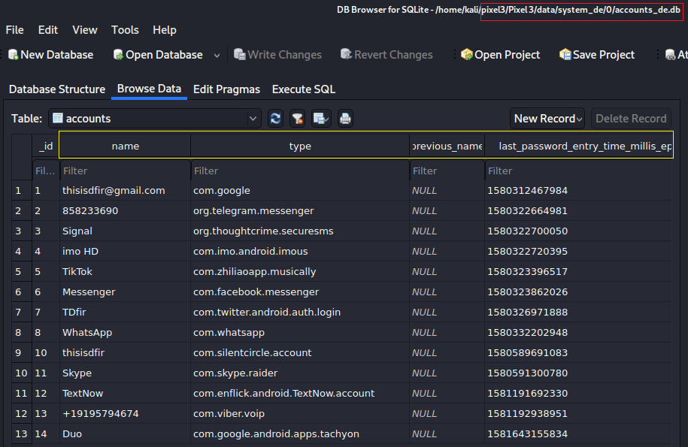
List possible apps username and password (account_de.db/accounts)
need convert last password entry time to human readable
Notes:
tree -L 1 'Pixel 3/data/system_de/0/'

Slide 41
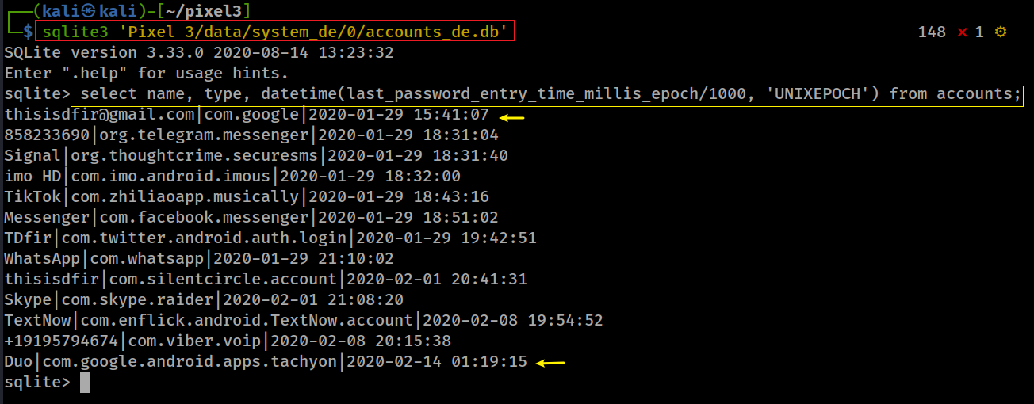
Convert last password entry time millis epoch to human readable
Notes:
sqlite3 'Pixel 3/data/system_de/0/accounts_de.db'
select name, type, datetime(last_password_entry_time_millis_epoch/1000, 'UNIXEPOCH') from accounts;
thisisdfir@gmail.com|com.google|2020-01-29 15:41:07
858233690|org.telegram.messenger|2020-01-29 18:31:04
Signal|org.thoughtcrime.securesms|2020-01-29 18:31:40
imo HD|com.imo.android.imous|2020-01-29 18:32:00
TikTok|com.zhiliaoapp.musically|2020-01-29 18:43:16
Messenger|com.facebook.messenger|2020-01-29 18:51:02
TDfir|com.twitter.android.auth.login|2020-01-29 19:42:51
WhatsApp|com.whatsapp|2020-01-29 21:10:02
thisisdfir|com.silentcircle.account|2020-02-01 20:41:31
Skype|com.skype.raider|2020-02-01 21:08:20
TextNow|com.enflick.android.TextNow.account|2020-02-08 19:54:52
+19195794674|com.viber.voip|2020-02-08 20:15:38
Duo|com.google.android.apps.tachyon|2020-02-14 01:19:15

