Slide 1
Pixel 3 GMS App Investigations
Part 2: Google Maps
Notes:
https://digitalcorpora.s3.amazonaws.com/corpora/mobile/android_10/Non-Cellebrite%20Extraction/Pixel%203.zip

Slide 2
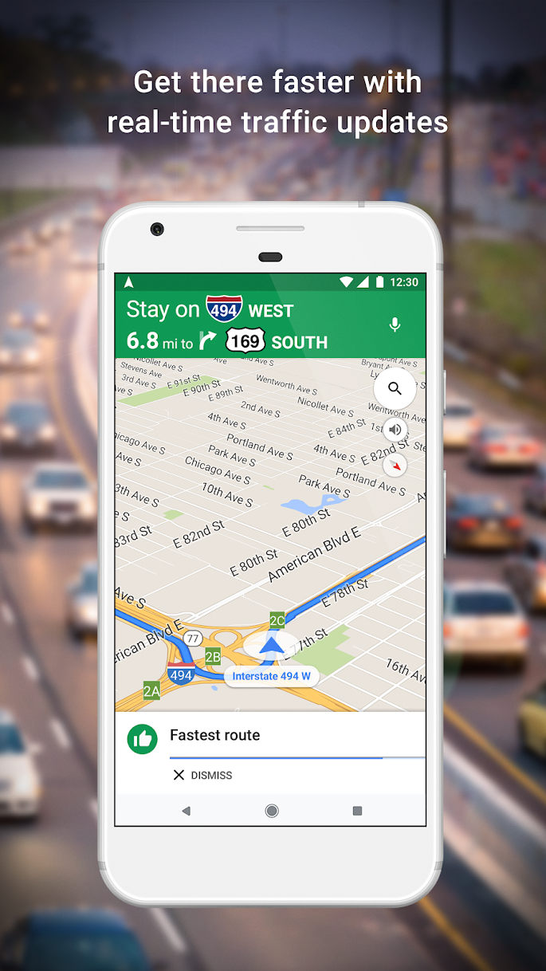
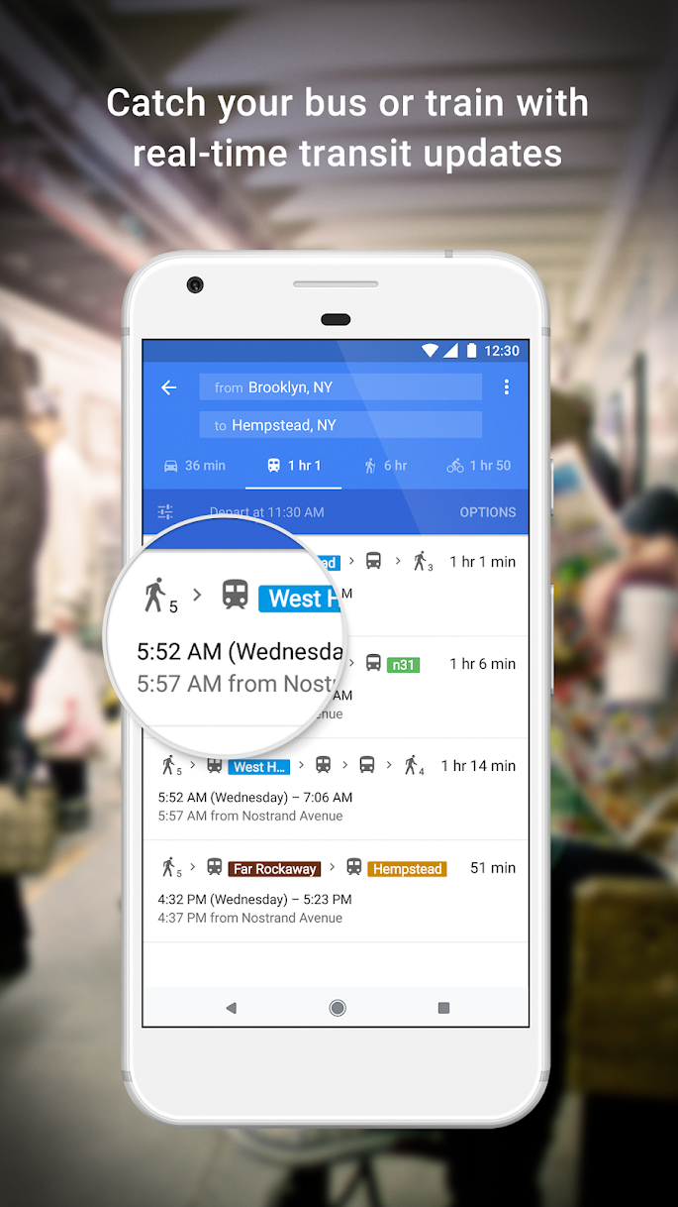
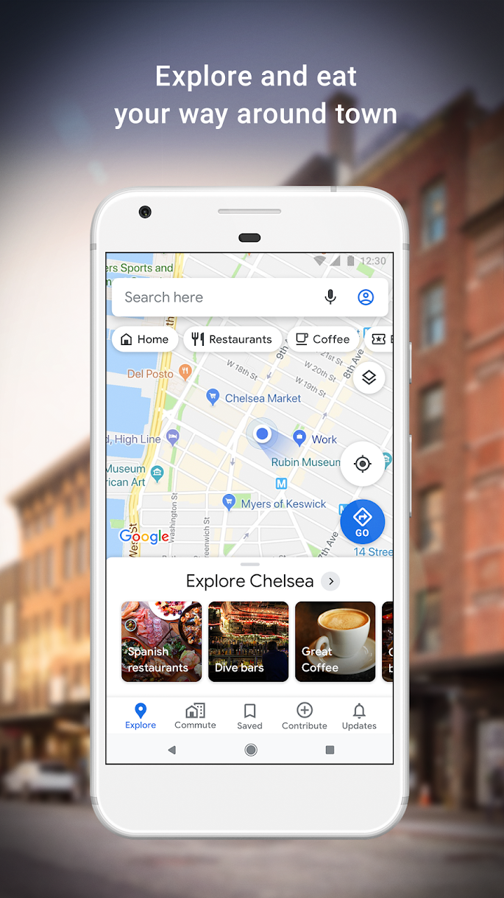
What is google maps?

Slide 3
Where does evidence come from?
Generated by Google Maps
Current location
Navigate location directions
Search location

Slide 4
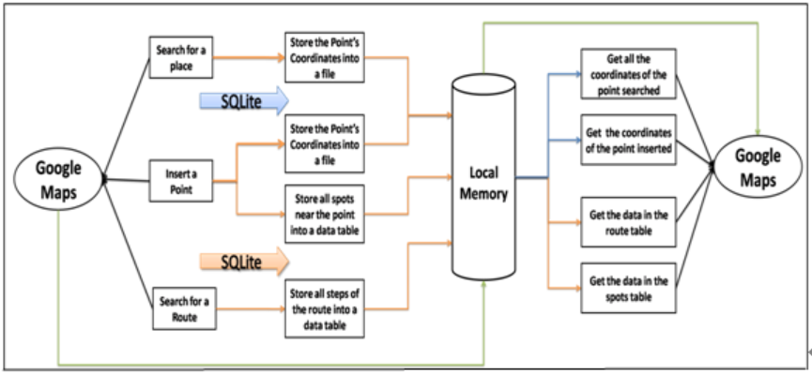
How to find evidence generated by google maps?
A location scenario using Google maps
Forensic questions related to maps
Notes:
https://www.geos.ed.ac.uk/~mscgis/11-12/s1104136/design.htm

Slide 5
Location scenario
Assuming that suspect has saved location data in the phone
What is location data?
It is information collected by a network or service about where the user's phone or other device is or was located – for example, tracing the location of a mobile phone from data collected by base stations on a mobile phone network.
Location data usually gets stored in database but sometimes in files too
Location evidence includes
Location history
Timestamps of visits
Offline saved directions

Slide 6
Forensic questions related to location data
Which places suspect visited and at what time?
Did suspect save any directions in offline mode?
What was the starting point of the suspect?
What was the distance from source to destination?
Which route suspect chose?
Was there any toll plaza on the way?
How long it took to reach the destination?
Did suspect make any stop on the way?

Slide 7
a. Which places suspect visited and at what time?
Step 1: Find the database where location evidence is stored
Step 2: Find the table contains the location data
Step 3: Find the column contains the location data
Step 4: Find the location data in a cell

Slide 8
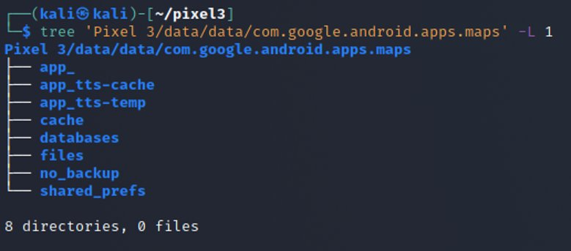
Step 1: find the database where location data is stored
Show Google Maps package structure
-L: Level
Notes:
Cmd: tree 'Pixel 3/data/data/com.google.android.apps.maps' -L 1

Slide 9
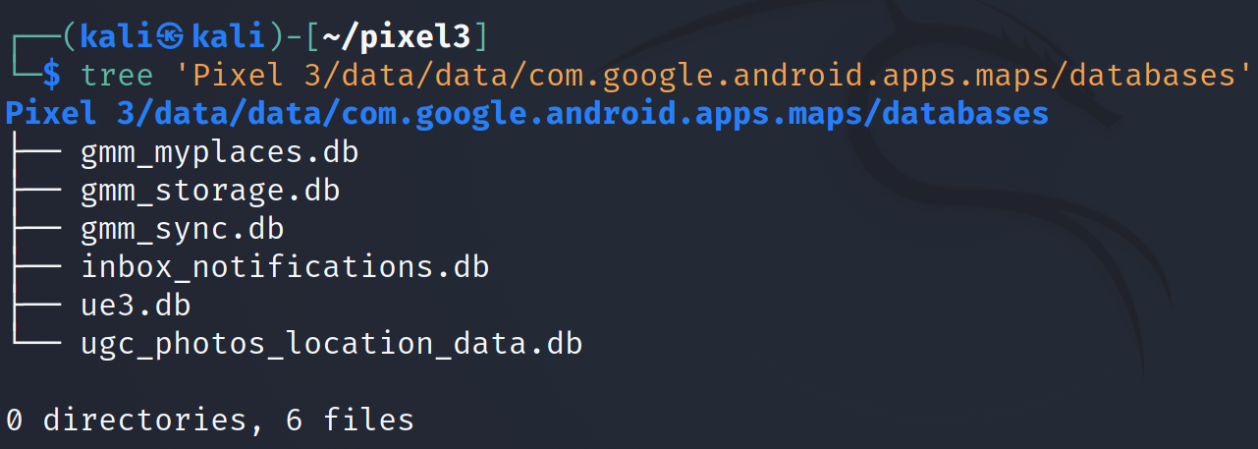
Show Google Maps database
Notes:
Cmd: tree 'Pixel 3/data/data/com.google.android.apps.maps/databases'

Slide 10
Step 2: Find the table that contains location data with timestamps
Open the database (gmm_sync.db)
Tables in gmm_sync database
Table contains location data
Notes:
Cmd: sqlitebrowser 'Pixel 3/data/data/com.google.android.apps.maps/databases/gmm_sync.db'

Slide 11
Step 3: Find the column that contains location data along with the timestamp
Open the sync_item_data table
Use below link to find exact location using latitude and longitude​
https://www.melissa.com/v2/lookups/latlngzip4/​
​

Slide 12
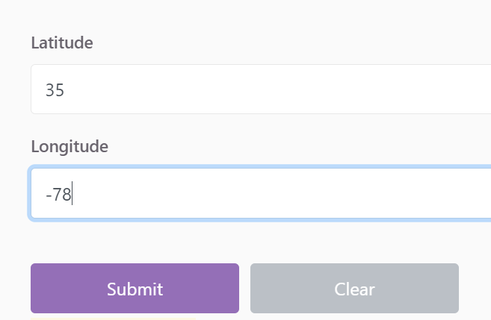
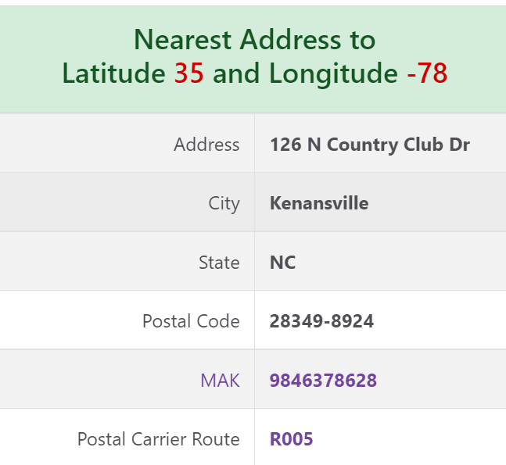
Solution to find location using latitude and longitude

Slide 13
b. Did suspect save any directions in offline mode?
Step 1: Find the files folder where offline directions are stored
Step 2: Find the file that contains the offline directions
Step 3: Open the file that contains the offline directions and look at the saved data

Slide 14
Step 1: Find the files folder where offline directions are stored
Show Google Maps package structure
Notes:
Cmd: tree 'Pixel 3/data/data/com.google.android.apps.maps' -L 1

Slide 15
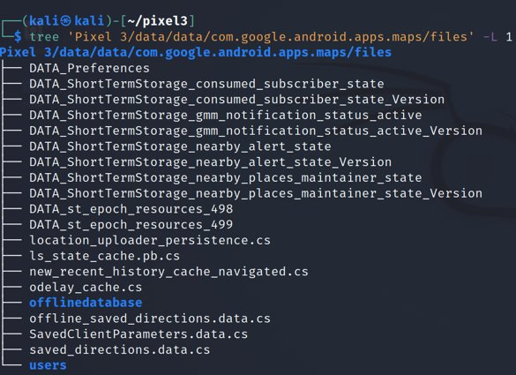
Step 2: Find the file that contains offline directions
Show Google Maps files

Slide 16
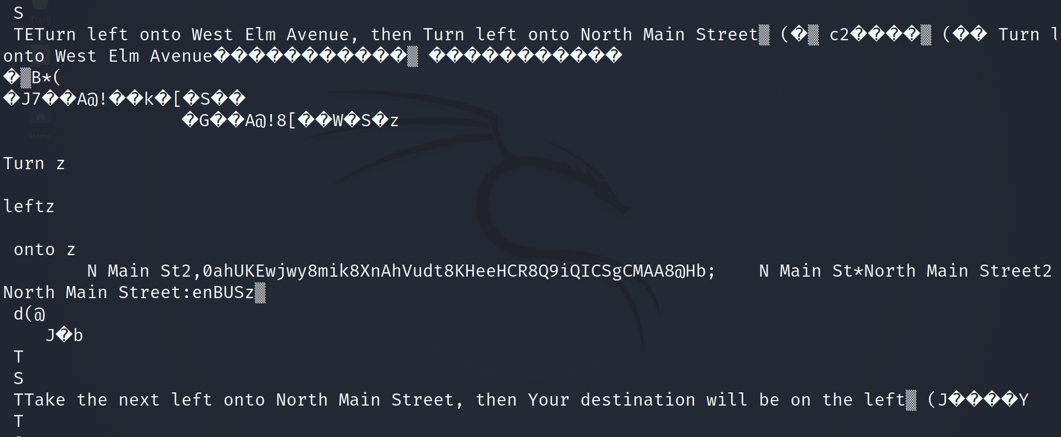
Step 3: Open the file that contains offline directions and look at the saved data
Open the file
Offline saved directions of below location

Slide 17
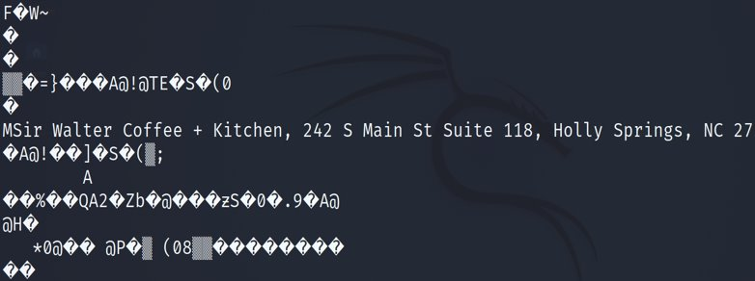
Solution

Slide 18
To summarize
Understand the application
Locate the application package/folder
Look at the application directories
Go to the "databases" directory
Open gmm_sync.db
Explore the tables
Look at the data in each column and fetch the information needed
Go to files folder to locate offline directions file
Fetch the information needed from that file

