Slide 1
Pixel 3 GMS App Investigations
Part 3: Google Photos
Notes:
https://digitalcorpora.s3.amazonaws.com/corpora/mobile/android_10/Non-Cellebrite%20Extraction/Pixel%203.zip

Slide 2
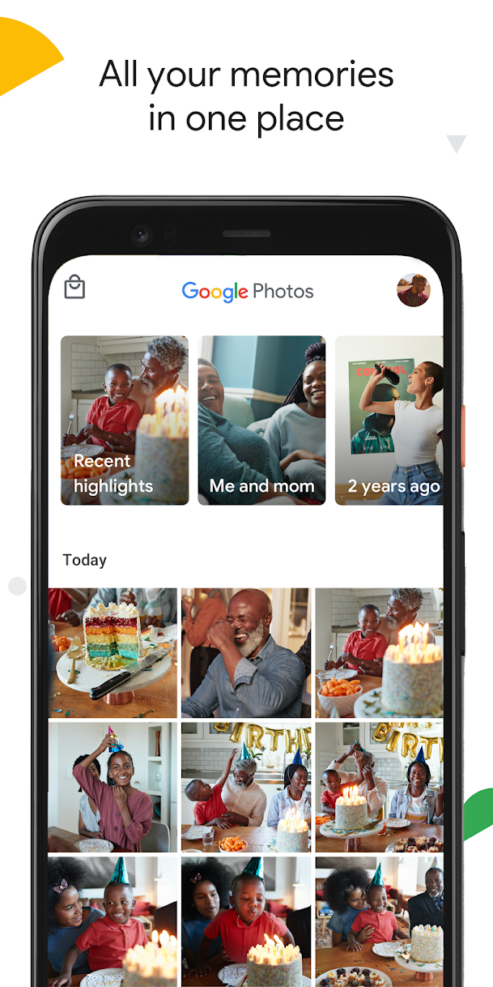
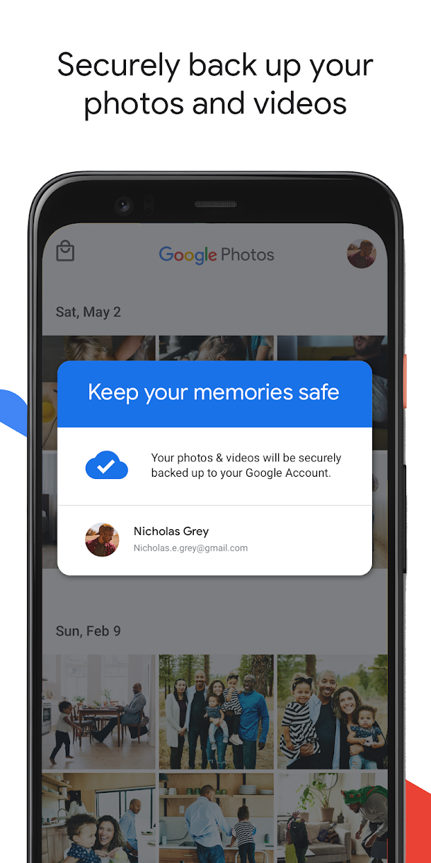
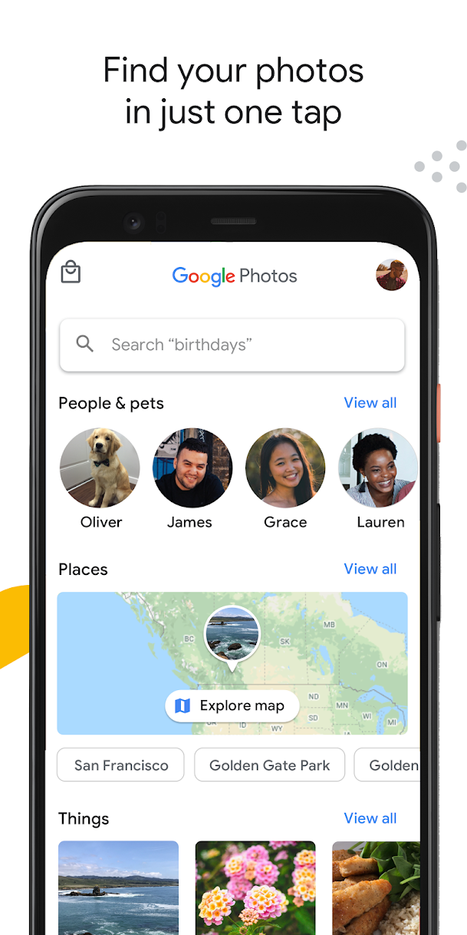
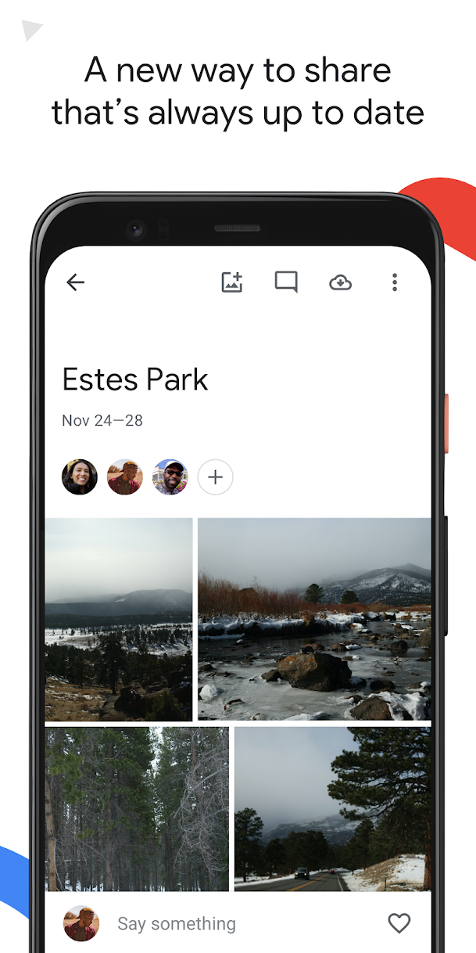
What is Google Photos ?

Slide 3
Where does the evidence come from?
Generated by Google Photos
Shared albums
Automatic creations
Advanced editing suite

Slide 4
How to find photos generated by google photos?
A photos scenario using google photos
Forensic questions related to photos

Slide 5
Photos scenario
Photos and videos are saved in suspect's phone and suspect may have taken back up
What is a photo?
A photo is a picture taken by a camera, digital camera or smartphone that is capable of producing a hard copy or a digital copy
Photos usually get stored in databases
Photo evidence includes:
Saved photos
Photos back up timestamp

Slide 6
What is back up and how to know if it was done?
Any photos that you take from a device with backup enabled will be saved to your Google Account. If you edit and save a photo on your phone, the photo will look the same on Google Photos
Shared prefs is the folder where such information gets stored.
Shared Preferences allows activities and applications to keep preferences. The primary purpose is to store user-specified configuration details, such as user specific settings, keeping the user logged into the application

Slide 7
Why it's important to look for back up?
Back up is crucial in an investigation because:
Suspect may have deleted data related to the case but took back up before deleting
If system crashes, data can be recovered quickly from back up
Usually back up is done to save something important
Timestamps of the backup can be useful

Slide 8
Forensic questions related to photos
What kind of photos are saved and at what time?
Is there any backup done by the suspect? If yes, when was it done?What is the location saved along with photos/videos?
What location has the most photos?
Did suspect receive the photos from someone or were clicked using the phone?
Can we deduce the suspect's relation to people in the photos/videos
Is there any backup done by the suspect? If yes, when was it done?

Slide 9
a. what kind of photos are saved and at what time?
Step 1: Find the database where photos are stored
Step 2: Find the table that contains the photos
Step 3: Find the column contains the photos
Step 4: Find the photos in a cell

Slide 10
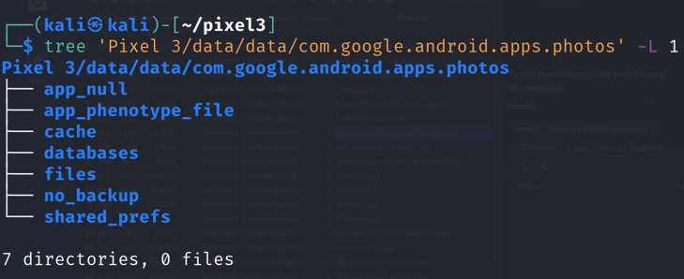
Step 1: Find the database where photos are stored
Show Google Photos package structure
Notes:
Cmd: tree 'Pixel 3/data/data/com.google.android.apps.photos' -L 1

Slide 11
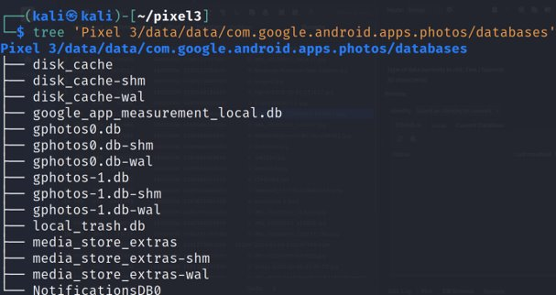
Show Google Photos database
Notes:
Cmd: tree 'Pixel 3/data/data/com.google.android.apps.photos/databases'

Slide 12
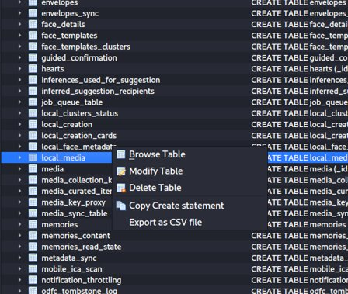
Step 2: Find the table that contains photos
Open the database (gphotos-1.db)
Local_media table contains photos
You can explore other tables as well based on what information you need
Notes:
Cmd: sqlitebrowser 'Pixel 3/data/data/com.google.android.apps.photos/databases/gphotos-1.db'

Slide 13
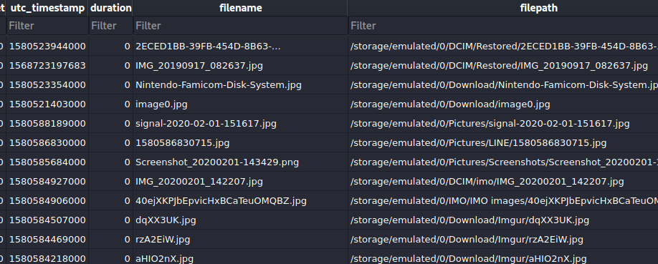
Step 3: Find the column that contain photos
Open the local_media table

Slide 14
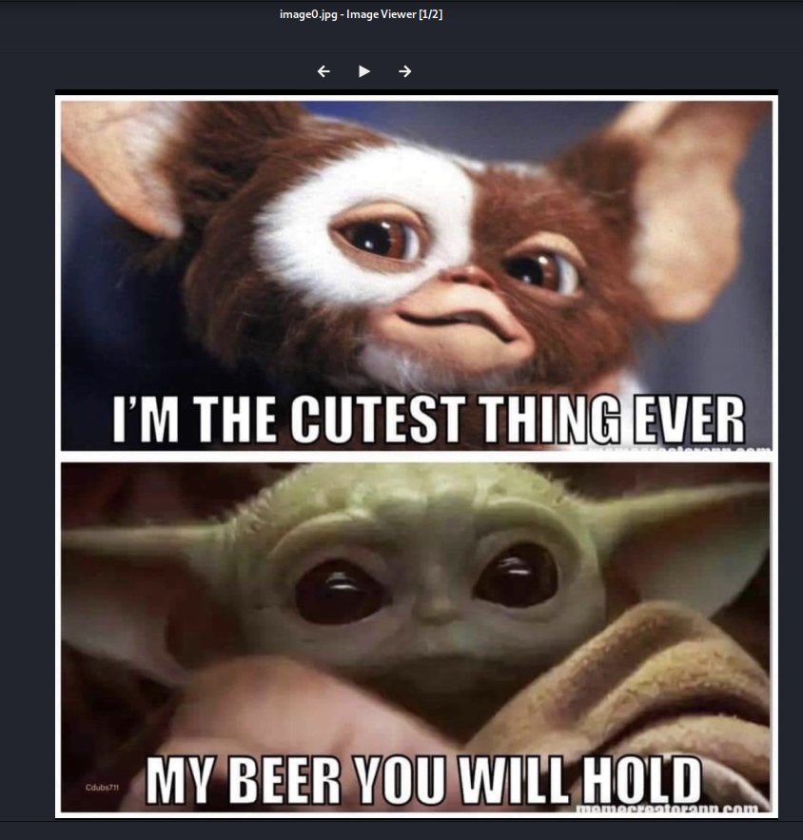
Solution
Image0.jpg
Date when image was clicked

Slide 15
b. Is there any backup done by the suspect? If yes, when was it done?
Yes, back up was done by the suspect
Steps
Step 1: Find the folder where back up information is stored
Step 2: Find the file that contains the backup information
Step 3: Open the file that contains the backup information and look at the saved data

Slide 16
Step 1: Find the folder where backup information is stored
Show Google Photos package structure
Notes:
Cmd: tree 'Pixel 3/data/data/com.google.android.apps.photos' -L 1

Slide 17
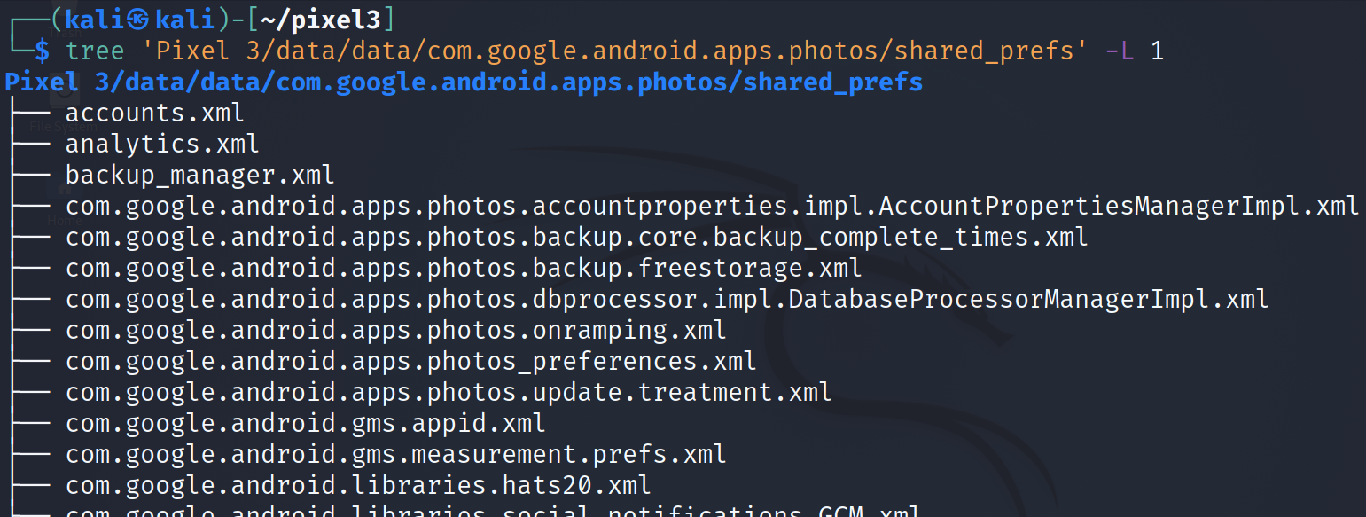
Step 2: Find the file that contains backup information
Show Google Photos files
Notes:
Cmd: tree 'Pixel 3/data/data/com.google.android.apps.photos/shared_prefs' -L 1

Slide 18
Step 3: Open the file that contains backup information and look at saved data
Open the file
This is the time when the account back up was done
Solution: timestamp
Notes:
Cmd: cat 'Pixel 3/data/data/com.google.android.apps.photos/shared_prefs/com.google.android.apps.photos.backup.core.backup_complete_times.xml'
Date cmd: date –d '@1581647595' -u

Slide 19
To summarize
Understand the application
Locate the application package
Look at the application directories
Go to the databases directory
Open gphotos-1.db
Explore local_media table
Go to the shared prefs folder
Find the the file that contains back up information

Slide 20
Email and Contact

Slide 21
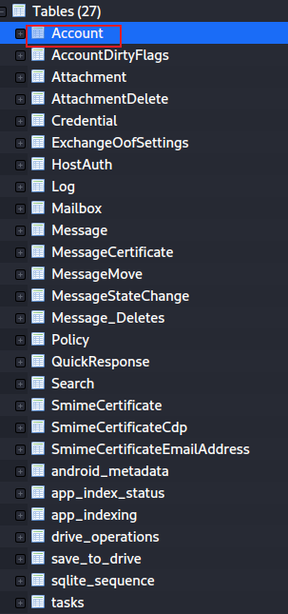
Gmail messages
did find any accounts
Notes:
tree 'Pixel 3/data/data/com.google.android.gm/databases/'

